Slide 1



Mentoring CHV Supervisors to
Ensure Treatment Adherence of TB Patients

Slide 2
Roles and Responsibilities of Frontline Health Workers (BHWs/CHVs)
in the National TB Control Program
(Case Finding and Case Holding)

Slide 3
Objective
The CHV Supervisors and CHVs will be able to understand their roles and responsibilities in the TB Control Program
    In case finding
    In case holding

Slide 4
Roles and Responsibilities: In Case Finding
Conduct TB education
Identify presumptive TB in the community
Convince presumptive TB cases to seek consultation at the health center
Convince them to undergo and complete DSSM (2 sputum examinations) and X-ray when required by the health center

Slide 5
Roles and Responsibilities: In Case Finding
Should be able to explain to presumptive TB cases that:
TB is an infectious disease,
they should seek consultation at the health center and submit for diagnosis when required,
undiagnosed TB cases will continue to infect their family and the community,
treatment with anti-TB drugs kills bacteria in the lungs and transmission of bacteria can be lessened or prevented.

Slide 6
Roles and Responsibilities: During Treatment
Provide counseling so that TB patient continues treatment
Be a treatment partner with proper training
  Ensure that patient actually takes the medication
  Remind patient of sputum follow-up
  Ensure regular supply of drugs
  Keep and maintain NTP ID card

Slide 7
WHO CAN BE A TREATMENT PARTNER?
Health workers like:
Nurse
Midwife
Trained barangay health workers (BHW)
Trained community health volunteers (CHV)
Trained barangay officials
Family members (last priority)

Slide 8
Roles and Responsibilities: During Treatment
Should talk with the TB patient and agree on where and when the daily DOT will be done
Should not dictate the place and time but rather consider the convenience of the patient
The place where DOT can be done:
  Rural Health Unit
  Barangay Health Station
  Patient’s house
  Treatment partner’s place

Slide 9
Roles and Responsibilities: During Treatment
Should ask what time the patient takes his/her breakfast
- TB drugs should be taken:
with empty stomach or one hour before breakfast
2 to 3 hours after breakfast
Should know how many tablets should be taken daily and ensure that the drugs are given daily
- TB drugs should be taken one after the other with at least 5 minutes interval (not 3 times a day)

Slide 10
Roles and Responsibilities: During Treatment
Ensure regular supply of drugs
− Should check adequacy of drugs for the patient
− Should remind the nurse or midwife before the medicines run out
(The quantity of TB medicine to be given to the treatment partner/patient is decided by the nurse⎯usually 1 to 2 weeks supply or depending on accessibility of the area)

Slide 11
Roles and Responsibilities: During Treatment
Should ensure that drugs are safe from theft and reach of other people, particularly children, if the patient keeps the medicine in his/her house

Slide 12
What the treatment partner should not do
Leave drugs to patient for later intake if requested by the patient. The treatment partner should see that drugs are actually swallowed by the patient
Leave all the medicines to the family member and allow them to supervise the daily intake

Slide 13
Roles and Responsibilities: During Treatment
Keeping and Maintaining the NTP ID Card
The NTP ID Card (2 copies) is kept by the treatment partner and the patient
The nurse or midwife fills up the information on the card before handing it over to the treatment partner
The treatment partner ensures that all information on the card are complete
It is important that the schedule for sputum follow-up is filled up at the beginning so the treatment partner knows when to remind the patient about the schedule

Slide 14
Roles and Responsibilities: During Treatment
The treatment partner will record the daily drug intake of the patient
In the portion of the drug intake ─
− the treatment partner should mark the days the patient has taken the medicines and affix his/her initials
− when DOT is not done (weekends and holidays) the treatment partner should mark a horizontal line (--) on the corresponding days
− if the patient missed taking the medicines, the treatment partner should put (X) instead

Slide 15
Form 5. NTP ID Card

Slide 16
Form 5. NTP ID Card

Slide 17
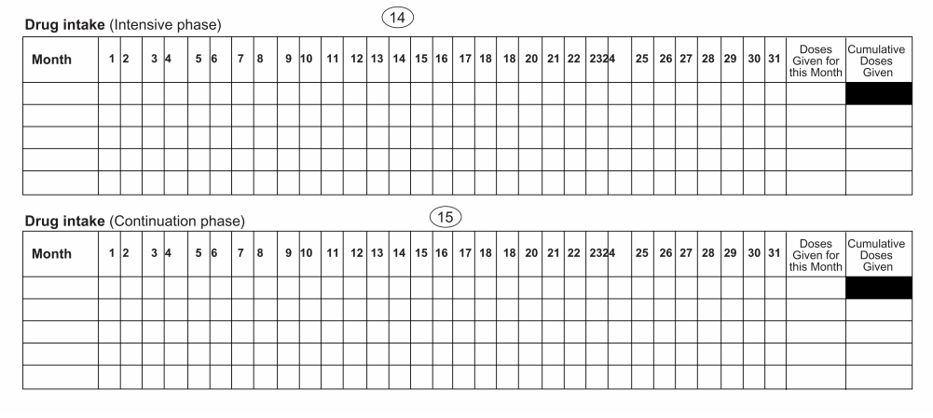

Slide 18
DEMONSTRATION
AND
PRACTICE SESSION

Slide 19
Case Scenario (for filling up the NTP ID Card)
Romy is a 55 y/o patient, with diagnosis of pulmonary TB, and was given Cat 1 treatment regimen. Patient was started treatment on January 11, 2013. Today is June 18, 2013 and the days the treatment partner did not do DOT were all the Saturdays and Sundays of March and April 2013. The patient also missed taking his medicines on March 12, 13, 14 and April 2, 3, 17 & 18.

Slide 20
Roles and Responsibilities: During Treatment
  Know the patient’s schedule for sputum follow-up
  Remind patient of the scheduled sputum follow-up
  Convince patient to return to Health Center on the date of sputum follow-up
  Educate the patient on the importance of sputum follow-up

Slide 21
Sputum Follow-up
Why is it important?
To determine the effectiveness of treatment
Basis for decision on the next treatment regimen
To be able to label a patient as “Cured”
(increase in Cure Rate)

Slide 22
Schedule of Sputum Follow-up
Category | Schedule
 | First Follow-up | Second Follow-up | Third Follow-up
I | End of 2nd month of treatment | End of 5th month of treatment | End of 6th month of treatment
II | End of 3rd month of treatment | End of 5th month of treatment | End of 8th month of treatment

Slide 23
Scenario 1
On the scheduled visit, a patient tells his treatment partner to just leave the medicines with him. The patient says he will just take them later. The patient is insistent and gives several excuses.

Slide 24
Scenario 2
The patient is already at the beginning of the sixth month of treatment and a sputum follow-up should be done. Because he is already feeling well, he doesn’t want to go to the Health Center for the last sputum follow-up. He thinks he is already cured and there is no need for him to be examined.

Slide 25
Scenario 3
A patient is experiencing itchiness and has difficulty sleeping, which has affected him so much. He plans to stop taking his medicines.

Slide 26
THANK YOU

