Slide 1



BACKGROUND ON
DRUG-RESISTANT TUBERCULOSIS AND PMDT
Aniette: I think you have to look at Slide #15 again and see if the notes make sense to you.

Slide 2
Objectives
At the end of presentation, the participants will be able to:
understand the basic concept of drug-resistant tuberculosis (DRTB),
familiarize themselves with the National TB Control Program and Programmatic Management of Drug- resistant Tuberculosis (PMDT), and
learn the causes of drug-resistant tuberculosis
Department of Health – National TB Control Program

Slide 3
What is drug-resistant TB?
TB caused by Mycobacterium tuberculosis that is resistant in vitro to the effects of any anti-TB drug
In field practice, much significance is referred to resistance to first-line anti-TB drugs
Department of Health – National TB Control Program

Slide 4
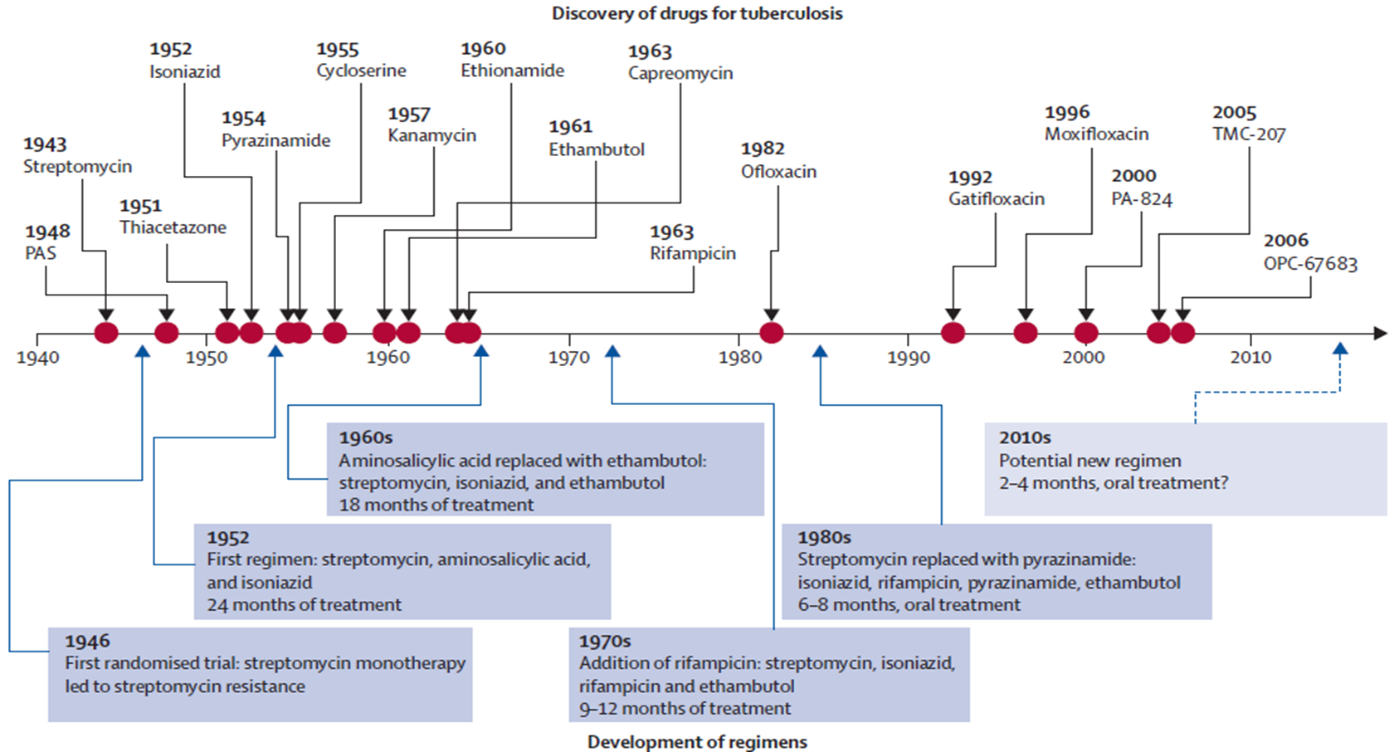
Available Anti-TB Drugs

Slide 5
TB Classification Based on
Drug Susceptibility Testing
Monoresistant TB
  Resistance to one first-line anti-TB drug (FLD) only
Polyresistant TB
  Resistance to more than one first-line anti-TB drug (other than both Isoniazid and Rifampicin)
Rifampicin-resistant TB (RR-TB)
  Resistance to Rifampicin detected using phenotypic or genotypic methods, with or without resistance to other anti-TB drugs
Department of Health – National TB Control Program

Slide 6
TB Classification Based on
Drug Susceptibility Testing
Multidrug-resistant TB (MDR-TB)
  Resistance to at least Isoniazid AND Rifampicin, with or without resistance to other anti-TB drugs
Extensively drug-resistant TB (XDR-TB)
  MDR-TB with resistance to any fluoroquinolone and to at least one of the three second-line injectable drugs (Capreomycin, Kanamycin, and Amikacin)
Department of Health – National TB Control Program

Slide 7
Exercise
First-line Drugs
Fluoroquinolones
Second-line
Injectable Drugs
H R Z E S
Ofx Lfx Mfx
Km Am Cm
Ans: Mono-resistant TB
Ans: Poly-resistant TB
Ans: MDR-TB
Ans: XDR-TB
Ans: RR-TB
Department of Health – National TB Control Program
Notes:
H resistant – monoresistant
HZES resistant – polyresistant
R resistant – monoresistant, RRTB
RZS resistant – polyresistant, RRTB
HR resistant – MDRTB, RRTB (polyresistant but explain that MDRTB is distinguished from other polyresistant)
ROfxLfxMfx resistant – polyresistant, RRTB
HRZES resistant – MDRTB, RRTB
HROfxLfx resistant – MDRTB, RRTB
HRLfxKmAm resistant – XDRTB, RRTB
HZSOfxCm resistant – polyresistant
HRZESOfxLfxMfxKmAmCm – XDRTB

Slide 8
How does DRTB occur?
By Human Error
No. of bacilli required for the appearance of a mutant resistant to different drugs
Isoniazid | 1 x 10⁵ – 10⁶ bacilli
Rifampicin | 1 x 10⁷ – 10⁸ bacilli
Streptomycin | 1 x 10⁵ – 10⁶ bacilli
Ethambutol | 1 x 10⁵ – 10⁶ bacilli
Pyrazinamide | 1 x 10² – 10⁴ bacilli
Fluoroquinolonoe | 1 x 10⁵ – 10⁶ bacilli
Other drugs | 1 x 10³ – 10⁶ bacilli
By Nature
Selection due to inadequate treatment
Mutation every
1 x 10⁵-10⁶
Naturally resistant mutants
M. TB
colony
Acquired
resistance
Primary
resistance
Transmission
Est. bacterial population in diff. TB lesions
Smear-positive TB | 10⁷ – 10⁹ bacilli
Cavitary TB | 10⁷ – 10⁹ bacilli
Infiltrates | 10⁴ – 10⁷ bacilli
Nodules | 10⁴ – 10⁷ bacilli
Adenopathies | 10⁴ – 10⁶ bacilli
Renal TB | 10⁷ – 10⁹ bacilli
Extrapulmonary TB | 10⁴ – 10⁶ bacilli
Diagnostic Delay Absence of Treatment
inadequate infection control
HIV infection & other co-morbidities
Lung Center of the Philippines - National Center for Pulmonary Research
Notes:
Source: Caminero JA, ed. Guidelines for Clinical and Operational Management of Drug-Resistant Tuberculosis. Paris, France: International Union Against Tuberculosis and Lung Disease, 2013.

Slide 9
Causes of Drug-resistant TB
ACQUIRED
DRUG RESISTANCE
Two pathways leading to
drug-resistant TB
PRIMARY
DRUG RESISTANCE
Exposure to
drug-susceptible TB
Exposure to
drug-resistant TB
Infection with
drug-susceptible TB
Infection with
drug-resistant TB
Improper exposure to
anti-TB drug/s
Active
drug-susceptible TB
Further
drug resistance
Active
drug-resistant TB
Improper exposure to
anti-TB drug/s
Department of Health – National TB Control Program
Notes:
Improper exposure to anti-TB drugs pertains to:
incomplete duration and number of anti-TB drugs
Poor quality of drugs
Note: this will be reiterated in the succeeding slide

Slide 10
Causes of Drug-resistant TB
Acquired Drug-resistant TB
  selection of mutant resistant strains, eventually becoming the dominant strain
  result of inadequate, incomplete, or poor treatment quality
Department of Health – National TB Control Program

Slide 11
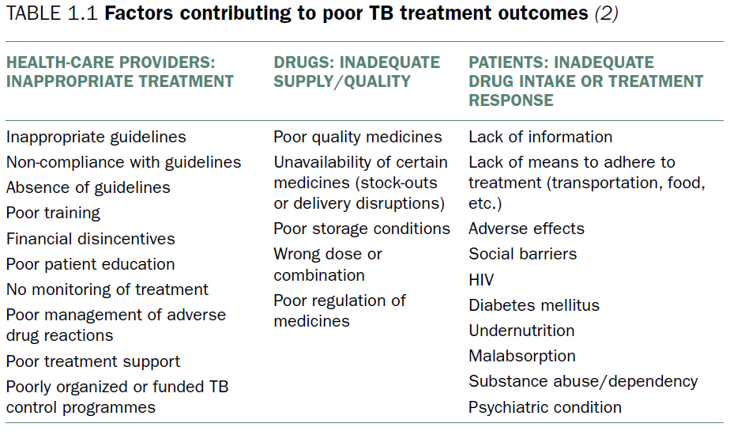
Causes of Drug-resistant TB
Companion Handbook to WHO Guidelines for DR-TB, 2014
Department of Health – National TB Control Program

Slide 12
Causes of Drug-resistant TB
Primary (Initial) Drug-resistant TB
  a person has been infected with a drug-resistant TB strain
  undiagnosed, untreated, or poorly treated drug-resistant TB increases the risk of exposure in the community
  environments conducive for TB transmission (e.g., crowding, poor ventilation, poor infection control, congregate settings)
  impaired immune system (e.g., HIV, diabetes)
Department of Health – National TB Control Program

Slide 13
Cross-cutting Factors Contributing to the Spread of DRTB
Insufficient health financing
Non-functioning health information system
Interrupted supply of medicines
Weak government stewardship or regulation
Health System Weaknesses
Absence of diagnostics and other commodities
Under-developed health care infrastructure
Poor health coverage
Untrained and unmotivated workforce
Department of Health – National TB Control Program

Slide 14
Cross-cutting Factors Contributing to the Spread of DR-TB
Social and economic constraints
Poor living/ working conditions
Inequity
Immuno-compromising conditions
Underlying Risk Factors and Social Determinants
Weak immigration policies
Weak or absent social support and protection
Disasters and emergencies
Poor access to diagnosis and treatment
Department of Health – National TB Control Program

Slide 15
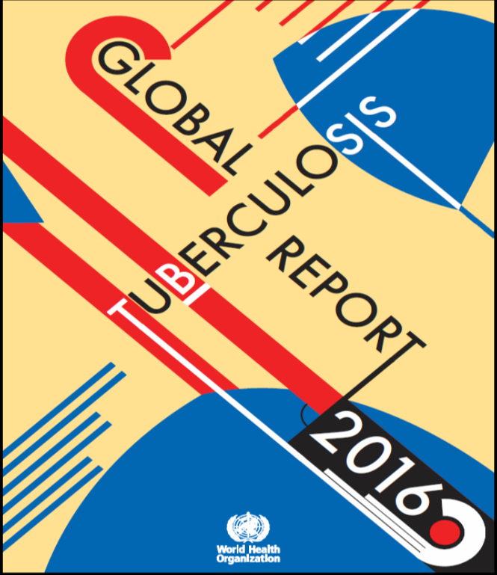
MDR-TB Situation in the Philippines (2016)
Estimated MDR/RR-TB cases
  New TB cases - 2.6 % (from 2.1%)
  Previously treated TB cases - 29% (from 21%)
Incident cases of MDR/RR-TB: 30,000
Estimated MDR-TB cases among
notified TB cases: 20,000 (from 15,000)
MDR/RR TB notified: 5238
MDR/RR TB enrolled: 5258
Treatment Success Rate (cohort of 2014): 46%
Source: WHO Global TB Report 2017
Notes:
This is a WHO global TB report. The New TB Cases and Previously treated TB cases have escalated to 2.6% and 21%, respectively, because before we were just looking at the estimated MDR, not included the Rif res TB cases only, so that would account for the increase from 2.1- 2.6% and 21-29%. Incident cases is from the whole population, while among notified cases were the ones reported by the TB program. Notified cases 4,778 is far from the Estimated cases 15,000 and there is still a big gap from notified and enrolled. TSR rate is from our 2012 cohort, 2013 cohort will be analyzed next year.
The direction of the program is to strengthen on how to test all retreatment cases (target should be 100% be tested on Xpert). Looking at the data, from Estimated to detected is just around 32% and detected to enrolled is around 85%. There are 15% Initial Lost to Follow-up and the notification rate from estimate to enroll is only 27%. This is our problem in the Philippines.

Slide 16
Socioeconomic Consequences of DRTB
Individual
  illness → 3−4 months absence from work → loss of income = PhP33,792 (PhP11,264 x 3 mo) [min. wage = PhP512] = 30% loss in household income
  death due to TB → approx 15 years loss of productive years
Municipal/Province/City
  people with TB → spread the disease → poor people get the disease → they get poorer → increased pressure on LGU budget
Source: WHO. Economic Burden of TB

Slide 17
Socioeconomic Consequences of DRTB
National
  increased pressure on LGU budget → LGUs become poor → increased pressure on national budget → more budget allocated for TB program → less budget for other national projects → country becomes poor

Slide 18
Socioeconomic Consequences of DRTB
Global
  8.4 million sick → bulk of them potential wage-earners → 30% decline in average productivity → amounts to approximately $1 billion yearly
  2 million annual deaths → average loss of 15 years' income → additional deficit of $11 billion
Every year, TB causes somewhere near $12 billion to disappear from the global economy
Source: WHO. Economic Burden of TB

Slide 19

Socioeconomic Consequences of Treating MDR-TB
COUNTRY | COST OF TREATMENT/CASE (US$) | COST PER DALY* AVERTED (US$) (COST OF 1 YEAR OF HEALTHY LIFE SAVED)
ESTONIA | 10,880 | 598
PERU | 2,423 | 163
PHILIPPINES | 3,613 | 143
TOMSK | 14,657 | 745
Notes:
DALY is a measurement of overall disease burden expressed as the # of years lost due to ill health, disability or early death.
Cost of MDRTB treatment seems so high but the cost of life being saved is only 143. This means that if we save one life, this patient can still become economically productive and the total cost we spent from treating the disease can still be recovered.

Slide 20
Five Principal Ways to
Prevent Drug-resistant TB
  Early detection and high quality treatment of drug-susceptible TB
  Early detection and high quality treatment of drug-resistant TB
  Effective implementation of infection control measures
  Strengthening and regulation of health systems
  Addressing underlying risk factors and social determinants
Department of Health – National TB Control Program

Slide 21
Programmatic Management of
Drug-resistant TB
A collective strategy using the different components of the national TB control program to effectively manage drug-resistant tuberculosis
Includes case detection, treatment, surveillance, monitoring and evaluation of the program’s performance
Department of Health – National TB Control Program

Slide 22
Treatment Success of 85%
Innovate TB surveillance, research and data generation for decision making
PhilSTEP(1)
2017−2022
Harmonize national and local efforts to mobilize adequate and capable human resources for TB elimination
Enforce NTP TB care and prevention standards and use of quality TB products and services
National TB Control Program
Case notification rate:
DSTB 525/100K
Case detection rate:
DRTB 90%
Success rate:
DSTB > 92%
DRTB 85%
Collaborate with other government agencies and partners to reduce out-of- pocket expenses of TB patients and expand social protection measures
Value clients and patients through provision of integrated patient-centered services
Activate TB patient support groups and communities to access quality TB services
Engage local government units to implement localized TB elimination plans through multi-sectoral collaboration
Interim 2017- 2022 Philippine Strategic TB Elimination Plan(Phase I) . Department of Health, Philippines
Lung Center of the Philippines - National Center for Pulmonary Research

Slide 23

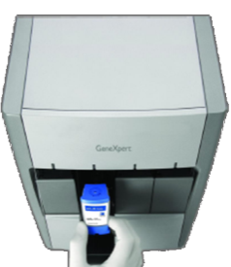
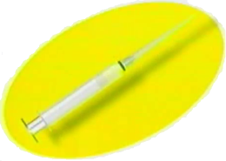
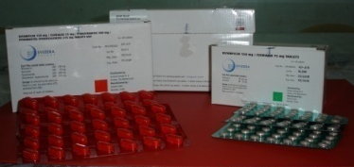
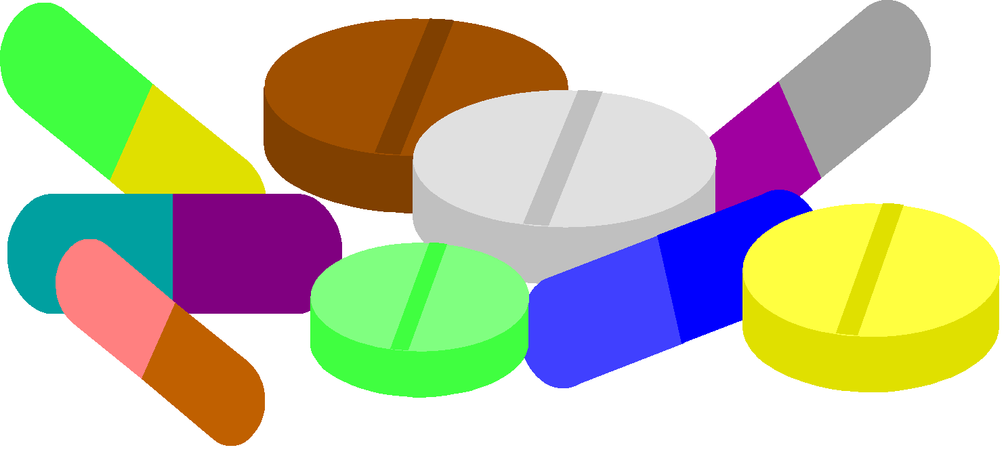
PMDT under NTP Framework
5 ELEMENTS OF DOTS
Sustained political commitment
₱
Rational case finding: accurate and timely diagnosis through quality- assured microscopy, culture and DST
Uninterrupted supply of
anti-TB drugs
Department of Health – National TB Control Program
Notes:
It has to be emphasized that managing drug susceptible and drug resistant TB should have the 5 elements of DOTS. There should be sustained political commitment, accurate and timely diagnosis, uninterrupted supply, treatment should be supervised, and patient is monitored during the whole treatment.

Slide 24
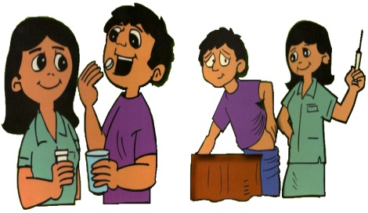


PMDT under NTP Framework
5 ELEMENTS OF DOTS
Supervised treatment
Presumptive TB Masterlist
Patient and program monitoring
DSTB Register
DRTB Register
Department of Health – National TB Control Program
Notes:
Although all the 5 elements are important, supervision of treatment is the key element that ensures completion of treatment and prevents further drug resistance. Previously, patients with DR-TB on treatment were given at least 18 months of supervised treatment.

Slide 25
Treatment Regimens
SSTR − Standard Short Treatment Regimen,
9-11 months
CTR − Conventional Treatment Regimen,
20-24 months
Lung Center of the Philippines - National Center for Pulmonary Research
Notes:
Currently, there are two regimens for DR-TB depending on the profile and criteria met by the patient.
Highlight: It is critical to ensure that DR-TB patients adhere to treatment until successful completion because:
DR-TB treatment is the last therapeutic option for many patients
There is serious public health consequence if therapy fails

Slide 26
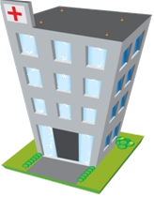
Ambulatory Service Delivery at Health Facilities
Hospitals, big DOTS facilities
          − Accept patients beyond catchment area
    − Where most presumptive DRTB are referred and diagnosed
    − Where all confirmed DRTB cases are initiated on second-line drug treatment
PMDT Facility
Local RHUs, private clinics
− Where presumptive DRTB are identified
− Where DRTB cases continue treatment as soon as they are able to adjust to the second-line drug treatment
Local DOTS Facility
Department of Health – National TB Control Program
Notes:
Management of DRTB in the Philippines is done in an ambulatory setting.

Slide 27
PMDT Services
CASE FINDING
Identification of presumptive DRTB Collection and transport of sputum specimens Diagnosis of DRTB Presentation of cases to the TB Medical Advisory Committee Intensified case finding
CASE HOLDING
Preparation for treatment initiation Initiation of treatment Supervision of treatment Case management Monitoring response to treatment PICT Management of treatment interruption Decentralization Psychosocial support Determining treatment outcome Presentation of cases to the Consilium
DSM
Requisition Receipt of requested drugs and storage Use and dispensing drugs inventory
R&R
Recording Reporting Using information on DRTB diagnosis and treatment
Department of Health – National TB Control Program
Notes:
The following must be available in all facilities offering PMDT services.

Slide 28
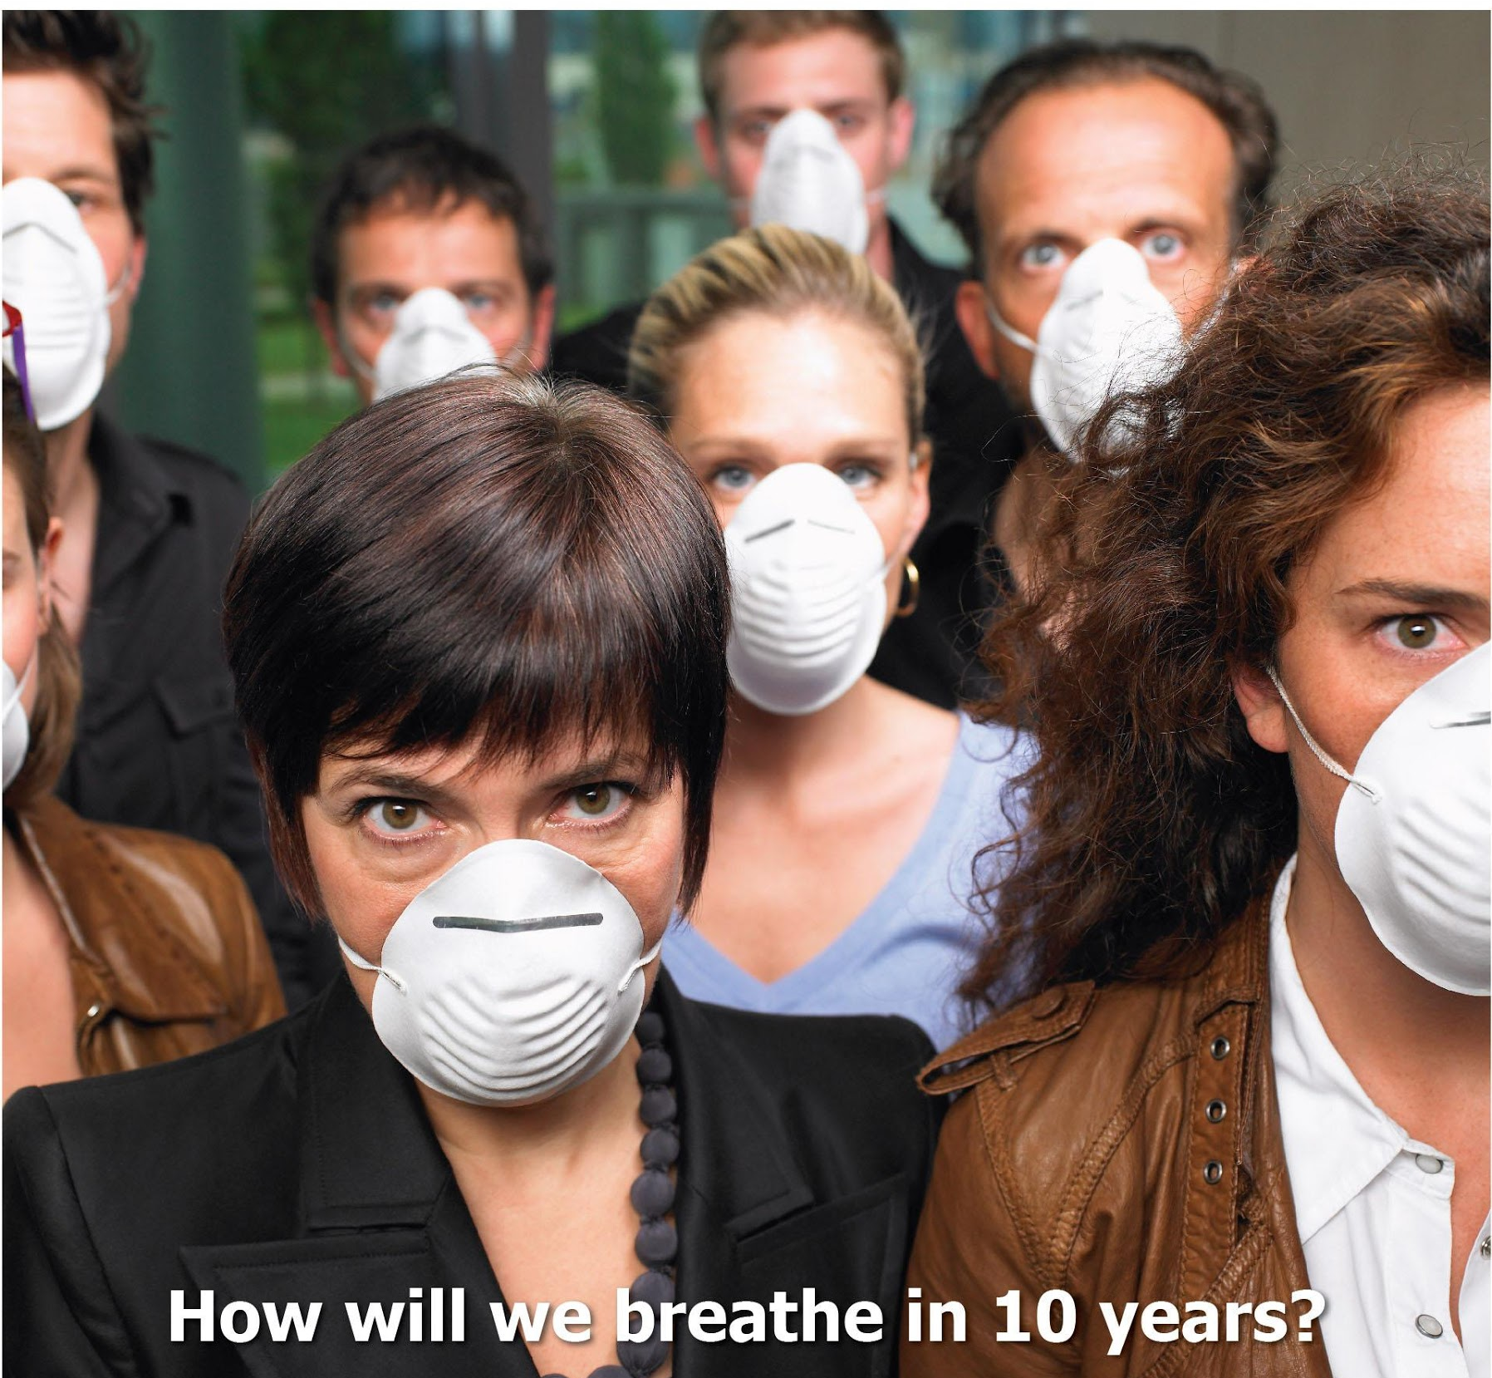
Notes:
Photo downloaded @ http://www.action.org/blog/post/romanian-ngos-call-on-decision-makers-to-save-lives

Slide 29

`
FOR A TB-FREE COUNTRY…
Notes:
Photo downloaded @ http://womenspowerhour.blogspot.com/2012/02/lonely-woman-listen-here-by-regina.html

Slide 30
End of Presentation

