Slide 1



DR-TB Case-finding and Referral Procedures

Slide 2
Objectives
At the end of the presentation, the participants will be able to:
identify their roles and tasks related to DRTB case finding;
identify presumptive TB and DRTB cases;
refer presumptive TB and DRTB cases;
perform proper collection, handling and storage of quality specimens for Xpert MTB/RIF testing;
understand the result of Xpert MTB/RIF testing; and
understand the procedures of referring presumptive DRTB
Department of Health – National TB Control Program

Slide 3
Roles of Public and Private Health Workers in PMDT
CASE FINDING
Identify presumptive DRTB and refer them to:
  PMDT facilities (TC/STC/iDOTs using − NTP Form 7: Referral Form (public)
  − Referral letter if from private
Explain to patients and family what MDRTB means and the framework of management
Instruct and encourage patients to submit sputum specimens for Xpert MTB/RIF testing
Department of Health – National TB Control Program

Slide 4
Case Finding for PMDT
IDENTIFICATION OF
PRESUMPTIVE DRTB
Department of Health – National TB Control Program

Slide 5
Presumptive DRTB
Presumptive TB (whether adult, adolescent or child) who belongs to any of the DRTB high-risk groups, such as:
  Retreatment cases
  New TB cases who are contacts of confirmed DRTB cases or non-converter of Category 1
  People living with HIV with signs and symptoms of TB
Department of Health – National TB Control Program

Slide 6
Groups with High Risk for DRTB
RETREATMENT CASES
RELAPSE
TREATMENT AFTER FAILURE | OR
A patient previously treated for TB, who has been declared cured or treatment completed in his/her most recent treatment episode, and is currently diagnosed with bacteriologically confirmed or clinically diagnosed TB
A patient who has been previously treated for TB and whose treatment failed at the end of his/her most recent course
A patient (child or EPTB) for whom sputum examination cannot be done and who did not show clinical improvement anytime during treatment
Department of Health – National TB Control Program

Slide 7
Groups with High Risk for DRTB
RETREATMENT CASES
TREATMENT AFTER LOST TO FOLLOW-UP (TALF)
PREVIOUS TREATMENT OUTCOME UNKNOWN
OTHERS
A patient who was previously treated for TB but was lost to follow-up for two months or more in his/her most recent course of treatment and is currently diagnosed with either bacteriologically confirmed or clinically diagnosed TB
A patient who was previously treated for TB but whose outcome after his/her most recent course of treatment is unknown or undocumented
Patients who do not fit in any of the categories listed above
Department of Health – National TB Control Program

Slide 8
Groups with High Risk for DRTB
NEW CASES
NON-CONVERTEROF CATEGORY 1
CONTACT OF CONFIRMED MDR-TB CASE | A person who shared an enclosed space, such as a house, a social gathering place, workplace or facility, for extended periods within the day with the index case during the 3 months before commencement of the current treatment episode
PLHIV WITH SYMPTOMS OF TB | People living with HIV with chest X-ray suggestive of TB, or any of the four symptoms: cough, fever, weight loss, night sweats
A patient who is sputum smear positive at the end of the 3rd month of treatment
Department of Health – National TB Control Program

Slide 9
Exercise
Patient SSB, 34 yrs old, who took only 4 months of Category I treatment last year, sought consultation at your health facility. She complains of persistent cough for the last 4 weeks, with back pain, hemoptysis, and weight loss.
Presumptive DRTB?
High-risk group?
YES
TALF
Department of Health – National TB Control Program

Slide 10
Exercise
Patient ABN, who had received 3 different courses of TB medications over a period of many years with a private physician, was referred to you by the last physician who treated her because her recent CXR result was suggestive of TB. According to her records, she took all of the medicines and completed each prescribed treatment.
Presumptive DR-TB?
High-risk group?
YES
RELAPSE
Department of Health – National TB Control Program

Slide 11
Exercise
Patient GGG, a DRTB patient currently undergoing treatment, brought his 6-year-old son to your facility. The child has been experiencing cough for one week. The child has no history of any TB treatment and could not yet expectorate.
Presumptive DRTB?
High-risk group?
YES
CONTACT OF A CONFIRMED
DRTB CASE
Department of Health – National TB Control Program

Slide 12
Exercise
Patient SNM, a 17-year-old female student, has come to your treatment facility for cough of more than two weeks and fever of five days. She has never been diagnosed or treated for TB in the past. She is unaware of any exposure to anyone with TB in the home or in school. You examined her and she has rales on both lower lung fields.
Presumptive DRTB?
High-risk group?
NO, presumptive DSTB only
N/A
Department of Health – National TB Control Program

Slide 13
Exercise
Patient JGS, 18 years old, who is being treated for HIV in one of the treatment hubs in Metro Manila, has been experiencing cough for 7 days already. She has no previous anti-TB treatment.
YES
DRTB suspect?
High-risk group?
PLHIV with signs and symptoms suggestive of TB
Department of Health – National TB Control Program

Slide 14
Exercise
Patient RRH is currently on Category 2 treatment (Relapse). His Xpert result prior to starting treatment was: MTB detected, Rif resistance not detected. After 3 months of intensive phase (2HRZES/1HRZE), his follow-up DSSM was 1+.
Presumptive DRTB?
High-risk group?
YES
NON-CONVERTER OF CAT II
Department of Health – National TB Control Program

Slide 15


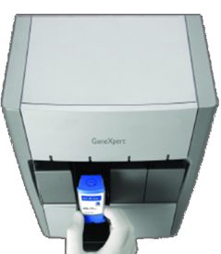

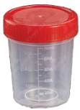
Case-finding Procedure for PMDT
Facility without PMDT Services
PMDT Facility
Rifampicin
resistant
Bacteriologically confirmed RR-TB
Xpert MTB/RIF Test
Identification and referral of Presumptive DRTB
Screening, assessment, sputum collection
Department of Health – National TB Control Program
Notes:
Xpert MTB Rif test shall be the primary diagnostic tool for all presumptive DRTB patients

Slide 16
Case-finding Procedure for PMDT
Facility with or without PMDT services
PMDT Facility
Rifampicin
resistant
Identification and referral of presumptive DRTB
Xpert MTB/RIF Test
Treatment
Bacteriologically confirmed RR-TB
Screening,
sputum collection
Department of Health – National TB Control Program
Notes:
Xpert MTB Rif test shall be the primary diagnostic tool for all presumptive DRTB patients

Slide 17
PMDT Treatment Facilities and Rapid TB Diagnostic Laboratories in the Region
  Provide the following in this slide:
  Name and picture of PMDT treatment facility(ies) and rapid TB diagnostic laboratories (RTDLs) in the Region
  Operating hours or schedule for receiving referrals
  Complete Address
  Contact Information
  Name of PMDT treatment facility head/physician
Department of Health – National TB Control Program
Notes:
This has to be updated before the lecture
17

Slide 18
PROCEDURES FOR REFERRING PRESUMPTIVE DRTB
Department of Health – National TB Control Program

Slide 19
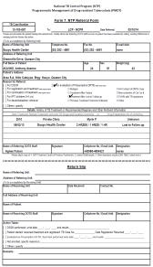

Referring Presumptive DRTB
Option 1: Presumptive DRTB identified can be referred directly to the PMDT treatment facility for diagnosis and treatment
Step 2
Step 3
Step 1
TS, DOTS facilities, PPMDs, hospitals, clinics
Assess identified Presumptive DRTB.
Accomplish Form 7. NTP Referral Form.
Instruct patient to report to the PMDT facility.
PMDT Facility
Department of Health – National TB Control Program
Notes:
A presumptive DRTB can be referred to the nearest PMDT facility with PMDT services for systematic screening
Use Form 7. NTP Referral Form (public)
Referral Letter (private)
19

Slide 20
Ensure COMPLETENESS and CORRECTNESS of information!!!
Please attach copy of:
NTP treatment card/s of previous treatment/s
Latest DSSM results
Other laboratory results (CXR, TBDC, blood chemistry)

Slide 21
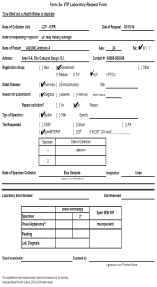
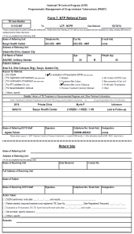

Referring Presumptive DRTB
Option 2: Request for Xpert test directly at Xpert site (if with access) and refer confirmed RR-TB to PMDT treatment facility
Step 3
Step 1
Step 2
MTB detected, Rifampicin
resistance detected
Bacteriologically confirmed RR-TB
TS, DOTS facilities, PPMDs, hospitals, clinics
Xpert Site
Assess identified presumptive DRTB, collect sputum specimen, and fill out Form 2a. NTP Laboratory Request Form.
Send collected specimen and request form to Xpert site.
Fill out Form 7. NTP Referral Form and refer confirmed RR-TB case to the PMDT facility (with the DSSM and Xpert results).
PMDT Facility
Department of Health – National TB Control Program
Notes:
21

Slide 22
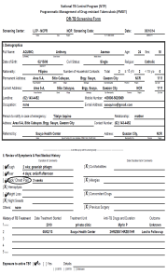
Referring Presumptive DRTB
Option 3: Send accomplished PMDT documents and collected specimen
Step 1
Step 3
Step 2
MTB detected, Rifampicin
resistance detected
courier
TS, DOTS facilities, PPMDs, hospitals, clinics
Assess identified presumptive DRTB and fill up the DRTB Screening Form and Suspects Referral Form.
Collect 1 sputum specimen (preferably early morning specimen).
Send documents and collected specimen to the PMDT facility via courier.
PMDT Facility
Department of Health – National TB Control Program
Notes:
22

Slide 23
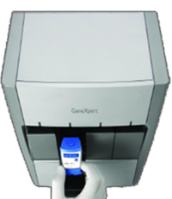
Referring Presumptive DRTB
Option 4: Send accomplished laboratory request form and collected specimen
Step 1
Step 3
Step 2
MTB detected, Rifampicin
resistance detected
courier
TS, DOTS facilities, PPMDs, hospitals, clinics
RTDL
Assess identified presumptive DRTB and fill-up the DRTB Screening Form and Suspects Referral Form.
Collect 1 sputum specimen (preferably early morning specimen).
Send documents and collected specimen to RTDL via courier.
Department of Health – National TB Control Program
Notes:
23

Slide 24
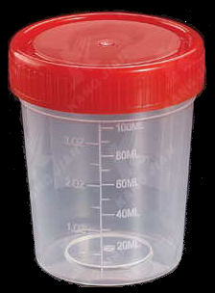
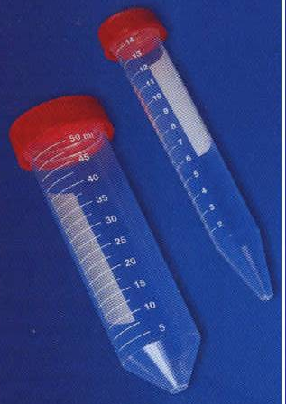
Sputum Collection for Xpert MTB/RIF Test
Use wide-mouthed sputum cup or 50 ml conical tube
Label the body of the sputum cup/ conical tube, indicating patient’s complete name and that specimen is for Xpert MTB/RIF test
Department of Health – National TB Control Program

Slide 25
Amount and Quality of Specimen for Xpert MTB/RIF Test
Only ONE specimen (> 1ml)
Solid or purulent particles, coughed out deeply from the lungs
Non-salivary
No food particles
Not blood stained
Department of Health – National TB Control Program

Slide 26
Storage of Specimen
If the sputum cannot be processed immediately, the specimen can be stored:
  35°C maximum of 3 days
  4°C maximum of <10 days
Department of Health – National TB Control Program
Notes:
10 days

Slide 27
END OF PRESENTATION

