Slide 1
Other Indications for
Xpert MTB/RIF Test

Slide 2
Objectives
At the end of the presentation, the participants will be able to:
know other indications for Xpert MTB/RIF,
interpret the results of Xpert MTB/RIF, and
follow the recommended algorithm on diagnosis using Xpert MTB/RIF and TB treatment
Department of Health – National TB Control Program

Slide 3
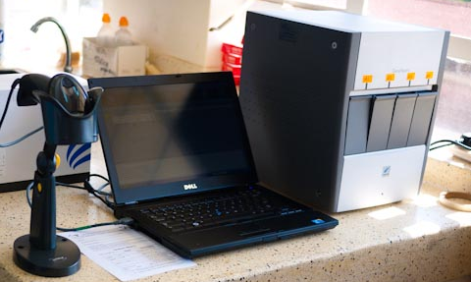
Xpert MTB/RIF Test
Sensitive and fully automated rapid test that detects Mycobacterium tuberculosis and rifampicin resistance
Needs minimum laboratory expertise
Biosafety requirements are similar to sputum smear microscopy
Department of Health – National TB Control Program
Notes:
Photo on the left downloaded @ www.siftingforseeds.com
Photo on the right downloaded @ www.cepheidcares.com

Slide 4
Who are qualified for GX testing?
Department of Health – National TB Control Program

Slide 5
Presumptive DRTB
History of Treatment | Definition
Retreatment | A patient who had been previously treated with anti-TB drugs for at least one month in the past This includes: Relapse Treatment After Lost to Follow-up (TALF) Previous Treatment Outcome Unknown (PTOU) Non-Converter of Category II
New | A patient who has never had treatment for TB, or who had taken anti-TB drugs for less than one month, and has the following: Contacts of confirmed DR-TB cases Non-converter of Category 1 People living with HIV with CXR suggestive of TB or any of the four symptoms: cough of any duration, fever, weight loss, night sweats

Slide 6
Presumptive DSTB
Xpert MTB/RIF test should also be performed for the following patients with presumptive DSTB:
a) Selected vulnerable populations
i. Inmates in jails and prisons
ii. Children (less than 15 years old)
iii. Elderly (60 years old and above)
b) New cases who are presumptive EPTB
These cases are included in the group with low risk for DR-TB

Slide 7
Official Results of Xpert MTB/RIF Test
MTB detected, Rifampicin resistance not detected (T)
MTB detected, Rifampicin resistance detected (RR)
MTB detected, Rifampicin resistance indeterminate (TI)
MTB not detected (N)
Invalid/ no result/ error (I)
RE-TEST
RE-TEST
Department of Health – National TB Control Program

Slide 8
Current Diagnostic Algorithm Using Xpert MTB/RIF Test
Presumptive DRTB
Retreatment: Relapse, TAF, TALF, PTOU, Non-converter of Category II
New: Contacts of confirmed DR-TB cases, Non-converter of Category I, PLHIV with CXR suggestive of TB, or any of the four symptoms: cough of any duration, fever, weight loss, night sweats
New, DSSM(-), CXR suggestive of TB with or without symptoms
Selected Vulnerable Groups (Jail Inmates, Elderly, Children) and New Presumptive EPTB
Xpert MTB/RIF Test

Slide 9
Current Diagnostic and Treatment Algorithm Using Xpert MTB/RIF Test
Xpert MTB/RIF Test
MTB Not Detected
MTB Detected ,
RIF Resistance Not Detected
MTB Detected,
RIF Resistance DETECTED
MTB Detected,
RIF Resistance Indeterminate
Invalid/Error
New
Retreatment
Reassessment
High risk for MDR-TB
Low risk for MDR-TB
Second-line anti-TB treatment
Repeat Xpert
MTB/RIF Test
^{Second-line} ^{anti-TB} ^{ment}
First-line anti-TB treatment
Follow the result
of the 2nd test

Slide 10
END OF PRESENTATION

