Slide 1



CASE HOLDING FOR PMDT

Slide 2
Objectives
At the end of this session, participants will be able to:
perform the roles of health workers in managing patients with DRTB,
perform the processes and procedures for treatment initiation, and
determine appropriate treatment regimen using the DST results and patient’s history of drug use
Department of Health – National TB Control Program

Slide 3
Objectives
At the end of this session, participants will be able to:
know the necessary forms for treatment initiation of patients with DRTB,
know the schedule and necessary laboratory exams for treatment monitoring
perform the processes to ensure patient treatment adherence
Department of Health – National TB Control Program

Slide 4
Definition of Case Holding
A set of procedures that ensure all DRTB patients are promptly initiated on
treatment and are successfully treated
Department of Health – National TB Control Program

Slide 5
Roles and Tasks in Case Holding
Roles/Tasks | Persons Responsible
Counseling of patient in preparation for treatment (DRTB Treatment Information Form) | Physicians, Nurses
Determination of treatment regimen (SSTR or CTR ) | Physicians, Nurses
Preparation and filling up of forms (Form 6b DRTB, Treatment Card) | Nurses
Assessment of patients prior to treatment (physical exam, requisition of additional laboratory examinations) | Physicians
Facilitation of performance of baseline and other laboratory examinations | Nurses
Department of Health – National TB Control Program

Slide 6
Roles and Tasks in Case Holding
Roles/Tasks | Persons Responsible
Treatment supervision | Nurses and other health care workers
Management of adverse events | Physicians, Nurses
Management of treatment interruptions | Nurses and other health care workers
Determination of final treatment outcome | Physicians
Referral of difficult cases to TB Medical Advisory Committee | Physicians, Nurses
Department of Health – National TB Control Program

Slide 7
Processes and Procedures Prior to Initiation of Treatment
1. Counseling of patients, family and significant others
  For patients <18 years, mentally incapacitated and those who cannot make their own decision due to other reasons, the parent/guardian will be given the information regarding MDR-TB treatment

Slide 8
Processes and Procedures Prior to Initiation of Treatment
2. Administration of DRTB Information Form
Highlights −
− the agreement with the patient to undergo treatment, with emphasis on:
    Supervised treatment: 7 days a week
    Sputum and laboratory follow-up: monthly
    Consultation with physician: at least once a month
  information about anti-TB drugs
  information about infection control
Note: A copy of the DRTB Information Form can be found on pp 201−205 of the PMDT Implementing Guidelines

Slide 9
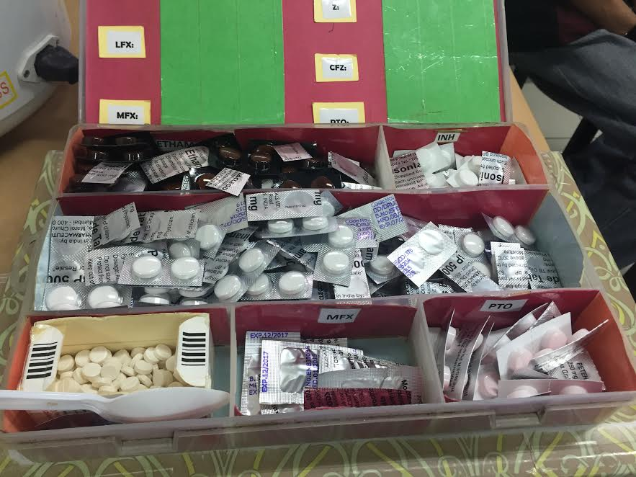
Treatment Regimen for DRTB
Second-line drugs for DRTB
Department of Health – National TB Control Program

Slide 10
Principles of Regimen Design
Need to have at least FIVE effective TB medicines during intensive phase: pyrazinamide + four core second-line TB drugs
  Susceptible by drug susceptibility test (DST)
  No previous history of use
Priority of selection is based on group hierarchy
Department of Health – National TB Control Program

Slide 11
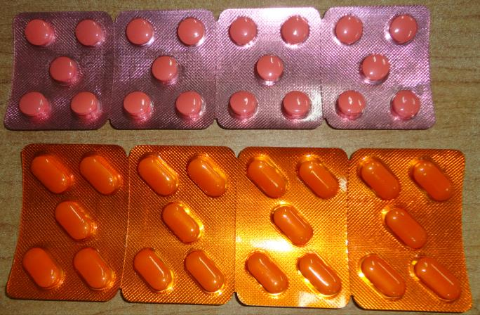
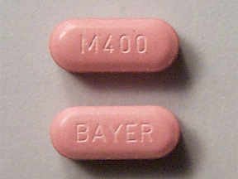
List of Drugs for DRTB According to Hierarchy
A. Fluoroquinolones | Levofloxacin Moxifloxacin Gatifloxacin (not available in the Philippines) | Lfx Mfx Gfx
Levofloxacin (Lfx) 250 mg/tab
Moxifloxacin (Mfx)
400 mg/tab
Levofloxacin (Lfx) 500 mg/tab
Department of Health – National TB Control Program

Slide 12
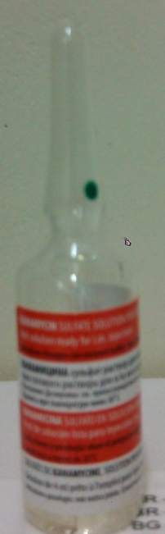
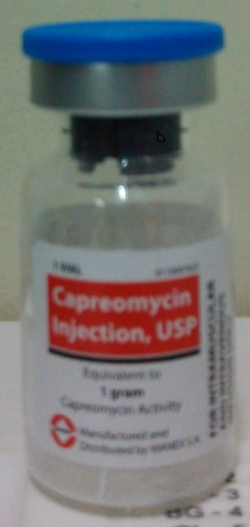
List of Drugs for DRTB According to Hierarchy
B. Second-line injectable agents | Amikacin Capreomycin Kanamycin (Streptomycin) | Am CM KM (S)
Kanamycin (KM)
1 G/4ml amp
Capreomycin (CM)
1 G/vial (3cc dilution)
Department of Health – National TB Control Program

Slide 13
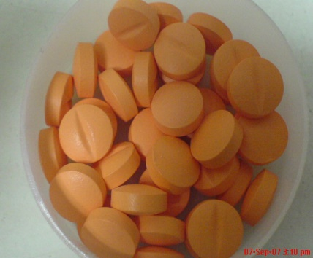

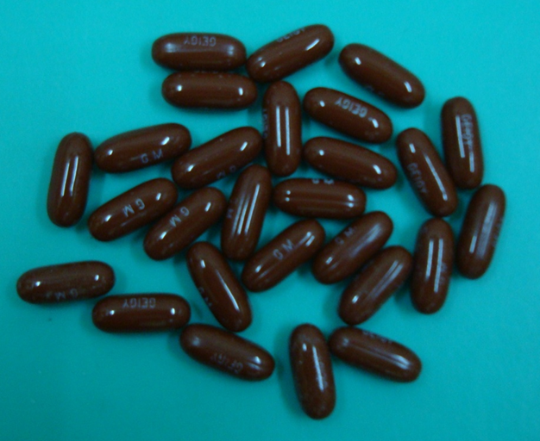
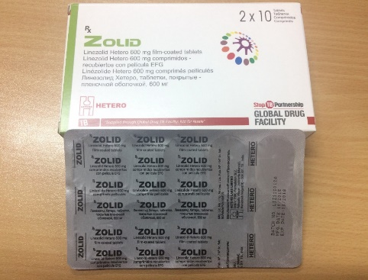
List of Drugs for DRTB According to Hierarchy
C. Other core second-line agents | Ethionamide / Prothionamide Cycloserine/Terizidone Linezolid Clofazimine | Eto / Pto Cs/Trd Lzd Cfz
Prothionamide (Pto)
250 mg/tab
Cycloserine (Cs)
250 mg/cap
Clofazimine (Cfz)
50mg/100mg gel cap
Linezolid (Lzd) 600 mg/tab
Department of Health – National TB Control Program

Slide 14
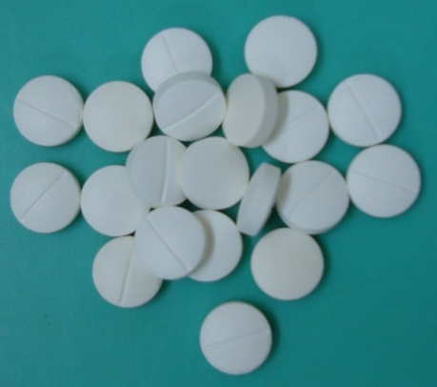
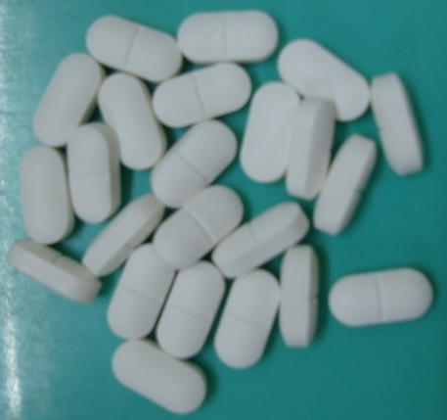
List of Drugs for DRTB According to Hierarchy
D. Add-on agents | D1 | Pyrazinamide Ethambutol High-dose Isoniazid | Z E Hh
Ethambutol (E)
400 mg/tab
Pyrazinamide (Z)
500 mg/tab
Department of Health – National TB Control Program

Slide 15
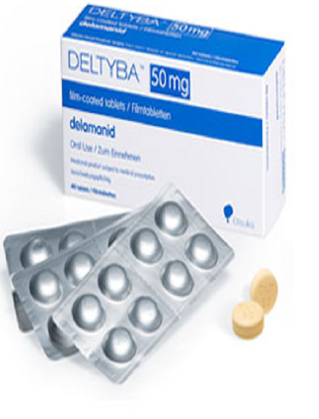
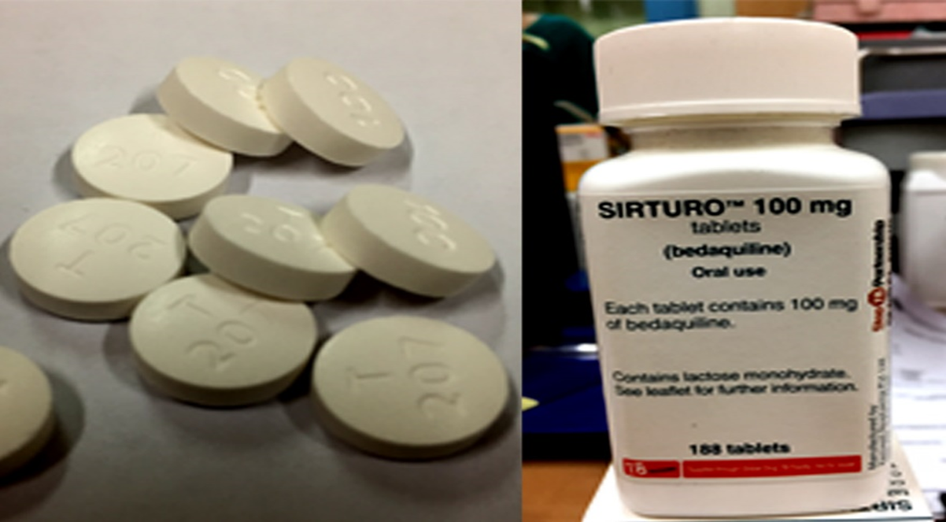
List of Drugs for DTB According to Hierarchy
D. Add-on agents | D2 | Bedaquiline Delamanid | Bdq Dlm
Bedaquiline (Bdq) 100 mg/tab
Delamanid (Dlm) 50 mg/tab
Department of Health – National TB Control Program

Slide 16
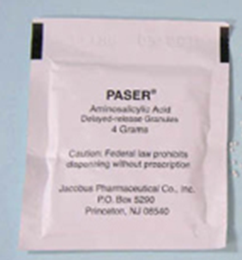
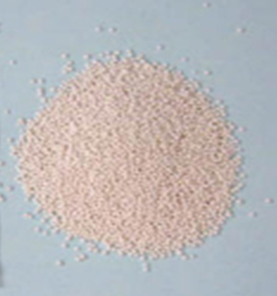
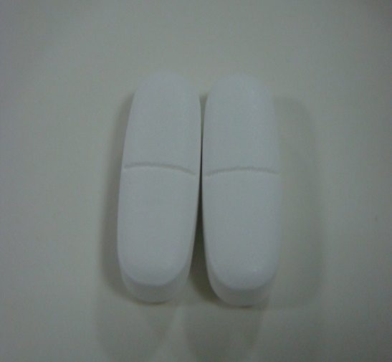
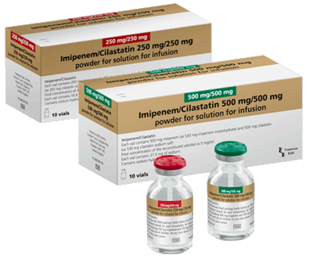

List of Drugs for DRTB According to Hierarchy
D. Add-on agents | D3 | p-aminosalicylic acid Imipenenem-cilastatin Meropenem Amoxicillin-clavulanate (Thiacetazone) | PAS Ipm Mpm Amx-Clv (T)
Para-amino salicylic acid (PAS) 4g/sachet
Amoxicillin-clavulanate (Amx/Clv)
Imipenenem/Cilastatin (Ipm)
Department of Health – National TB Control Program

Slide 17
Treatment Regimens for DRTB
1. Standardized Treatment Regimen
The same regimen is given to all patients in a defined group or category
It is based on DRS data from representative patient populations in the absence of individual DST
If possible, presumptive DRTB should be confirmed by DST (e.g., Standard Short Treatment Regimen)
Department of Health – National TB Control Program

Slide 18
Standard Short Treatment Regimen (SSTR)
The Standard Short Treatment Regimen may be used in patients with rifampicin-resistant or multidrug-resistant TB based on certain criteria
9-11 months
Intensive Phase:
Mfx Km Pto Cfz H Z E
Continuation Phase:
Mfx Cfz Z E
Department of Health – National TB Control Program

Slide 19
Standard Short Treatment Regimen (SSTR)
This cannot be given to the following patients:
  Confirmed or suspected resistance to second-line injectable agent and/or fluoroquinolone
  Exposure to > 1 second-line drug in the shorter MDR-TB regimen for >1 month
  Intolerance to > 1 drug in the shorter MDR-TB regimen or risk of toxicity (e.g., drug-drug interactions)
  Pregnancy
  TB meningitis, osteoarticular TB, disseminated TB
  At least one medicine in the shorter MDR-TB regimen not available in the program
Department of Health – National TB Control Program

Slide 20
Treatment Regimen for DRTB
2. Conventional Treatment Regimen
− recommended by TB Medical Advisory Committee (TB MAC*) to patients who do not meet the criteria for the standard regimen (e.g., individualized, empiric, XDR-TB regimen)
*TB MAC (previously known as Consilium) − a case management committee composed of health care providers with expertise in managing DRTB who reviews and approves the cases presented for empiric treatment, and provides recommendations on difficult cases
Department of Health – National TB Control Program

Slide 21
STEPS in Designing Conventional Treatment Regimen for Patients with DRTB
Review patient’s past history of TB treatment (drugs used) and DST
Select one later-generation fluoroquinolones from Group A
Select one injectable drug from Group B
Select other second-line drugs from Group C
Select add-on drugs from Group D
Department of Health – National TB Control Program
Notes:
Step 1: Review patient’s clinical history and DST.
Review patient’s DST and confirm the patient’s history of anti-TB treatment to determine if a drug has certain or almost certain effectiveness. If evidence about the effectiveness of a drug is unclear, the drug may be included in the regimen but it should not be counted as one of the four core drugs.
Step 2: Select one later – generation fluoroquinolone from Group A.
For MDRTB, this is will be considered as one of the effective drugs. For XDR-TB, fluoroquinolones will not be counted as one of the effective drugs due to possibility of cross-resistance.
Step 3: Select one injectable agent from Group B.
Always use one (1) group B agent during the intensive phase which should last 4-6 months for SSTR and about 8 months for the conventional treatment regimen (CTR). For MDRTB, this is considered as one of the effective drugs but not in XDR-TB due to possibility of cross-resistance.
Step 4: Select other SL drugs from Group C.
Add two (2) or more anti-TB drugs among Group C.
Step 5: Select add-on agents from Group D.
Select additional anti-TB drugs among group D only if the core regimen of four reliable anti-TB drugs cannot be formed from Group A-C because of resistance, previous use, or adverse events. For group D1, use Pyrazinamide and evaluate the use of Ethambutol but neither should be considered as one of the four effective drugs.
You have at least four (4) second line anti-TB drugs likely to be effective.

Slide 22
PMDT Recording and Reporting Forms
    1. Form 4b DRTB Treatment Card
    2. Form 5b DRTB Patient’s Booklet
    3. Form 6b DRTB Register
Department of Health – National TB Control Program

Slide 23
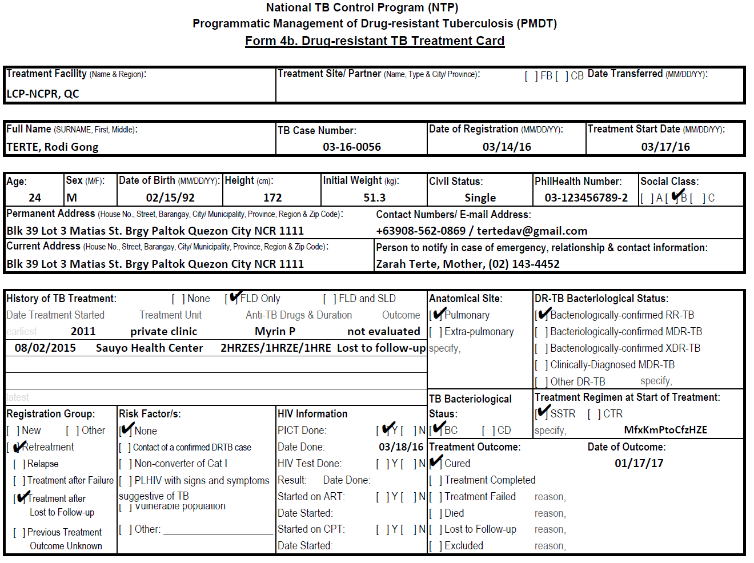
DRTB Treatment Card

Slide 24
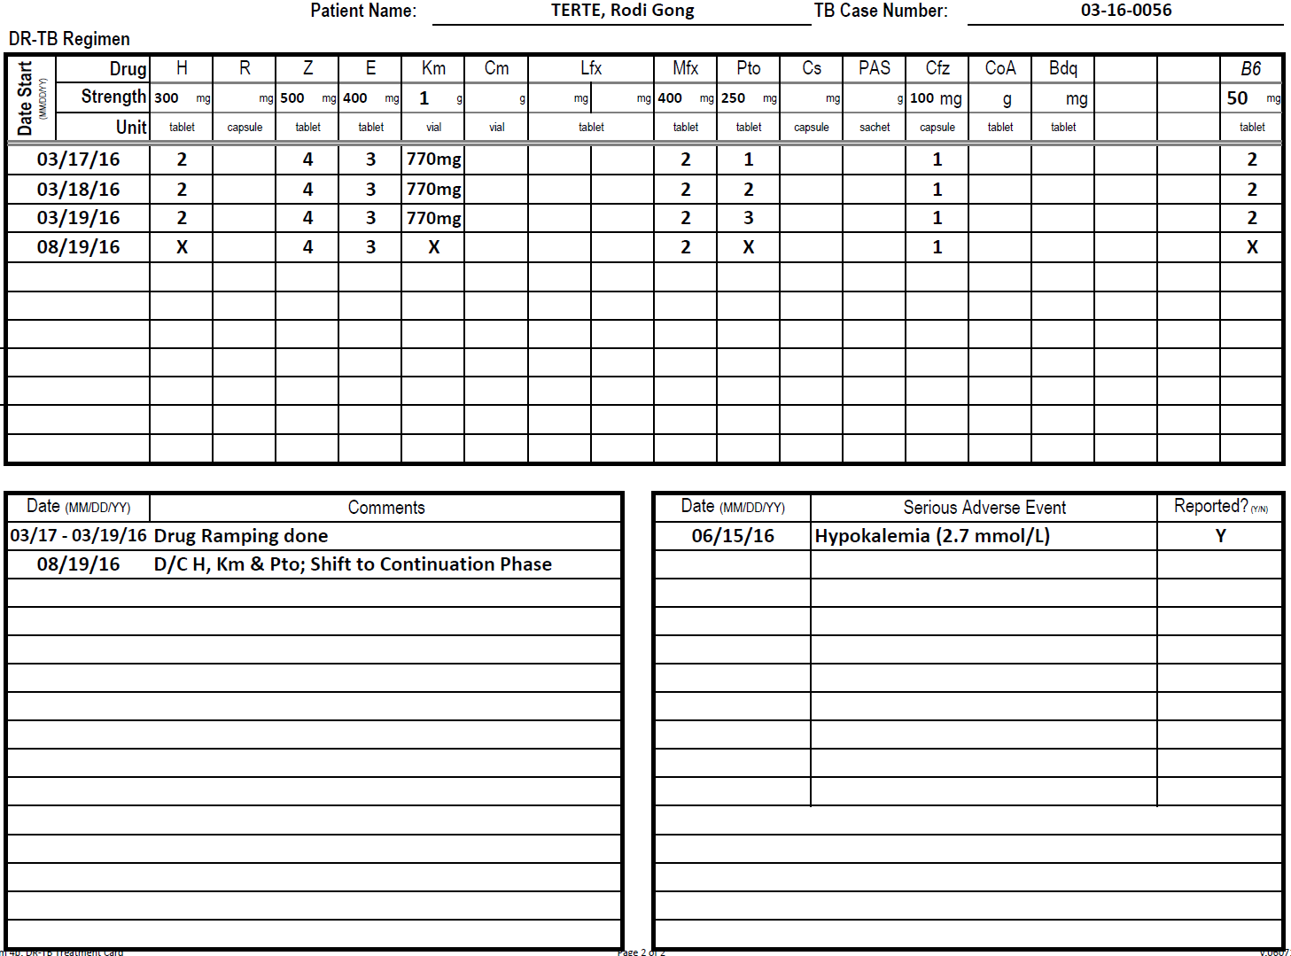

Slide 25
The first 2 days of drug ramping is considered full dose
24 months only

Slide 27
Patient’s Booklet
Department of Health – National TB Control Program

Slide 28
Patient’s Booklet
Department of Health – National TB Control Program

Slide 29
Patient’s Booklet
Department of Health – National TB Control Program

Slide 30
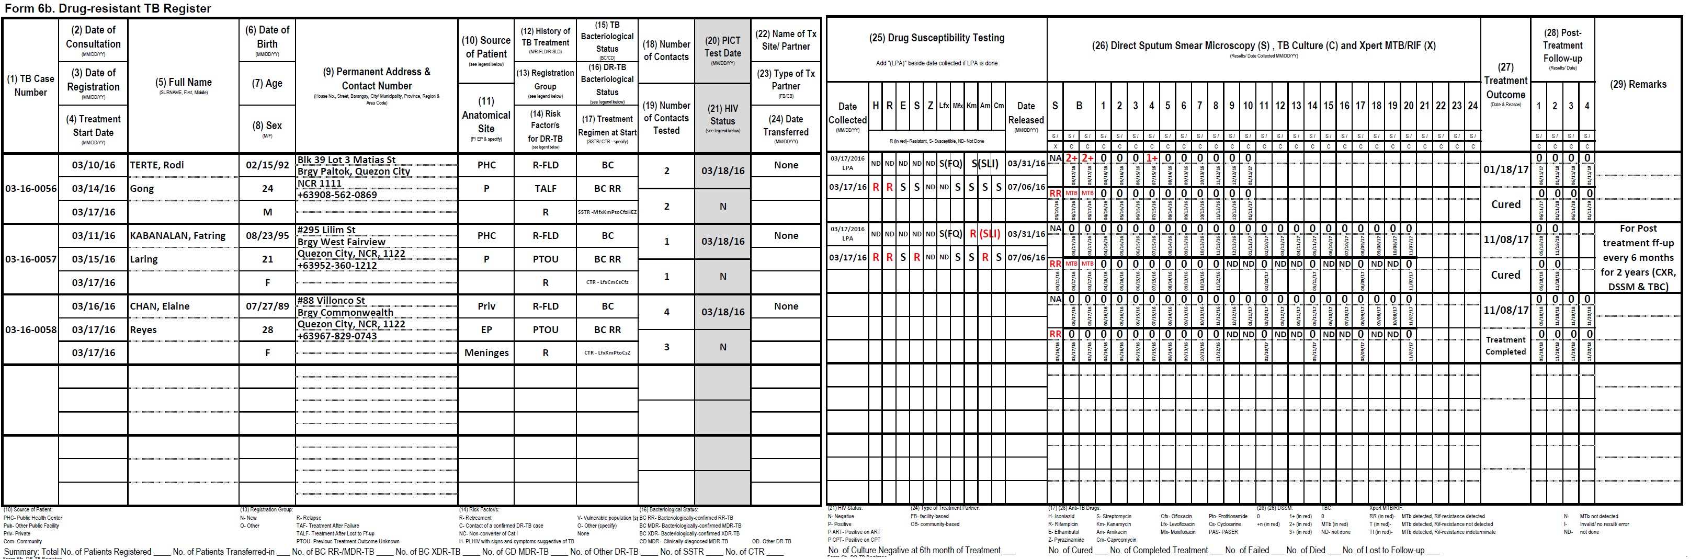
Lung Center of the Philippines - National Center for Pulmonary Research

Slide 31
Monitoring Response to Treatment
Department of Health – National TB Control Program

Slide 32

Schedule of Sputum Collection in SSTR and CTR
Test | Treatment Phase | Standard Short Treatment Regimen (SSTR) 9-11 | Conventional Treatment Regimen (CTR) 20-24
DSSM | IP | Baseline, Monthly
 | CP | Monthly
TBC | IP | Baseline, Monthly
 | CP | Monthly | Every 3 Months
Department of Health – National TB Control Program

Slide 33
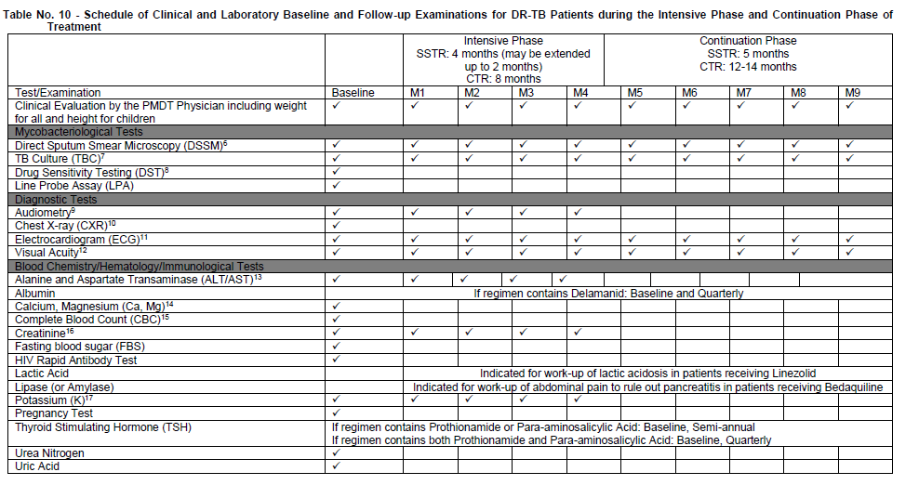
Schedule of Laboratory Examinations
Notes:
This is already included in the PMDT Implementing Guidelines. There is a need to emphasize that the above examinations are necessary to ensure that patient is responding to treatment.

Slide 34
Supervised Treatment
Treatment can be done in any place as agreed between the patient and the trained health worker:
  STC/TC
  iDOTS
  RHU
  Community
  Hospitals, etc.
Department of Health – National TB Control Program

Slide 35
Supervised Treatment
Supervised treatment must also include monitoring of adverse events (AEs) to ensure patients are adhering to treatment
AEs are recorded in the Patient Progress Report Form (PPRF)
Department of Health – National TB Control Program

Slide 36
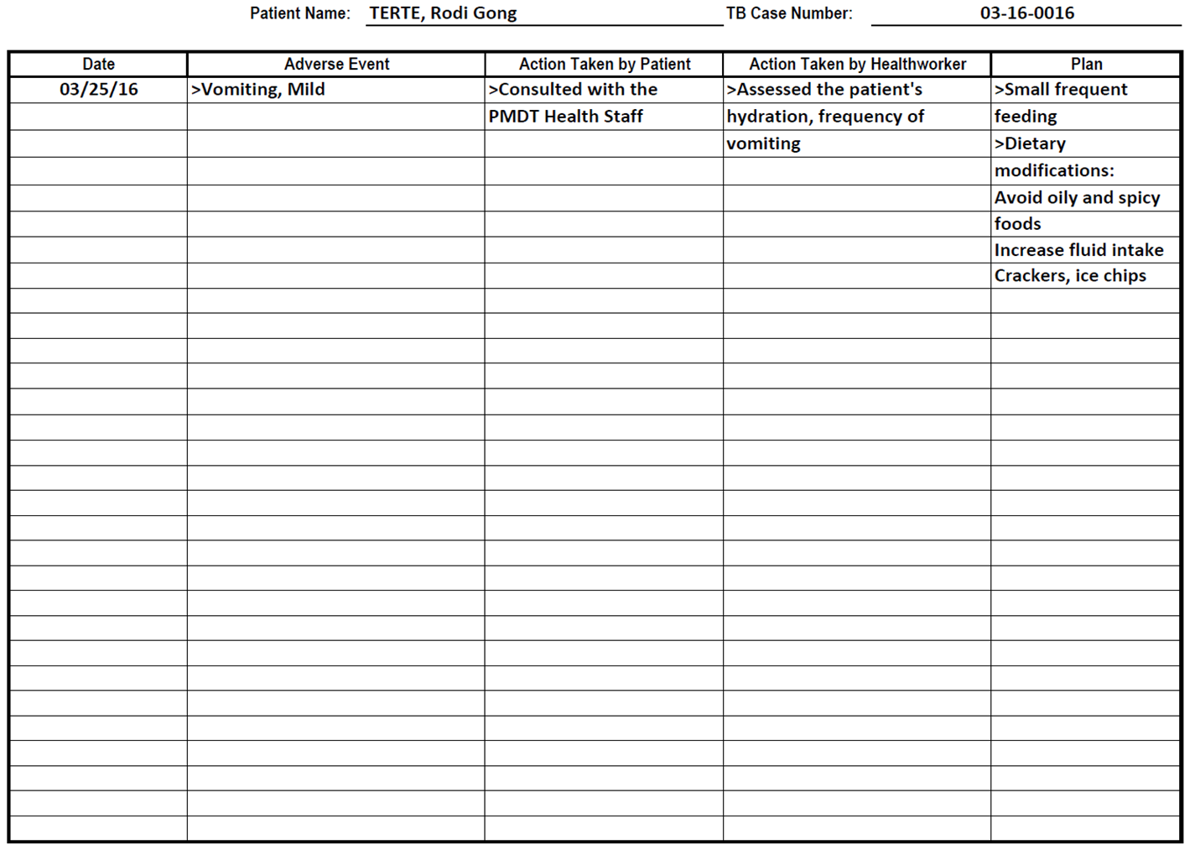
Sample PPRF

Slide 37
Managing Treatment Interruption
The following steps shall be taken for patients showing any signs of possible poor adherence:
Time-frame | Actions to be Taken | Person Responsible
Within 24 hr | Immediately follow up patients who missed a treatment⎯through phone call (3 attempts within the day followed by SMS) | PMDT treatment facility
Within 48−72 hr | Request the nearest health facility to visit patient's home/workplace if the patient still did not report to treatment and provide immediate feedback to the requesting PMDT treatment facility | DOTS facility staff
Department of Health – National TB Control Program

Slide 38
Managing Treatment Interruption
Patients who are interrupting treatment must be counseled
  to determine the root cause of interruption so that appropriate actions can be taken together with the patient
Department of Health – National TB Control Program

Slide 39
End of Presentation

