Slide 1



5th edition
NTP MANUAL OF
PROCEDURES
Introduction and Highlights
Notes:
Introduction to the NTP MOP and its highlights

Slide 2
Rationale for Updating the MOP
Policy issuances of WHO and ISTC
Expanded participation of non-NTP facilities like public-private mix DOTS, hospitals, private clinics, prisons
New initiatives such as intensified case finding, infection control
Roll-out of rapid diagnostic tools
Development of the 2010−2016 Philippine Plan of Action to Control TB (PhilPACT)
Notes:
WHO – World Health Organization
ISTC – International Standards for TB Care
PPMD – Private-Public Mix DOTS

Slide 3
Processes of MOP Revision
Core group drafted other chapters
TWG revised CF and CH
TRP reviewed
Stakeholders consulted
DOH order issued: TRP and TWG
Launched at PhilCAT convention
Participatory process
August 2013
October 2010

Slide 4
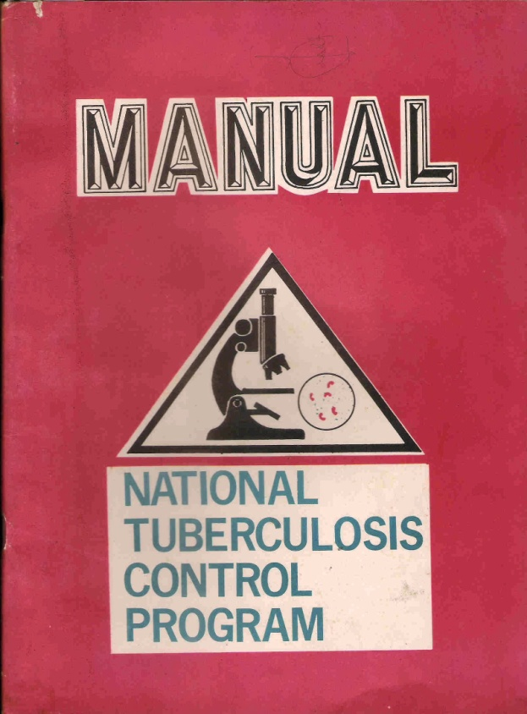
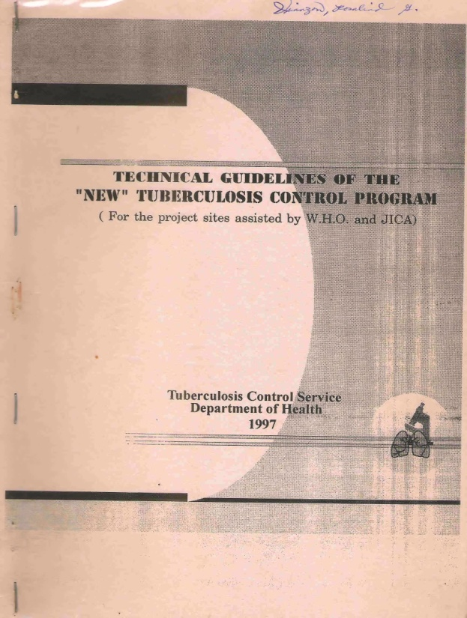
Evolution of the MOP
1969
1980
1st edition
1988
2nd Edition
1997 Technical Guidelines

Slide 5
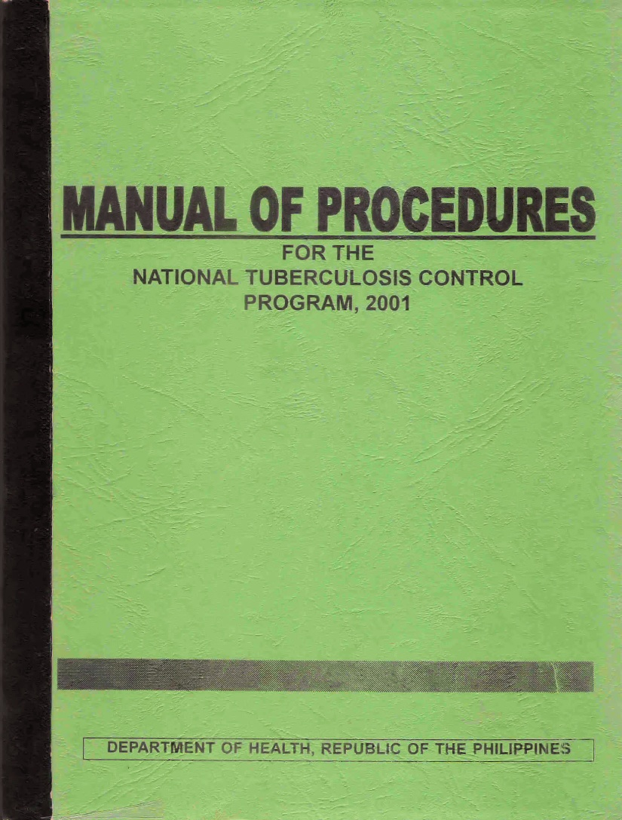
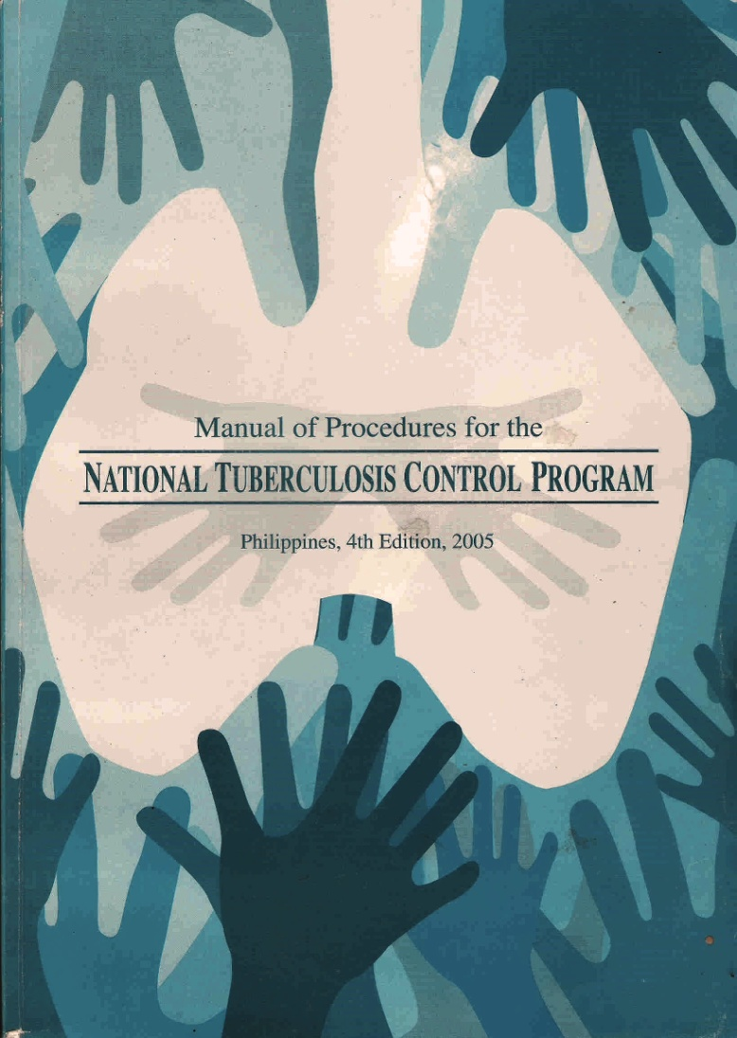
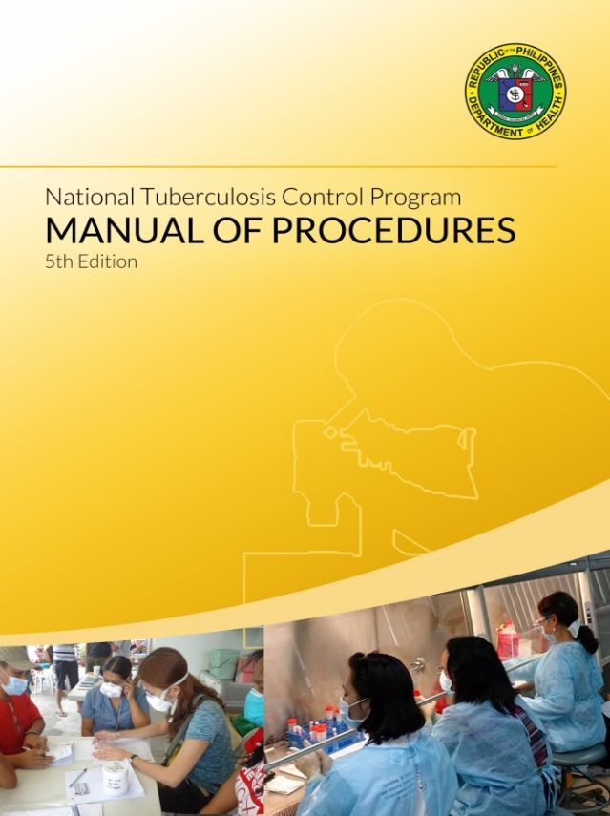
Evolution of the MOP
3rd Edition
2001
2005
4th Edition
2005
5th Edition
2013

Slide 6
Uses of MOP
Provides technical policies and guidelines on how to diagnose, treat and counsel TB cases
Provides guidelines on how to strengthen NTP support health systems such as logistics management, and recording and reporting
Defines the roles and tasks of offices/persons involved in TB control
Serves as reference for monitoring, supervision and evaluation

Slide 7
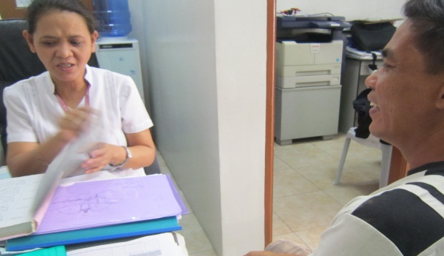
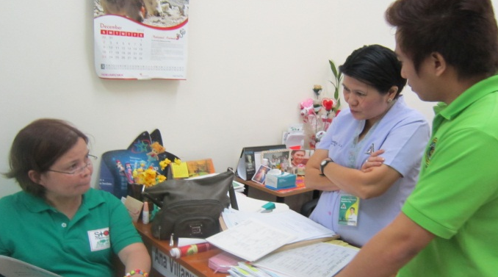
Users of MOP
Primary users
TB care providers – staff of DOTS facilities such as health centers, rural health units, PPMDs, hospitals, government health facilities, private clinics
Secondary users
Program managers – provincial / city TB coordinators and regional TB coordinators, IDO-DOH
Policy makers, advocates, researchers
Partners including donors

Slide 8
Preface: DOH Secretary’s Call
“I call on all health organizations and facilities to ensure that all their health care providers possess the capability to provide quality TB care through training and supervision. Only through well-trained cadres would our fight against TB bring us closer to our vision of a TB-free Philippines.”
Enrique T. Ona, MD, FPCS, FACS
Secretary of Health

Slide 9
Table of Contents
Chapter 1. Introduction
Chapter 2. Case Finding
Chapter 3. Case Holding
Chapter 4. Prevention of TB
Chapter 5. Records and Reports
Chapter 6. Logistics Management
Chapter 7. Referral System
Chapter 8. Advocacy, Communication, and Social Mobilization
Chapter 9. Certification and Accreditation
Chapter 10. Monitoring and Evaluation
Annexes
Notes:
Table of Contents of the NTP MOP, 5th edition

Slide 10
General Changes in the MOP
Integrated case-finding and case-holding guidelines for adults and children, drug-susceptible and multidrug-resistant TB
Introduced the intensified case-finding strategy for vulnerable populations
Included new chapters on TB prevention, referral system and DOTS certification and accreditation
Detailed policies and guidelines
Adopted “new” technical terms
More decision-making options to attending physician
Harmonized with the 2010−2016 PhilPACT
Notes:
For those who are familiar with the earlier edition of the NTP MOP, this slide and the following three slides show the main difference between the old and the latest edition.

Slide 11
Some technical changes/highlights in the MOP
Case finding
Expanded definition of presumptive TB (“symptomatic”)
2-sputum specimen for DSSM
Algorithm for adults and children
Use of Xpert
Intensified case finding among vulnerable populations
Case holding
Registration group
Treatment regimen (no Cat III )
Revised dosage for children
Schedule of sputum follow-up

Slide 12
Some technical changes/highlights in the MOP
Prevention of TB
Infection control
Isoniazid preventive therapy
Logistics
Detailed guidelines on logistics management cycle
Records and reports
R&R for adult and children
Reduced to 14 records and 9 reports

Slide 13
Some technical changes/highlights in the MOP
ACSM
Beyond health promotion
Certification and accreditation
Describes the cycle from certification to claims processing
Monitoring and evaluation
More key program indicators
Synchronized with PhilPACT

