Slide 1
EXERCISE 3.3: RECORDING FORMS FOR CASE FINDING
For each patient, accomplish Form 1, Form 2a and Form 3, as applicable.
(For this exercise, you may use the same presumptive TB Masterlist and Laboratory register.)

Slide 2
1. Melinda Tanun, 45 year old female, was referred by a private physician, Dr. Bert Santos, to the Victoria RHU because of chest X-ray findings of PTB (Jan. 7, 2014: streaky infiltrates in left upper lobe). At the RHU, the following information was obtained when she consulted on January 14, 2014: → She had cough of 3 weeks duration, with weight loss and fever. → She was treated for PTB in 2012 by another private physician. She could not recall the name of the medicines but said she took 3 tablets of the same kind everyday but only for 2 months. → There is no other member of the household with a history of TB. → Melinda lives in Purok 7, Bgy. Maalon, Victoria Municipality, Province B, in region 1.
(ACCOMPLISH Form 1 and the upper portion of Form 2a BEFORE PROCEEDING.

Slide 6
Patient’s surnames should be written in CAPITAL letters

Slide 7
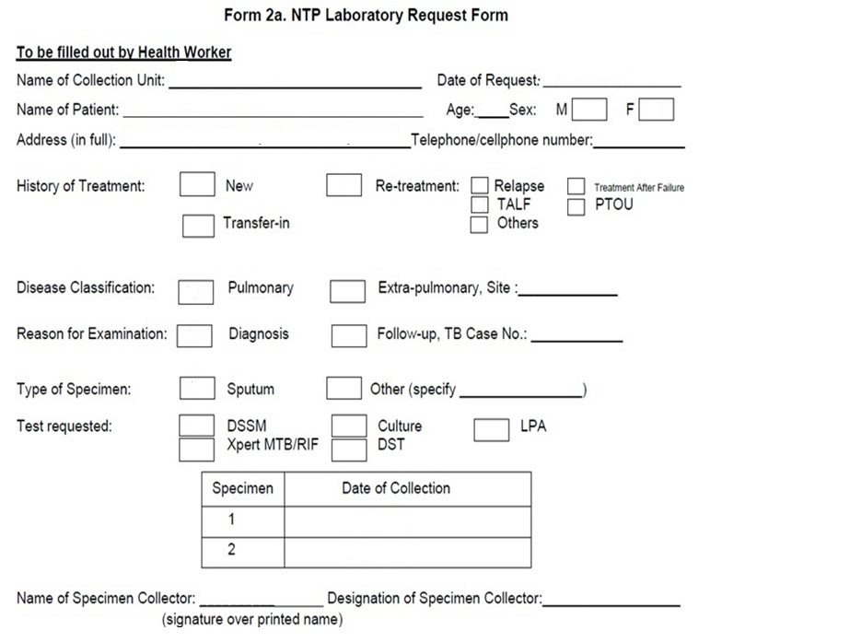

Slide 8
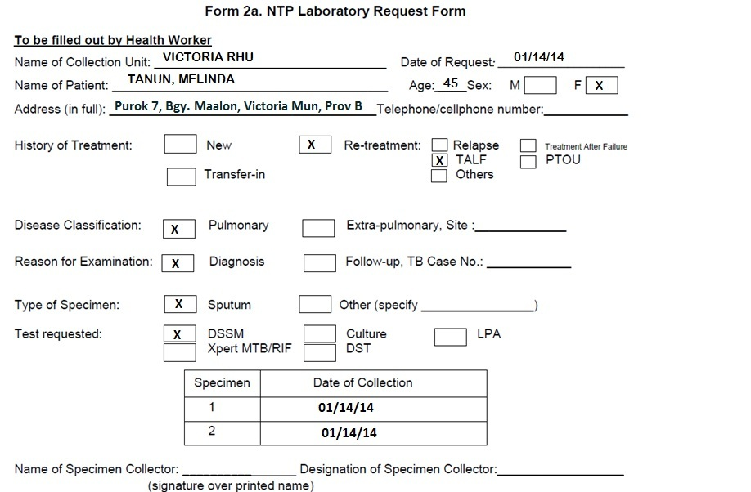

Slide 9
She was able to submit 2 specimens for DSSM on the same day. The specimens of Melinda Tanun were processed and read on the same day, January 14. Results were as follows: Specimen #1: 0 (salivary) Specimen #2: 0 (salivary)
(ACCOMPLISH Form 3 and the lower portion of Form 2a BEFORE PROCEEDING.
(Update Form 1)

Slide 13
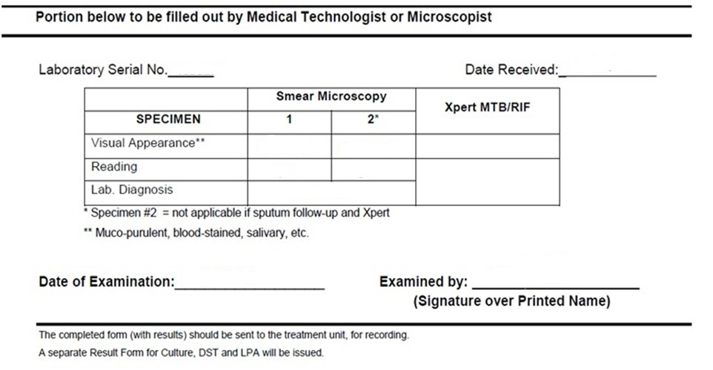
Form 2.a NTP Laboratory Request Form

Slide 14
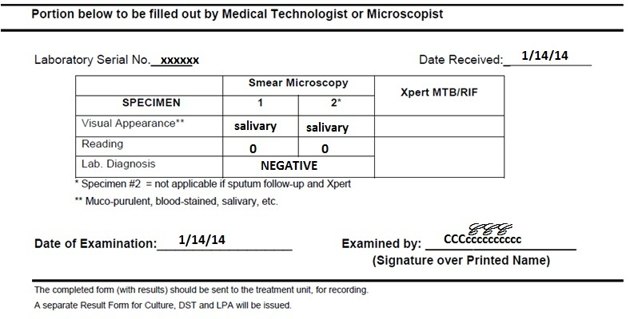

Slide 15
Update

Slide 17
The DOTS physician decided to refer Melinda to the accessible Xpert site which was District Hospital B.

Slide 18
Update

Slide 20
2. Justine David, a 4 year old boy, was brought to the Batasan DOTS facility on February 7, 2014 by her mother for evaluation. Her mother, Christa, was started on Category 1 treatment at Batasan 2 weeks ago. The family resides in #43 General St., Bgy. Batasan, City 123, in Region 2.
On evaluation, it was found that Justine has had cough for the past 4 weeks. His weight was below normal for his age and his mother reported he had a very poor appetite. He had been given Cotrimoxazole 3 weeks ago but still without resolution of cough after 7 days of intake. Justine also underwent a Chest X-ray (self-requested by the mother) and it read: hilar adenopathy, right consistent with PTB (January 24, 2014).

Slide 21
Justine has not been previously treated for TB. He could not produce sputum. A TST was done and read on February 9 as 12mm. (ACCOMPLISH Form 1)

Slide 22
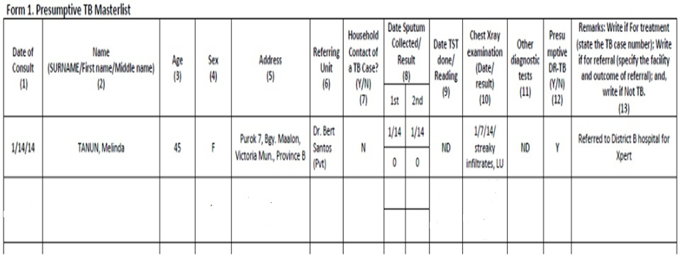

Slide 25
END OF EXERCISE 3.3
(CASE FINDING)

