Slide 1
EXERCISE 4.4: RECORDING FORMS FOR CASE HOLDING
From 1 case in exercise 3 (Recording Forms for Case Finding), accomplish Forms 4, 5 and 6a based on the following additional information. (For this exercise, you may use the same drug-susceptible TB register.)

Slide 2
Melinda G. Tanun
45 year old female; chest X-ray findings of PTB (Jan. 7, 2014: streaky infiltrates in left upper lobe)
consulted on January 14, 2014 → DSSM done same day
Specimen #1: 0 (salivary)
Specimen #2: 0 (salivary)
Treatment after Lost to follow up
lives in Purok 7, Bgy. Maalon, Victoria Municipality, Province B, in Region 1
Melinda was able to undergo Xpert testing at District Hospital B with result: MTB detected, Rifampicin resistance not detected (January 23). She returned to Victoria RHU on January 27 and was initiated on Category 2 treatment.

Slide 3
The following were additional information obtained from Melinda:
Born March 23, 1968.
Housewife, married to Marvin D. Tanun; lives with husband and 3 children: Mervin 20/M, Melba 15/F and Micah 12/M. Her daughter-in-law Sarah (21/F) and grandchild Dennis (2/M) also moved into their house 3 months ago.
A dependent of her husband whose Philhealth number is 19-000676363-2.
Her cellphone number is 0928-1234567. Her husband’s number is 0928-8901234.
Weighed 37 kg, height = 1.57 meters and did not have a BCG scar.
Was the 4th patient to be registered for the year (facility code of Victoria was 102).

Slide 4
She was able to take her medicines regularly for the next two weeks with you as treatment partner. After two weeks, on Feb 10, she agreed to HIV testing after being given PICT.
She brought her grandchild Dennis for evaluation on February 12. The other household members did not visit the RHU, but upon home visit by the BHW was found to have no symptoms.
Melinda was a perfect patient and did not miss any dose. She reported her cough resolved on her 2nd month visit. Her DSSM results during treatment were as follows:
April 15 – 0 her weight then was 39kg
June 11 – 0 wt = 40kg
Sep 2 – 0 wt =40kg
On September 7, she took her last dose of medicine.

Slide 6
Format for assigning TB case number
-- --- --- (last two digits of the year enrolled, followed by 3-digit Facility Code, followed by 3-digit patient number)
Melinda was the 4th patient to be registered for the year 2014 (facility code of Victoria was 102)
Melinda’s TB Case number: 14 102 004
Remember that Patient’s surname should be in CAPITAL letters

Slide 7
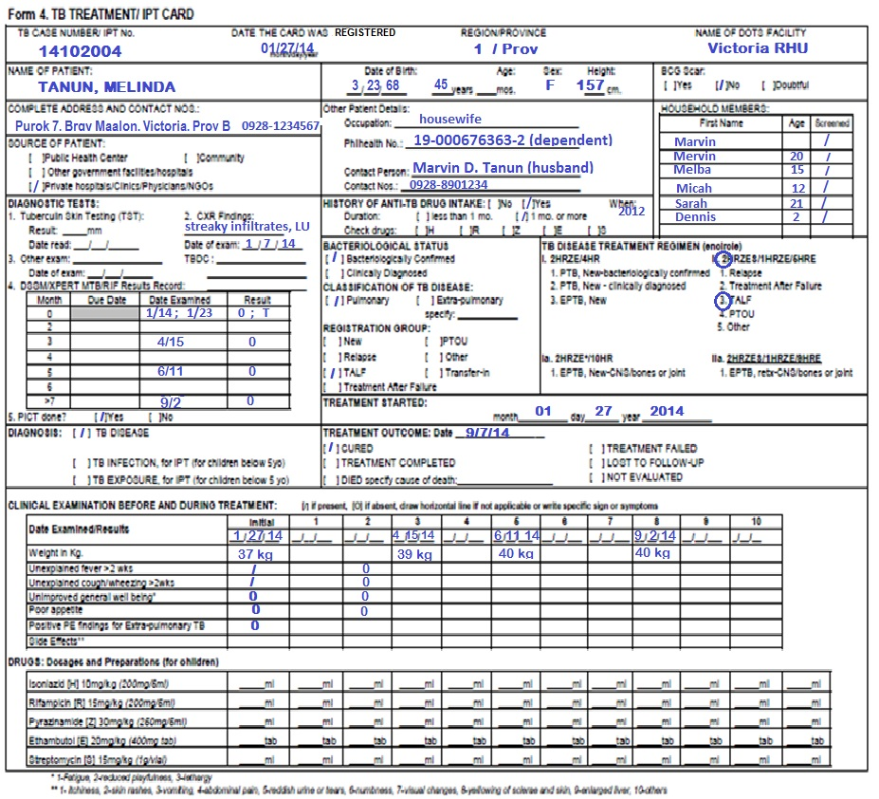

Slide 8
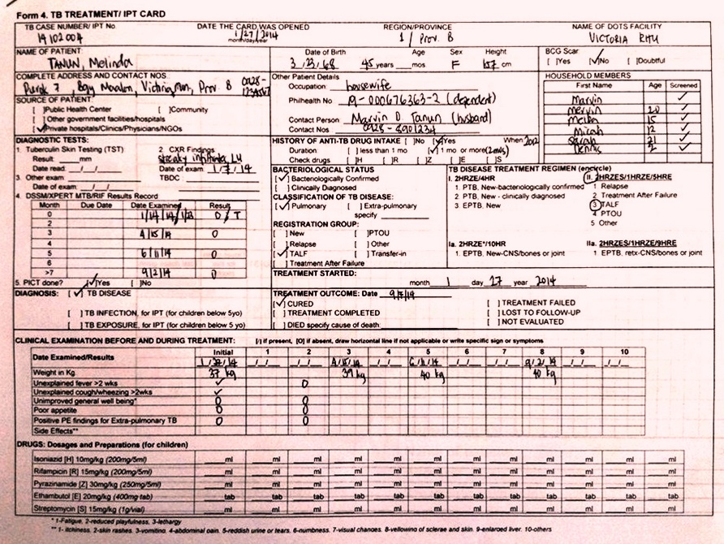

Slide 10
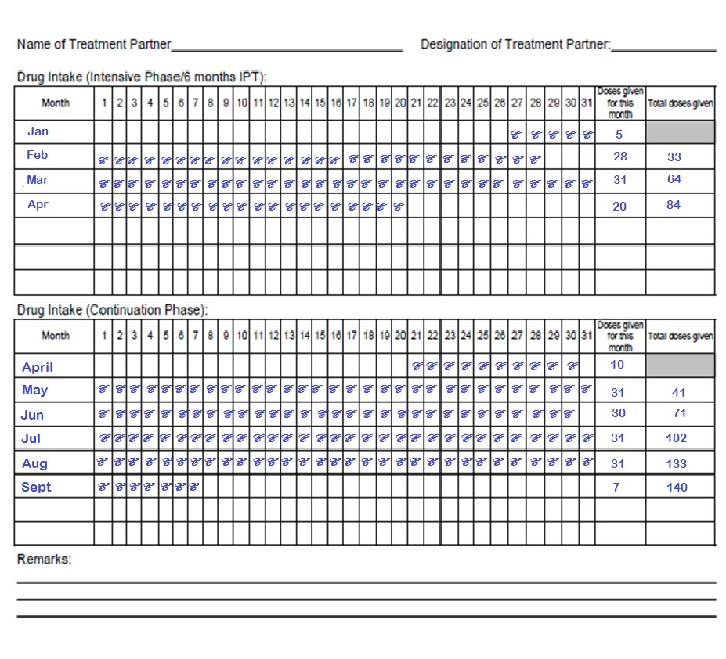

Slide 11
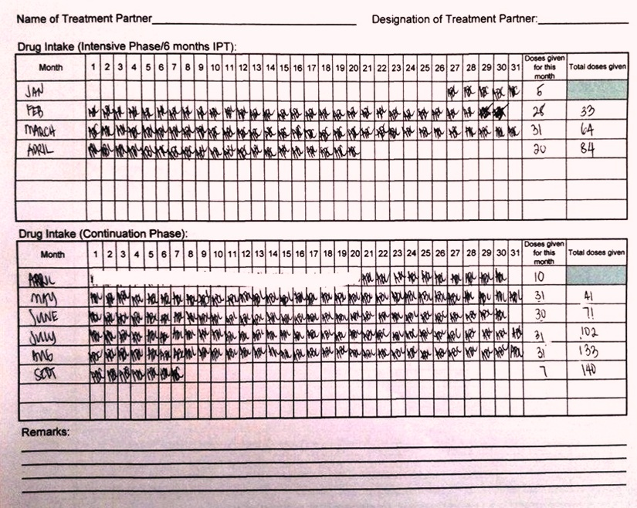

Slide 13
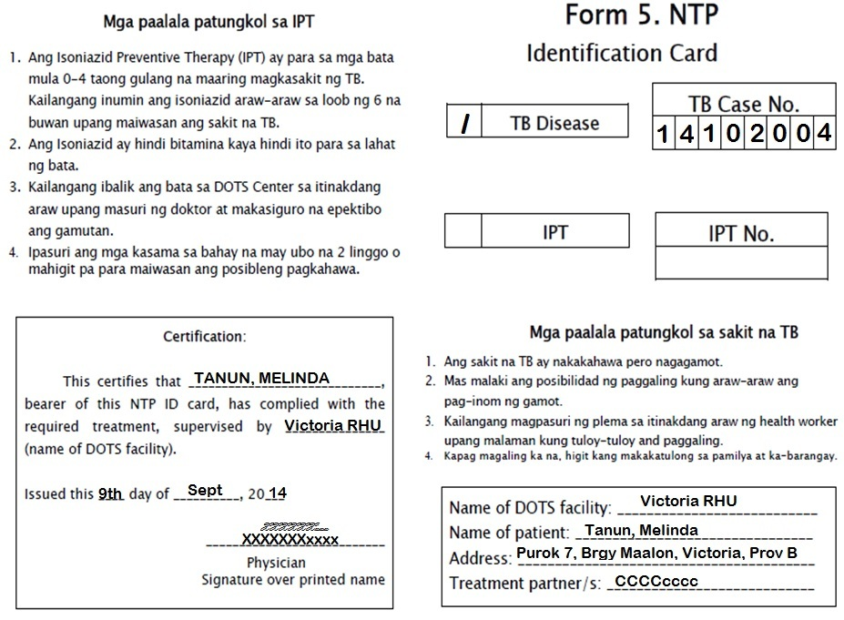

Slide 15
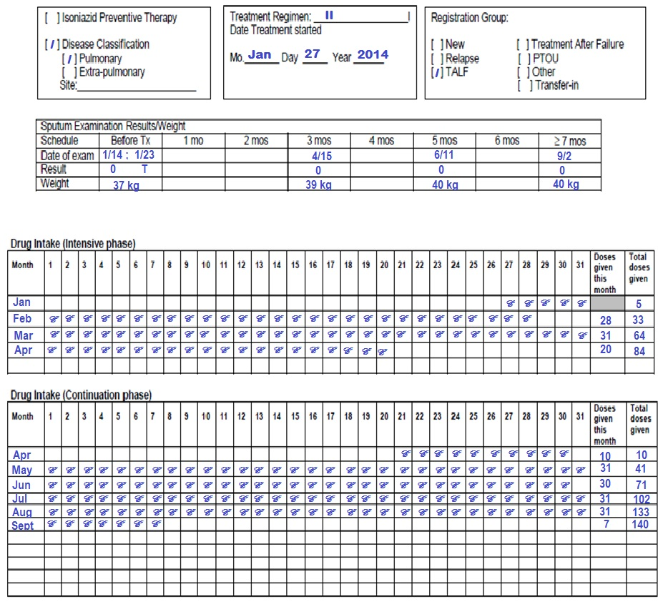

Slide 16
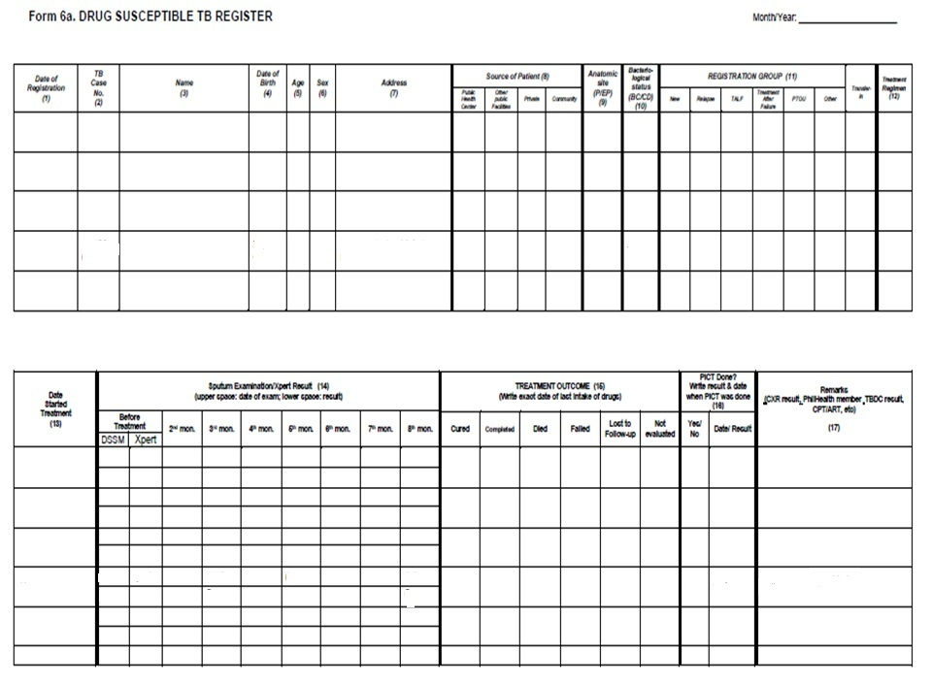

Slide 18
Melinda was the 4th patient to be registered for the year 2014 (facility code of Victoria was 102)

Slide 19

END OF EXERCISE 4.4
(CASE HOLDING)

