Slide 1
EXERCISE 5.2: RECORDING FOR IPT
For Case #1 in Exercise 8, accomplish Form 4. NTP Treatment/IPT Card and register in Form 9. IPT Register

Slide 2
Nesrin Gose, 4 years old, is the daughter of a bacteriologically confirmed TB case. She has no signs or symptoms and her TST was 3mm (March 12, 2014). She started IPT on March 15, 2014.
She resides in Lot 4, Block 7 Malunggay St. Barangay Uno Dos, City G, in Region 3.
Home phone number is 354-6872.
She was born January 27, 2010.
She lives with her parents: Mico (27/M) and Julia (24/F).
Mico is employed with Philhealth number 13-000778365-1. Nesrin is his dependent.
Nesrin weighed 14 kg and she had a BCG scar.

Slide 3
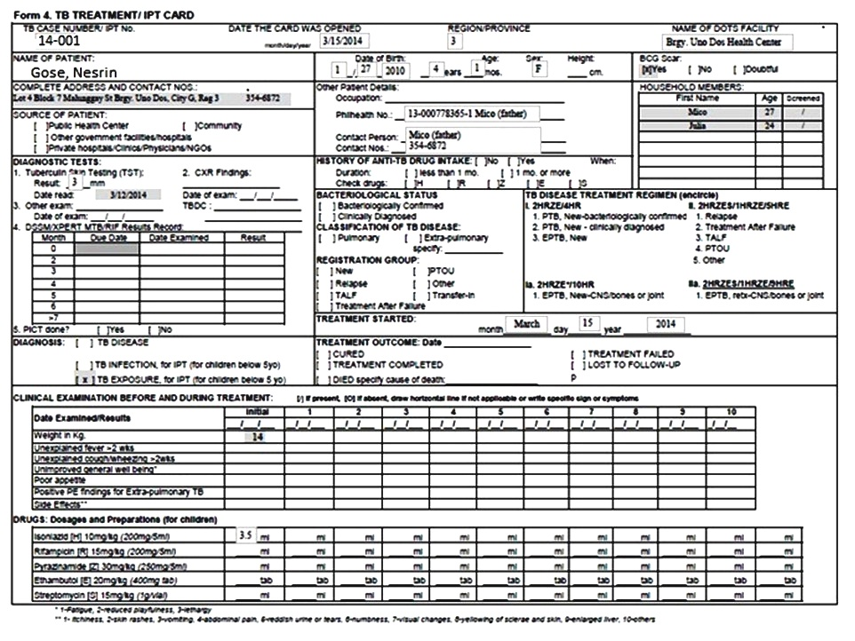

Slide 4
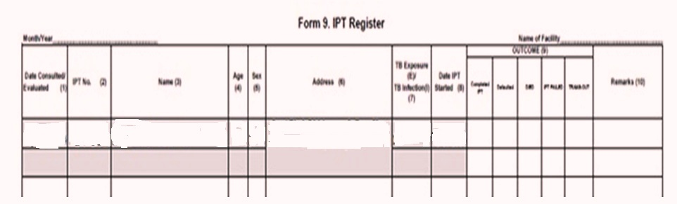

Slide 5
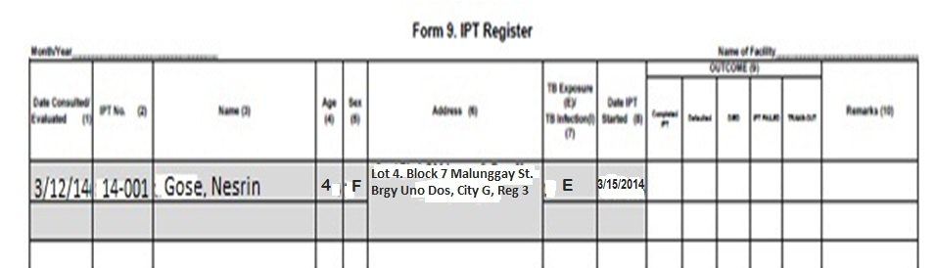

Slide 6

END OF EXERCISES
for TB PREVENTION

