Slide 1



5th edition
NTP MANUAL OF
PROCEDURES
Prevention of TB

Slide 2
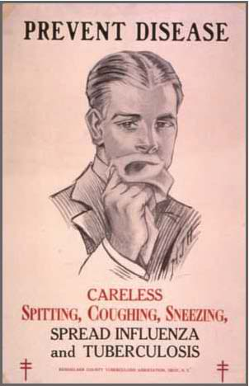
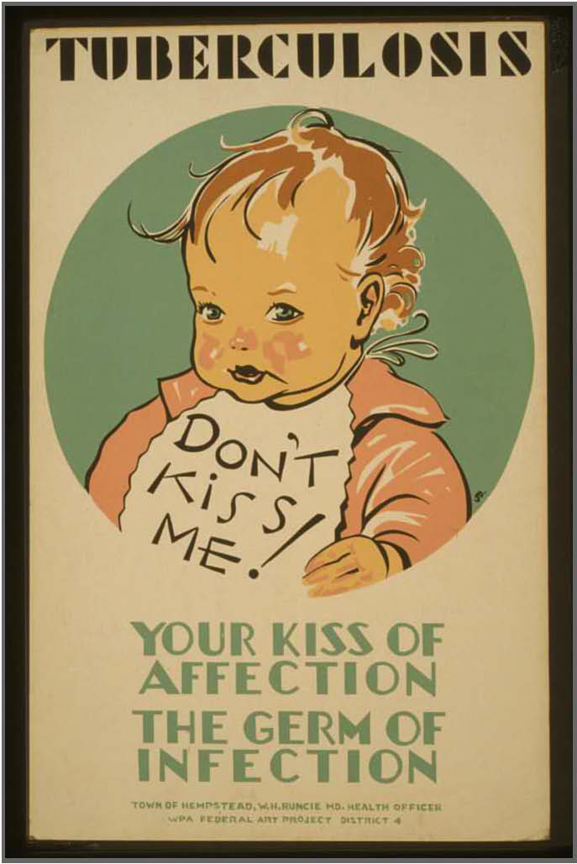
Prevention of TB
To effectively implement TB preventive measures in DOTS facilities, congregate settings (jails/prisons, residential institutions), workplaces, and households
To prevent exposure and infection
For vulnerable populations who are already exposed or infected, the aim is preventing progression to TB disease
  Young children (i.e., 0−4 years old)
  People living with HIV (PLHIV)
Notes:
There is a need to prevent TB transmission in high-risk settings and among vulnerable populations – particularly among the very young and those immunocompromised because of HIV/AIDS.
If possible, prevent exposure. No exposure, no infection…no infection, no disease.
Key to TB prevention is compliance to a good infection control plan, universal BCG vaccinations among newborns to protect the very young against serious forms of TB, and the use of IPT to prevent progression of the infection to a disease state.

Slide 3
Prevention of TB
Achieved through
  TB infection control
  Universal BCG vaccination discussed under EPI
  Isoniazid preventive therapy (IPT)
Notes:
There is a need to prevent TB transmission in high-risk settings and among vulnerable populations – particularly among the very young and those immunocompromised because of HIV/AIDS.
If possible, prevent exposure. No exposure, no infection…no infection, no disease.
Key to TB prevention is compliance to a good infection control plan, universal BCG vaccinations among newborns to protect the very young against serious forms of TB, and the use of IPT to prevent progression of the infection to a disease state.

Slide 4

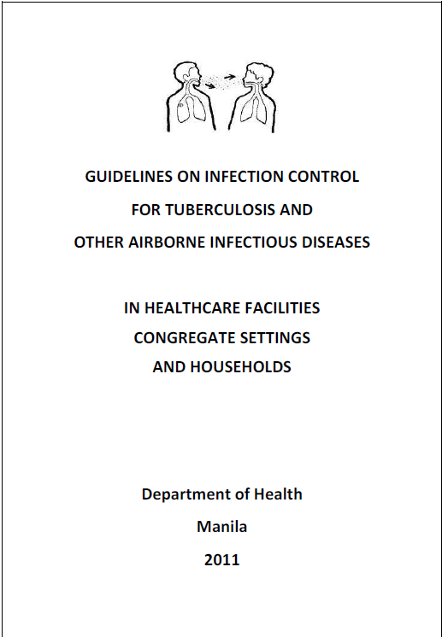
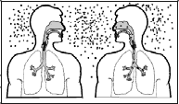
Definition of Terms
TB infection control (TB IC) − refers to specific measures and work practices that reduce the likelihood of spreading the TB bacteria to others
Administrative control − are measures that will reduce risk of TB transmission by preventing the generation of droplet nuclei or reducing exposure to droplet nuclei. This type of control has the greatest impact on preventing the spread of TB
Environmental control − are measures that will reduce the concentration of infectious droplet in the air especially in areas where contamination of air is likely
Notes:
The country in 2011 came up with its own IC guidelines for TB and other airborne diseases. It contains specific measures and recommended work practices to reduce the likelihood of spreading the TB bacteria.
There are several tiers of infection control with specific goals per level.
From a health worker’s standpoint, environmental control is the most important or the one with the greatest impact as it prevents the generation of the droplet nuclei and exposure to it. This includes the early treatment of an infectious case with an appropriate and adequate regimen (to be discussed further in succeeding slides).
Environmental control refers to measures that will reduce the concentration of infectious air droplets by improving the quality of air through proper ventilation, including the use of mechanical ventilation and possibly even engineering interventions.

Slide 5
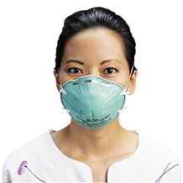
Definition of Terms
Respiratory protection controls − are measures that involve selection and proper use of respirators to protect one from inhaling droplet nuclei
  Respirator − is a special type of closely-fitted mask with the capacity to filter particles to protect users from inhaling infectious droplet nuclei
Managerial activities − are essential separate set of measures to facilitate the smooth implementation of the three components of TB IC: administrative, environmental and respiratory protection controls
Assess
Plan
Implement
Evaluate
Notes:
Respiratory protection controls involves the use of personal protective equipment (PPE), respirators in particular that protect users from inhaling infectious agents.
Managerial activities facilitate the implementation of these 3 components of infection control. A good manager is able to assess the situation, provide an appropriate and good plan, implement it accordingly, and then evaluate its effectivity in meeting its objectives.

Slide 6

Policies
All DOTS facilities and TB laboratories should implement TB IC interventions, following, in order of hierarchy, administrative, environmental and respiratory controls.
Managerial activities shall ensure that the above interventions are implemented.
Notes:
The implementation of infection control measures in all DOTS/PMDT centers and laboratories is part of the PhilPACT performance indicators (7.3).
Only those in areas where the risk of disease transmission is significant (e.g., PMDT treatment center) are recommended to use N95 or FFP2 masks.
Fit testing to be done annually to review healthworkers on the proper use of respirator masks or every time a new type of respirator type is introduced (e.g., the duckbill type of N95 mask )

Slide 7
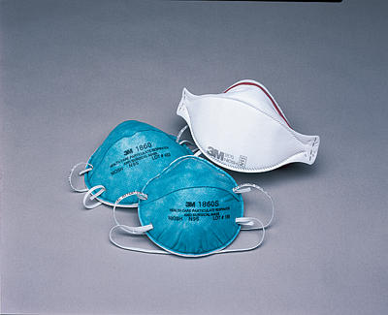
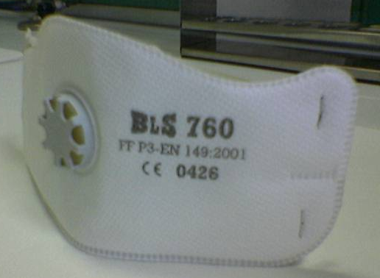
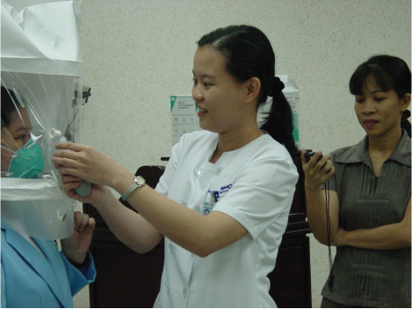
Policies
Use of respirators shall be limited to identified high-risk areas.
  Only respirators that meet international standards (e.g., NIOSH-certified N95 or CE-certified FFP2) shall be used.
  Proper training and “fit test” shall be undertaken for identified health care workers who will use respirators.
  Fit testing shall be done every year if the same respirator type will be used or every time before a new respirator type will be distributed.
Notes:
The implementation of infection control measures in all DOTS/PMDT centers and laboratories is part of the PhilPACT performance indicators (7.3).
Only those in areas where the risk of disease transmission is significant (e.g., PMDT treatment center) are recommended to use N95 or FFP2 masks.
Fit testing to be done annually to review health workers on the proper use of respirator masks or every time a new type of respirator type is introduced (e.g., the duckbill type of N95 mask )

Slide 8
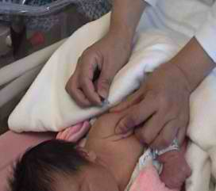

Policies
DOTS facility staff shall ensure that TB patients are informed about TB IC measures for their households, workplace and community.
All infants should be given a single dose of BCG except those who are known to be HIV positive, those whose HIV status is unknown but who are born to HIV-positive mothers, and those whose symptoms are suggestive of HIV.
IPT for six months shall be given to all eligible child household contacts and PLHIV once TB disease has been ruled out.
Notes:
Health workers should advise patients and their family members on proper IC measures to be observed at various settings.
BCG vaccination is not to be given to newborns suspected or documented to have HIV and those with unknown HIV status from known HIV+ mothers.
IPT for 6 months shall be given to eligible child (<5 years old) household contacts and HIV+ cases (>15 ears old) with no TB disease but assumed to have LTBI.

Slide 9
Policies
In the absence of PPD solution, symptomatic screening could be used alone to screen household contacts and identify children who will benefit from Isoniazid Preventive Therapy.
  The unavailability of PPD shall not deter the provision of IPT to 0−4 year old children who are household contacts of bacteriologically confirmed index cases.
IPT should NOT BE GIVEN to child contacts of drug-resistant TB.
Notes:
IPT is to provided to 0-4 year old children exposed to bacteriologically confirmed cases, whether TST +/-/not done, except if contact of known DRTB cases.

Slide 10
TB infection control in DOTS facilities
Managerial activities will ensure the smooth and effective implementation of the administrative, environmental and respiratory protection control measures.
    Developing a facility TB IC plan
    Organizing the infection control committee or team that will be responsible for the implementation of the TB IC plan
    Performing risk assessment of health care facilities
Assess
Plan
Implement
Evaluate
Notes:
Aside from institutionalizing a localized IC plan consistent with the national IC guidelines, managerial activities include the organization of the IC committee that will oversee its implementation. As previously mentioned, there is a need to perform a risk assessment that will guide the revised floor plan and possible renovations for optimal implementation of controls.
The assessment should also include surveillance for TB disease among health workers and possible use of periodic TST to check for ongoing transmission within the health facility. If TST-negative, an annual TST would be an appropriate means of checking for TB transmission among health workers. Re-emphasize that a positive TST in an adult should not be a basis for TB treatment and merely used as an indicator of TB infection. Once TST positive, however, CXR to check for progression to a disease state would now be the more appropriate method of monitoring for TB among health workers.
Monitoring and evaluation completes the management cycle that ensures proper implementation that addresses gaps identified in the assessment.

Slide 11
TB infection control in DOTS facilities
Managerial activities (cont’d)
  Rethinking the use of available spaces and considering renovation of existing facilities or construction of new ones to optimize implementation of controls
  Conducting on-site surveillance of TB disease among health care workers and assessing the facility
  Monitoring and evaluating the set of TB IC measures
Assess
Plan
Implement
Evaluate
Notes:
Aside from institutionalizing a localized IC plan consistent with the national IC guidelines, managerial activities include the organization of the IC committee that will oversee its implementation. As previously mentioned, there is a need to perform a risk assessment that will guide the revised floor plan and possible renovations for optimal implementation of controls.
The assessment should also include surveillance for TB disease among health workers and possible use of periodic TST to check for ongoing transmission within the health facility. If TST-negative, an annual TST would be an appropriate means of checking for TB transmission among health workers. Re-emphasize that a positive TST in an adult should not be a basis for TB treatment and merely used as an indicator of TB infection. Once TST positive, however, CXR to check for progression to a disease state would now be the more appropriate method of monitoring for TB among health workers.
Monitoring and evaluation completes the management cycle that ensures proper implementation that addresses gaps identified in the assessment.

Slide 12
TB infection control in DOTS facilities
Administrative controls are the first line of defense and the most important level in the hierarchy of TB IC. It is the first priority regardless of available resources.
I dentify people with TB symptoms (triage)
S eparate infectious cases
T ime is minimized in health care facilities (also ensure effective Treatment)
C ough etiquette
Notes:
As the first line of defense, administrative control involves triage, isolation, fast response and turnaround time in treating and addressing concerns of infectious cases, and promotion of cough manners among symptomatics.
Emphasize the meaning of ISTC from the IC standpoint.

Slide 13
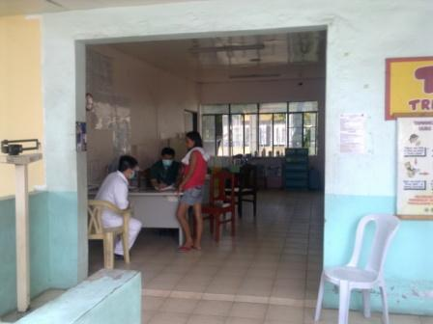
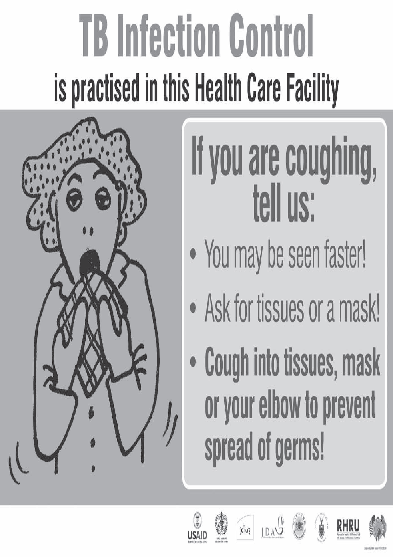
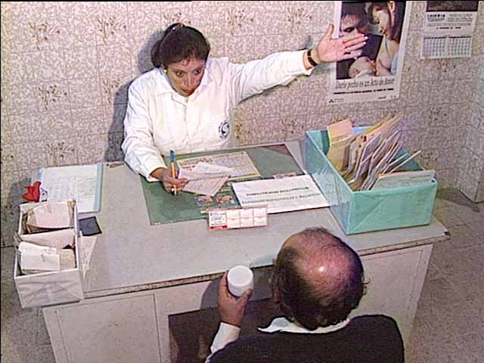
TB infection control in DOTS facilities
Administrative controls
  Promptly identifying people with TB symptoms (triage)
    Placing notices that one must immediately inform staff about cough lasting for 2 weeks or more
    Assigning staff to screen persons with cough and to collect sputum
Notes:
Symptomatic patients must be identified and addressed immediately to minimize to chance of disease transmission.
Appropriate IEC materials should be used to guide/instruct such patients.

Slide 14
TB infection control in DOTS facilities
Administrative controls
  Separating or isolating infectious patients
    Designating waiting areas for presumptive TB or TB patients
    Informing patients, staff and visitors by placing visible signages on restricted areas
Notes:
Symptomatic and known infectious patients must be segregated from others in the facility.
Appropriate IEC materials should be used to guide/instruct such patients.

Slide 15
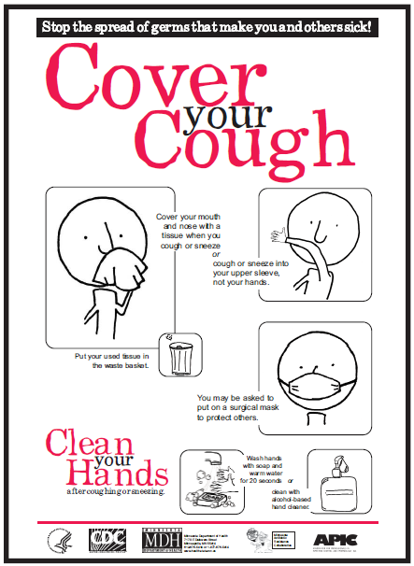
TB infection control in DOTS facilities
Administrative controls
  Controlling the spread of pathogens
    Placing signs and posters about cough etiquette
    Providing tissue paper, disposable surgical masks or ordinary cloth face masks to coughing patients and infectious TB patients.
    Providing daily health education on cough etiquette
Notes:
Promote cough etiquette and provide needed surgical masks or tissue paper to minimize the infected droplet nuclei from circulating.

Slide 16
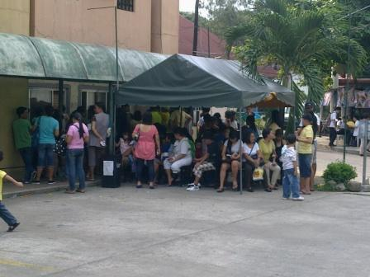
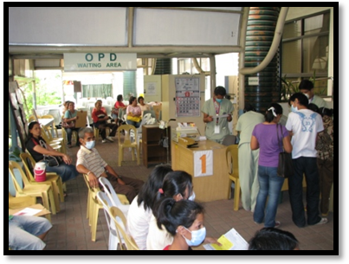
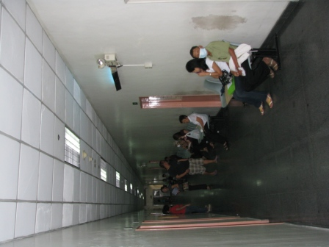
TB infection control in DOTS facilities
Administrative controls
  Minimizing the time spent by patients in a health care facility
    Managing patient flow by moving presumptive TB to the front of the waiting queue
    Minimize time spent receiving services by giving patients specific time slots or additional staff during busy days/hours
Notes:
Prioritize symptomatic and known infectious cases to minimize their indwelling time within the health facility.
Be systematic. Organize the traffic of patients and visitors within the health facility. Assign specific time slots for pediatric cases, who are not likely to be infectious; and adult cases, especially those who are symptomatic and likely to be infectious.

Slide 17
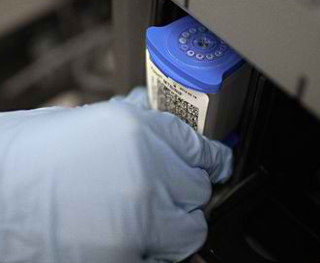

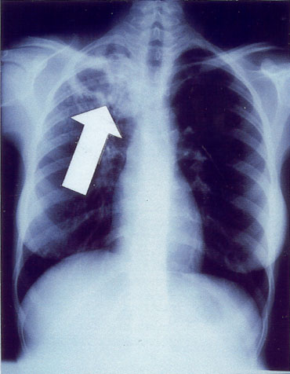
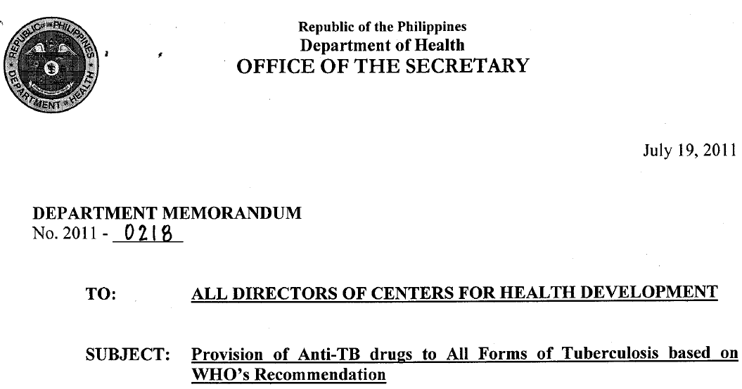
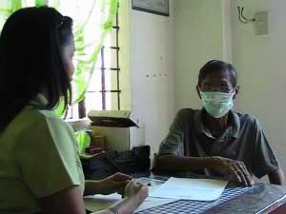
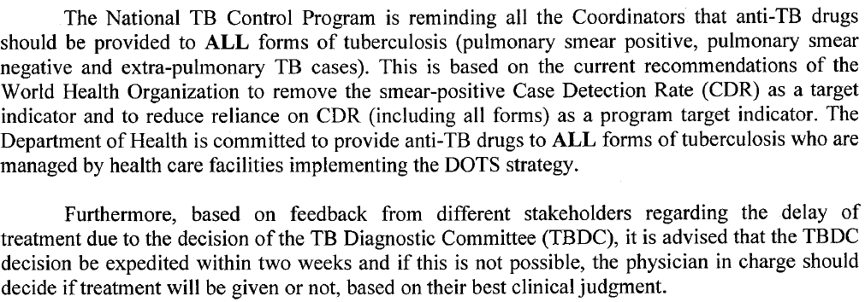
TB infection control in DOTS facilities
Administrative controls
  Reducing diagnostic delays
    Use of rapid diagnostic tests when available
    Reducing turnaround time for DSSM other diagnostic tests
  Early initiation of treatment for TB patients
Notes:
By reducing the turnaround time for DSSM and other diagnostic tests, a patient may be offered treatment earlier and thereby attain non-infectiousness earlier. Remember, it takes only 2-3 days of a multidrug regimen containing INH, acting on fast-growing extracellular bacilli (Period I of TB Treatment) to reduce the pre-treatment bacilli load by 90% and an average of 2-3 weeks, primarily because of the action of RIF, aided by PZA in acidic media, acting on slower-growing extracellular bacilli (Period II of TB Treatment) for the bacilli load to be reduced by 99% from its pre-treatment level.
Emphasize that a DOH department memo requires that a DOTS physician decide on the presence (or absence) of disease activity within 2 weeks. This might require the doctor to view and use the chest x-ray as additional basis for his clinical judgement.

Slide 18
TB infection control in DOTS facilities
Administrative controls
  Providing a package of prevention, treatment and care interventions for staff
    CXR as part of annual physical examination
    HIV prevention
    Anti-retroviral treatment and IPT for HIV positive staff
Notes:
Part of administrative control involves the prevention and treatment of TB among health workers.
As previously mentioned, periodic TST may be employed to check for ongoing transmission within the health facility. If TST-negative, an annual TST would be an appropriate means of checking for TB transmission among health workers. Re-emphasize that a positive TST in an adult should not be a basis for TB treatment and merely used as an indicator of TB infection. Once TST positive, however, CXR to check for progression to a disease state would now be the more appropriate method of monitoring for TB among health workers.
Universal precautions, which includes appropriate measures for HIV prevention, should be observed at all times. HIV+ health workers without TB disease should be offered ARTs and IPT. There should be non-discrimination inasmuch as there is unlikely exchange of body fluids in dealing with patients. Strict compliance with proper IC measures should be observed.

Slide 19
TB infection control in DOTS facilities
Environmental control includes technologies for the removal or inactivation of airborne infectious droplet nuclei.
  It is considered the second line of defense for preventing the spread of TB and, in combination with the right administrative controls, will reduce the risk of infection.
  Cost-effective environmental control measures that could be used at the DOTS facilities are natural ventilation and mixed-mode mechanical ventilation (i.e., use of fans together with natural ventilation).
  Ensure that fans are clean and working properly.
Notes:
Environmental control is the second line of defense as it promotes improved quality of air in health facilities, together with appropriate administrative controls, to reduce the risk of infection.
Environmental controls need not be expensive and resource-intensive. It can be achieved even with natural ventilation or in combination with mechanical ventilation.

Slide 20
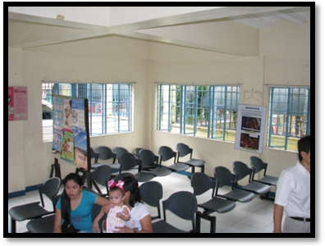
TB infection control in DOTS facilities
Environmental control
  Open windows and doors to improve natural ventilation.
  Evaluate and document direction of airflow daily in high-risk areas within the DOTS facility. Use smoke test (incense sticks or mosquito coil) to visualize air movement.
Notes:
It might just involve opening windows and removing obstructions to airflow within a health facility.
Use a burning incense stick or mosquito coil to demonstrate and visualize air movement.

Slide 21
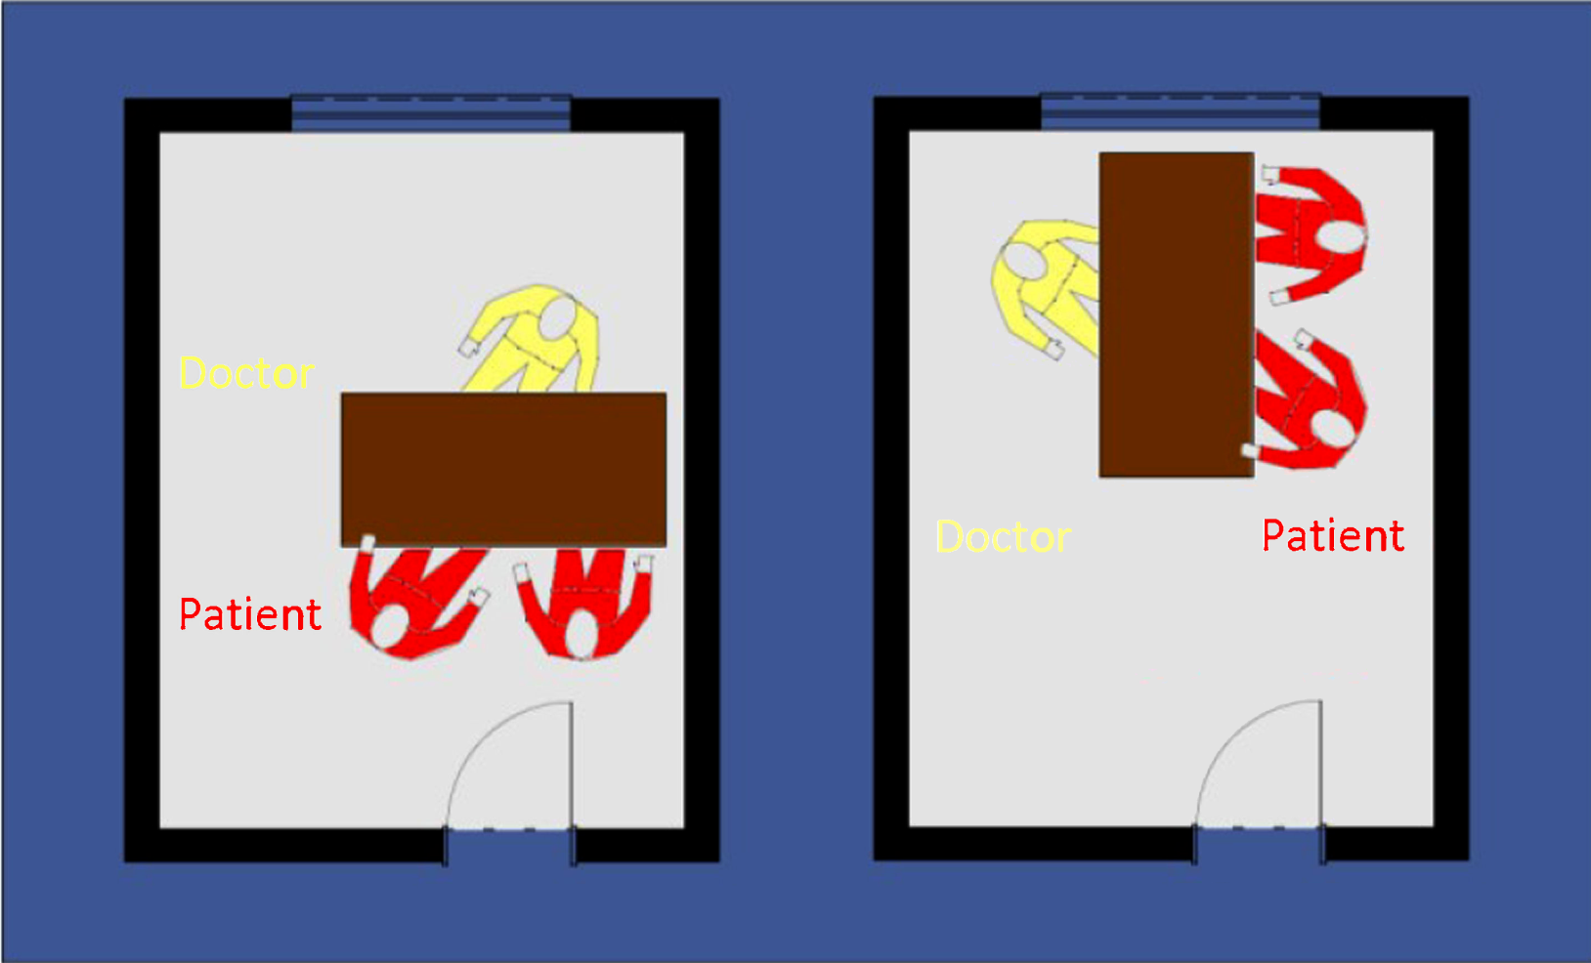
TB infection control in DOTS facilities
Environmental control
  Place or re-arrange furniture and seating such that staff-patient interaction occurs with airflow passing from health worker to patient or between health worker and patient, rather than from patient to health worker (i.e., airflow from “clean to dirty”).
  Ensure that fans are clean and working properly.
Notes:
Consider re-arranging room furnishings based on the prevalent direction of airflow within the room to achieve the ideal set-up.

Slide 22
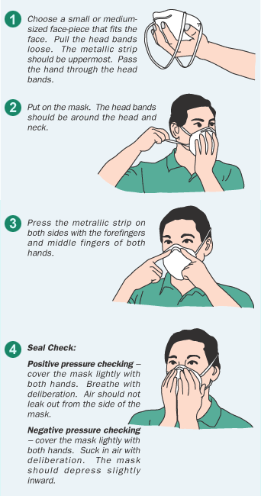
TB infection control in DOTS facilities
Respiratory protection control is considered the last line of defense.
  Based on the risk-assessment, identify who will wear respirators, where and when respirators will be used.
  Perform fit test.
  Train staff on how to wear, care for, maintain and dispose of the respirator.
Notes:
Proper use of respirator masks in high-risk areas will significantly reduce TB transmission.
Emphasize the need to pinch the nose clip over the bridge to ensure proper fit. Use both straps to minimize and control movement of the mask across the face.

Slide 23
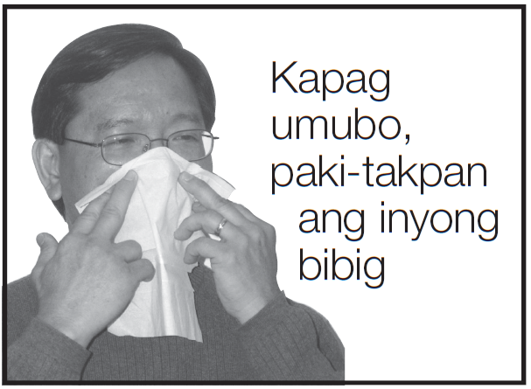
TB infection control in households/congregate settings
Early detection and treatment of TB, and prompt screening of household contacts/inmates
Reduce exposure
  Cough etiquette (i.e., covering mouth and nose when sneezing or coughing)
  Minimizing time spent by infectious TB patients in crowded public places
  Opening windows and removing any obstruction to ventilation in rooms where TB patient sleeps or spends much time
Notes:
The same general principles of infection control should be observed at home and in congregate settings.
Emphasize the need to correct popular beliefs/myths regarding the need to segregate a patient’s dinner ware and utensils.

Slide 24

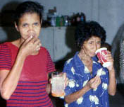
Isoniazid Preventive Therapy
Given for six months to the following:
  Children <5 years old without signs and symptoms of TB and without radiographic findings suggestive of TB, and who are household contacts of:
    a bacteriologically confirmed TB case regardless of TST results
    a clinically diagnosed TB case (if the child has a positive TST result)
  PLHIV with no signs and symptoms of TB regardless of age
Children qualified for IPT could be identified through household contact investigation.
After ruling out any signs and symptoms suggestive of TB, start INH at 10mg/kg.
Notes:
Highlight the indications for IPT as specified.
PLHIV cases are likely to receive their IPT at the treatment hub. But anticipate possible exceptional cases that will require IPT to be arranged at the local health facility. Observe appropriate infection control measures for this high-risk clinical group.

Slide 25
Procedures (Household contacts of drug-susceptible TB)
Asymptomatic household contacts
Age
<5 y/o?
Age >5,
<15 y/o?
Bacteriologically confirmed PTB
Classification of Index Case?
Clinically diagnosed PTB
Tuberculin Skin Test positive?
No
Give Isoniazid Preventive Therapy
Yes
Tuberculin Skin Test positive?
Yes
No
No
With access to CXR and findings are suggestive of TB?
Other lab findings suggestive of TB?
Child to be re-evaluated once with signs or symptoms suggestive of TB
No
Yes
Yes
Clinically diagnosed PTB
COLOR LEGEND
Question
Refer to previous Figure XX (previous algorithm)
Diagnostic Test
Classification
Treatment
Disposition

Slide 26
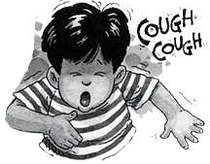
Isoniazid Preventive Therapy
Open Form 4. TB Treatment/IPT Card and register the child in Form 9. IPT Register.
Assess the child at least every 2 months and check for presence of signs or symptoms of TB.
  If the child gains weight during the follow-up visits, adjust dosage of INH accordingly.
If the child develops any signs or symptoms, evaluate for TB according to case-finding procedures.
  If the child is assessed to have TB disease, stop IPT, start treatment for TB disease and declare IPT outcome as failed.
Notes:
Specified forms will be shown in succeeding slides, including highlights of appropriate sections of the forms.
IPT cases are to assessed for clinical signs and symptoms of TB and weight at least every 2 months (so its possible to check even more frequently – e.g., monthly) to monitor treatment response and anticipate possible dose adjustments with increased body weight.
The presence of any TB sign or symptom should lead to disease activity assessment. Once proven to have TB disease, IPT outcome is noted as “treatment failed” and the case is started on Category I TB treatment regimen. Emphasize the prior IPT is not to be considered as previous TB treatment.

Slide 27
Form 4. TB Treatment-IPT Card
Notes:
Point out the pertinent sections of Form 4.

Slide 28
Form 4. TB Treatment-IPT Card
Notes:
Point out the pertinent sections of Form 4. The extra rows for the “intensive phase” are meant to accommodate the 6-months of IPT.

Slide 29
Form 9. IPT Register

Slide 30
Form 9. IPT Register

Slide 31
Isoniazid Preventive Therapy
After six months of IPT, determine the outcome of IPT and record in Form 4 and Form 9
Outcome | Definition
Completed IPT | a child who has completed 6 months of IPT and remains well or asymptomatic during the entire period.
Lost to follow-up IPT | a child who interrupted IPT for 2 consecutive months or more.
Died | a child who dies for any reason during the course of therapy.
IPT (Treatment) Failed | a child who developed TB disease (pulmonary or EPTB) anytime while on IPT
IPT Not Evaluated | a child who has been transferred to another health facility with proper referral slip of continuation of IPT and whose treatment outcome is not known.
Notes:
Note the outcomes for IPT and the revisions to be consistent with nomenclature used for regular TB treatment outcomes: i.e., “Lost to follow-up” to replace “default,” IPT as equivalent for “treatment” for “Treatment failed” and “Not evaluated” to replace “Transferred out.”

Slide 32

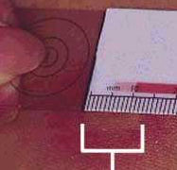
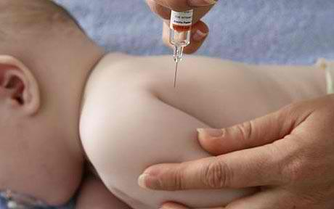
Baby born to mother with TB disease
Assess the newborn. If the newborn is not well, refer them to a specialist/pediatrician.
If the newborn is well (absence of any signs or symptoms presumptive of TB), do not give BCG first. Instead give IPT for three months.
After three months, perform TST.
If TST is negative, stop IPT and give BCG.
If TST is positive and baby remains well, continue IPT for another three months.
After six months of IPT and if the baby remains well, give BCG.
Notes:
IPT is to be given to newborns of mothers with TB and on treatment prior to TST.
Compared to the previous MOP’s recommendation of providing the newborn IPT up to 3 months beyond the mother’s period of infectiousness (which may vary depending on the mother’s treatment phase upon birth date), the new MOP now simplifies the directive by specifying to provide 3 months IPT for all.
If TST-, stop IPT (an exception to the recommended 6 months duration) and give BCG.
If TST+ with no TB disease, IPT will continue up to 6 months then followed by BCG vaccination.

Slide 33
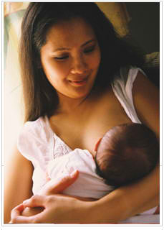
Baby born to mother with TB disease
If TST is not available and the newborn is well, the newborn should receive six months of IPT followed by BCG immunization.
If mother is taking anti-TB drugs, she can safely continue to breastfeed. Mother and baby should stay together and the baby may be breastfed while on IPT.
  Pyridoxine (Vitamin B6) for infants breastfed by mother on INH:
    5 mg in infants from birth to 1 month
    5−10 mg thereafter
Notes:
If TST is not available, complete the recommended 6 months of IPT then give BCG.
Emphasize that mothers need not discontinue TB treatment while breastfeeding and the INH that passes through the breast milk is not equivalent to IPT for the newborn (i.e., INH levels in the breast milk is not enough to protect the child).
Breastfed infants of mothers taking INH and/or given INH themselves should receive low-dose vitamin B6 to prevent INH toxicity.
Vitamin B6 is NOT to be routinely offered to TB patients unless pregnant, breastfed infants of mothers on INH, children less than 4 years old on IPT and those with INH toxicity.

