Slide 1
5th edition NTP MANUAL OF PROCEDURES Reporting

Slide 2
Objectives
The objectives of recording and reporting are to:
document patient and program information that would ensure high-quality patient care, a continuum of care among referred TB cases, and information sharing among health care providers;
provide tools to help staff in providing adequate services to individual patients; and
allow program managers at different levels of the health care system in the NTP to monitor and evaluate program performance in a standardized and internationally comparable manner.
Notes:
Recording has been discussed in previous chapters. This presentation focuses only on reporting.

Slide 3
Policies
Recording and reporting for NTP shall be implemented in all DOTS facilities whether public or private.
Recording and reporting shall include all cases of TB, classified according to internationally accepted case definitions. Quarterly reports should reflect the sex, age, type and source of cases reported from various units in the province/city/municipality.
Recording and reporting for NTP shall use the FHSIS network for routine reporting and feedback.
Notes:
RECORDING
Put not applicable/ not done instead of blank
Red line every quarter
Black ink except for positive results which should be in red
REPORTING
Put zero instead of blanks

Slide 4
Policies
The Integrated TB Information System (ITIS) shall be the official electronic TB information system.
Records and reports shall allow for the calculation of the main indicators for program evaluation.
All quarterly reports should be sent to the DOH through channels (DOTS facility to PHO/CHO to RHO to NCDPC-DOH) based on agreed timeline.
Notes:
RECORDING
Put not applicable/ not done instead of blank
Red line every quarter
Black ink except for positive results which should be in red
REPORTING
Put zero instead of blanks

Slide 5
Procedures
IDO-NTP
NTRL
RHO
PHO
CHO
RHU
HC
PPMD
Hospitals
PPMD
Municipal Hospitals
NGOs
The NTP reporting forms should be accomplished quarterly by all DOTS facilities or TB laboratories and submitted to the next higher level (i.e., Provincial or City Health Office).
All reports should be reviewed and approved by the DOTS facility physician before submission.
The reports will be consolidated and analyzed by the PHOs/CHOs and submitted to the RHOs.

Slide 6
Procedures
IDO-NTP
NTRL
RHO
PHO
CHO
RHU
HC
PPMD
Hospitals
PPMD
Municipal Hospitals
NGOs
The RHOs will, likewise, analyze and consolidate the reports.
The laboratory reports (Reports 1a, 1b and 2a) will be submitted to NTRL while the rest (Reports 3a, 3b, 4, 5a, 5b, 5c and 6) will be submitted to IDO-NTP.

Slide 7
Timeline for submission
RHO
PHO
RHU
CHO
HC
2nd week
1st week
Hospital
PPMD
IDO-NTP
3rd week
Notes:
This is from the MSE chapter

Slide 8
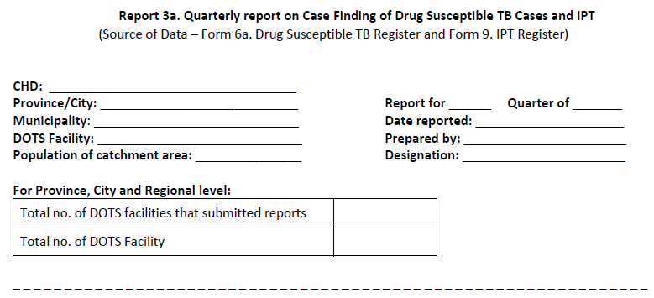
General Parts of the Report
Name of Facility, Municipality, Province/City and Region
Title of the Report
To be used by CHO/PHO and RHO when consolidating reports
Report Cohort, Date Submitted, Prepared by

Slide 9
Report 1a
Title | Quarterly Report on TB Microscopy and GX Laboratory Examinations
Prepared by | Medical technologist or microscopist/ Xpert Operator in the microscopy center and Xpert sites
Submitted to | PHO/CHO -> RHO -> NTRL -> NTP
Frequency | Quarterly
Cohort | Current reportable quarter
Data Source | Form 3a. NTP Laboratory Register (Microscopy and GX)

Slide 10
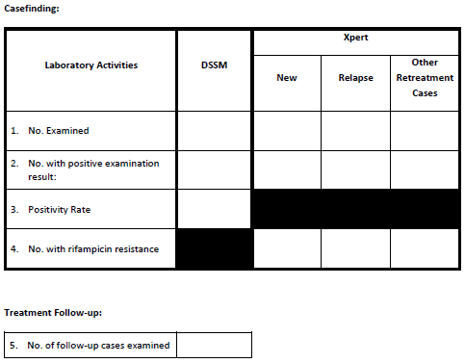
Inspect “reason for examination”; should be “diagnosis”
Inspect test done (DSSM or Xpert)
Inspect “history of treatment”
Inspect “examination result” if DSMM Positive or TBC Positive (MTB Detected)
Positivity rate = #3 / #2
Inspect “reason for examination”; should be “follow-up”

Slide 11
Report 2
Title | Quarterly Report on EQA for TB Microscopy
Prepared by | Validator (medical technologist) at the provincial or city Quality Assurance Center
Submitted to | PHO/CHO -> RHO -> NTRL
Frequency | Quarterly
Cohort | Current reportable quarter
Data Source | EQA reports

Slide 12
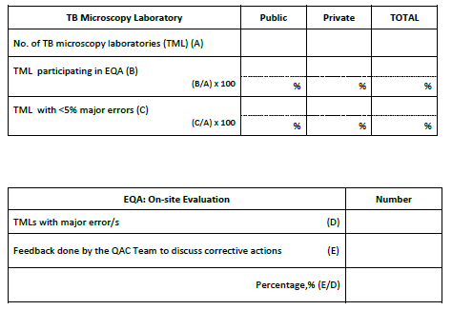

Slide 13
Report 3a
Title | Quarterly Report on Case Finding of Drug-susceptible TB Cases and IPT
Prepared by | Nurse at the DOTS facility
Submitted to | PHO/CHO -> RHO -> IDO-NTP
Frequency | Quarterly
Cohort | Current reportable quarter
Data Source | Form 6a. Drug-susceptible TB Register Form 9. IPT Register

Slide 14
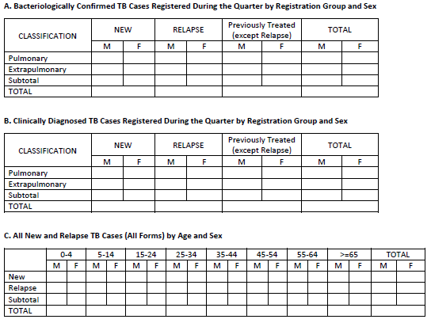
Inspect “bacteriologic status” if “BC”
Inspect “registration group”
Inspect “sex”
Inspect “anatomical site”
Inspect “bacteriologic status” if “CD”
New and Relapse of BC and CD; Subtotal of A + B should equal C
Inspect age

Slide 15
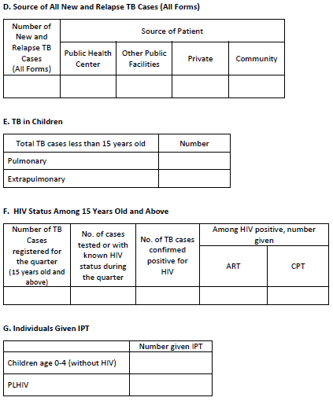
Subtotal in A & B should match with D
Patients in E have been reported in A & B
Regardless of Classification & Reg Group
Only for patients 15 y/o and above
Check “age”

Slide 16
Report 3b
Title | Quarterly Report on DR-TB Cases
Prepared by | Nurse in DOTS facilities providing PMDT services
Submitted to | PHO/CHO -> RHO -> IDO-NTP
Frequency | Quarterly
Cohort | Current reportable quarter
Data Source | Form 6b. DR-TB Register

Slide 17
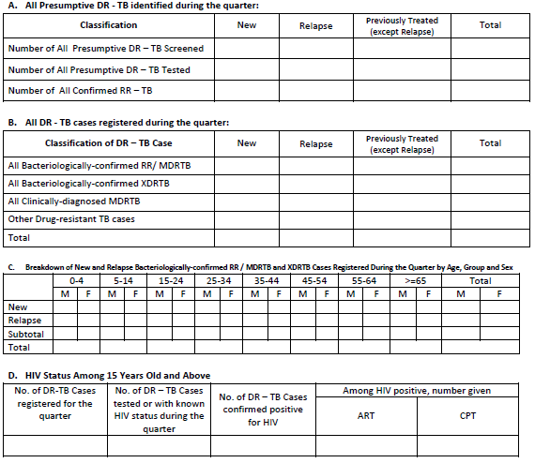
From Form 1. Presumptive TB Masterlist
From Form 6b.
Inspect “bacteriologic status at start of treatment” and “registration group”
BC cases only
Among all registered patients

Slide 18
Report 4
Title | Quarterly Report on Drug and Supply Inventory and Requirement
Prepared by | − Designated health worker (nurse or midwife) in the DOTS facility − At the provincial, city and RHO level, NTP nurse in coordination with the supply officer
Submitted to | PHO/CHO -> RHO -> IDO-NTP
Frequency | Quarterly
Cohort | Current reportable quarter
Data Source | Report 3a. Quarterly Report on Case Finding of Drug- susceptible TB and IPT for data on the number of TB cases treated and given IPT Report 1a. Quarterly Report on TB Microscopy and GX Laboratory Examinations for data on the number of patients undergoing laboratory examinations ─ stock cards ─ inventory reports

Slide 19
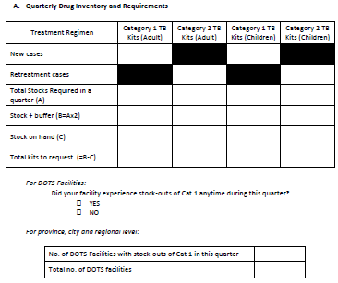

Slide 20
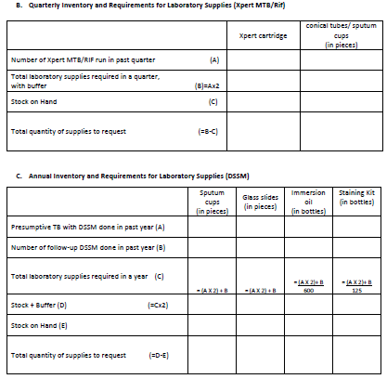

Slide 21
Report 5a
Title | Quarterly Report on Treatment Outcome of Drug-susceptible TB Cases
Prepared by | Nurse in the DOTS facility
Submitted to | PHO/CHO -> RHO -> IDO-NTP
Frequency | Quarterly
Cohort | One year ago of current reportable quarter
Data Source | Form 6a. Drug-susceptible TB Register
Reporting Period | Cohort of Patients to be Reported
1st quarter of current year (e.g, April 2013) | 1st quarter of previous year (e.g., Jan-Mar 2012)
2nd quarter of current year (e.g, July 2013) | 2nd quarter of previous year (e.g., Apr-Jun 2012)
3rd quarter of current year (e.g, October 2013) | 3rd quarter of previous year (e.g., July-Sep 2012)
4th quarter of current year (e.g, Jan 2014) | 4th quarter of previous year (e.g., Oct-Dec 2012)

Slide 22
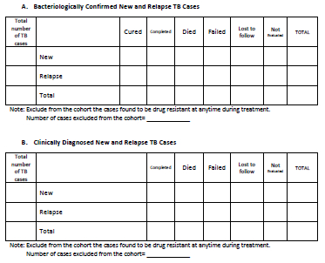
Total registered should equal total evaluated unless excluded
Total can be compared to that in previous Report 3A of same cohort
Patients who turned out DRTB are excluded from the cohort

Slide 23
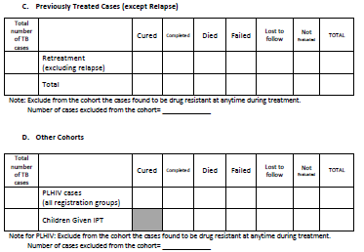
Patient may already be reported in A, B or C

Slide 24
Report 5b
Title | Quarterly Report on Treatment Interim Outcome of DR-TB Cases
Prepared by | Nurse in DOTS facilities with PMDT services
Submitted to | PHO/CHO -> RHO -> IDO-NTP
Frequency | Quarterly
Cohort | 4 quarters ago
Data Source | Form 6b. DR TB Register
Reporting Period | Cohort of Patients to be Reported
1st quarter of current year (e.g., April 2013) | 2nd quarter of previous year (e.g., Apr-Jun 2012)
2nd quarter of current year (e.g., July 2013) | 3nd quarter of previous year (e.g., July-Sept 2012)
3rd quarter of current year (e.g., October 2013) | 4rd quarter of previous year (e.g., October-December 2012)
4th quarter of current year (e.g, January 2014) | 1th quarter of previous year (e.g., Jan-Mar 2013)

Slide 25
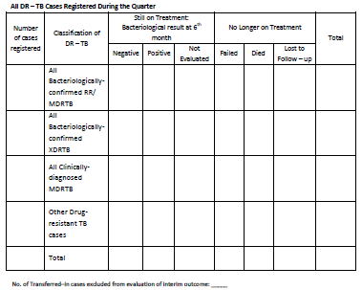

Slide 26
Report 5c
Title | Annual Report on the Treatment Outcome of DR-TB Cases
Prepared by | Nurse in DOTS facilities with PMDT services
Submitted to | PHO/CHO -> RHO -> IDO-NTP
Frequency | Annual
Cohort | 2 and 3 years ago
Data Source | Form 6b. DR-TB Register
Reporting Date | Report 5c to be Submitted
January 2014 | Patients registered in 2010 (36th month) Patients registered in 2011 (24th month)

Slide 27
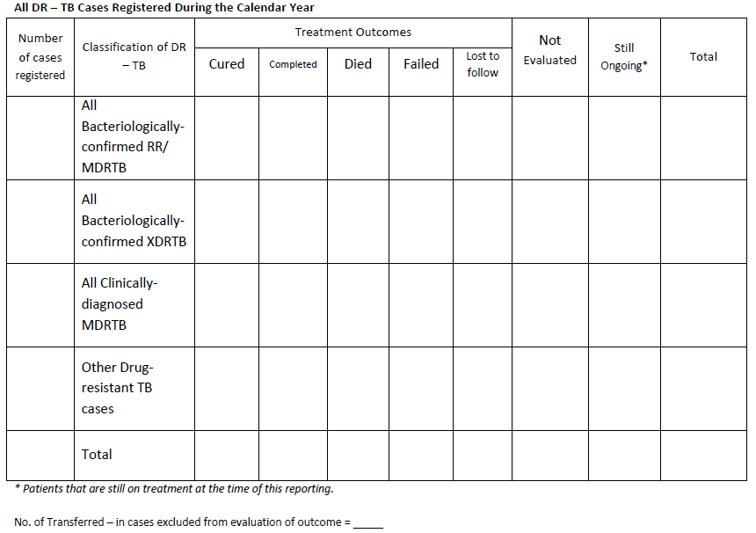

Slide 28
Report 6
Title | Quarterly Report of Hospital TB Referrals
Prepared by | Nurse of the hospital TB team
Submitted to | PHO/CHO -> RHO -> IDO-NTP
Frequency | Quarterly
Cohort | Current reportable quarter and quarter prior to it
Data Source | Form 8. Hospital TB Referral Logbook

Slide 29
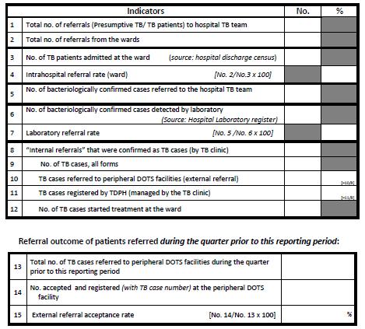
Count patients according to “date received by TB clinic”
From hospital
From lab register
Inspect column 8, “TB”
From Hospital TB Register
From two quarters ago, inspect column 21

Slide 30
Records | Reports
Form 1. Presumptive TB Masterlist Form 2a. NTP Laboratory Request Form Form 2b. NTP Laboratory Result Form for HIV Testing of TB Patients Form 3. NTP Laboratory Register (Microscopy and GX) Form 4. TB Treatment/IPT Card Form 5. NTP ID Card Form 6a. Drug-susceptible TB Register Form 6b. DR-TB Register Form 7. NTP Referral Form Form 8. Hospital TB Referral Logbook Form 9. IPT Register | Report 1a. Quarterly Report on TB Microscopy and GX Laboratory Examinations Report 2. Quarterly Report on EQA for TB Microscopy Report 3a. Quarterly Report on Case Finding of Drug-susceptible TB Cases and IPT Report 3b. Quarterly Report on DR-TB Cases Report 4. Quarterly Report on Drug and Supply Inventory and Requirement Report 5a. Quarterly Report on Treatment Outcome of Drug- susceptible TB Cases Report 5b. Quarterly Report on Treatment Interim Outcome of DR-TB Cases Report 5c. Annual Report on the Treatment Outcome of DR-TB Cases Report 6. Quarterly Report of Hospital TB Referrals
Notes:
New page per quarter
iTIS
Soft vs hard

