Slide 1



5th edition
NTP MANUAL OF
PROCEDURES
Management of TB Drugs and Diagnostic Supplies
Notes:
Introduction to the NTP MOP and its highlights

Slide 2
Contents
Objective
Definition of Terms
Policies
Procedures
  Calculation of medicines and diagnostic supplies
  Receiving medicines and supplies
  Storage
  Maintaining records
  Rational use

Slide 3
Objective
To ensure continuous supply of quality anti-TB drugs and diagnostic supplies at all DOTS facilities nationwide

Slide 4
Introduction
Anti-TB drugs and laboratory/diagnostic supplies are key elements of the National TB Control Program (NTP), an uninterrupted supply of which is necessary for the sustained provision of quality TB diagnostic and treatment services in all DOTS facilities.
An uninterrupted supply of drugs and supplies promotes better patient care, improves the health services’ credibility, and increases the patients’ trust and participation in the program.
This can translate to better treatment success and reduced TB deaths, and contributes to better overall health in the family and community.
TB drugs represent a major out-of-pocket expense for a patient and his/her family. The high cost of medicines for the poor is a major barrier that limits access to treatment and cure.

Slide 5
Product selection
Quantification and procurement
Inventory management, storage, and distribution to the next level
Rational use; monitoring and evaluation
Quality monitoring
Quality monitoring
Management support systems:
Information system
Organization and infrastructure
Human resources
Planning and budgeting
Training and supervision
Monitoring and evaluation
Quality monitoring
Quality monitoring
Policy, legal and regulatory framework
Supply chain management cycle for medicines and diagnostic supplies

Slide 6
Definition of terms
Supply chain management cycle − a systems-based process consisting of product selection, quantification and procurement, inventory management (distribution and storage), and rational use
  Guided by the national policy and legal framework that defines the goals for the management of drugs and diagnostic supplies and supports the continuous availability of these commodities and their appropriate use
  Supported by management systems that include planning, financial management, logistics information management system, organization and infrastructure, human resources, training, monitoring and evaluation, and quality monitoring of the commodities and the logistics process

Slide 7
Definition of terms
Product Selection − the process of establishing a limited list of essential anti-TB drugs to be procured based on the treatment guidelines and national formulary
  Selecting a limited number of essential medicines can help improve the supply of medicines, promote more rational use, and can lower the cost of medicines.
  Essential medicines are those that are considered necessary to meet the health care needs of the majority of the population.
  Selection is based on its relevance to the pattern of prevalent diseases, including recent drug resistance prevalence, proven efficacy and safety, adequate evidence of performance in a variety of settings, adequate quality, favorable cost-benefit ratio, and should be able to pass the national regulatory requirements.

Slide 8
Definition of terms
Quantification − the process of estimating the quantity and cost of the products required to ensure an uninterrupted supply
  Forecasting is the second part of quantification.
  This refers to the estimation (forecasting) of the quantity of each product to be dispensed or used during the year of quantification.
  It uses data related to demography, morbidity, services, and consumption to estimate the forecast.
  Supply planning refers to the development of a document (supply plan) that defines the quantities and costs of the total commodity requirement.
  The supply plan also includes the shipment quantities and delivery schedules. It uses data on product and supplier specifications, distribution and procurement requirements, funding level, and stock status.

Slide 9
Definition of terms
Procurement − the process of acquiring commodities via international, regional, or local sources of supply
  Procurement is a decision-making process that is taken when commodities are purchased. Procurement is based on the procurement plan.
  The procurement plan identifies the procurement requirements based on the forecast, supply plan, desired stock levels, amount in stock or on order, and provides a sound financial justification for the procurement.
  The procurement process ensures that correct products are purchased, made available in the country, and ready for distribution when needed.

Slide 10
Definition of terms
Inventory management (distribution and storage) − the process by which the products procured are received, assessed, and stored until they are distributed to the next level
  Inventory management is the process of overseeing and controlling ordering, storage, and distribution of commodities. The objective is to provide uninterrupted delivery of commodities at the minimum cost.
  Mismanagement of inventories can cause significant financial problems for the health system whether this results in an overstock, understock, or expiry.
  Good storage practices ensure the physical integrity and safety of the products and their packaging in all storage facilities until they are dispensed to patients.

Slide 11
Definition of terms
Inventory management (distribution and storage)
  An important related process is quality assurance; in service facilities, this is best done through visual inspection and looking for damage in packaging (e.g., tears or perforations), or in the commodity itself (e.g., crumbling tablets).
  Distribution is the movement of commodities from the central stores through a network of facilities where commodities are stored and distributed down to the service delivery points (e.g., DOTS facilities) using a variety of transportation methods.

Slide 12
Definition of terms
Rational use of medicines and diagnostic supplies − refers to the appropriate, safe, and effective use of TB drugs and diagnostic supplies based on program guidelines
  This also includes ensuring that the indications for drug use are present, and the contraindications are absent, especially absolute contraindications.
  Rational use involves appropriate case-finding and case- holding procedures based on NTP guidelines, including the management of adverse drug reactions.

Slide 13
Definition of terms
Quality monitoring − refers to the continuous monitoring of the quality of the commodities and the logistics process for suitability, effectiveness, and efficiency
  The performance of all levels of the system should be monitored and periodically evaluated for continuous improvement of performance.
  Information can be provided by the Logistics Management Information System (LMIS).
  LMIS provides data at each stage of the supply chain that managers can analyse and use to make decisions, improve functions, and coordinate future logistics activities.

Slide 14
Policies
The overall management of all TB drug supplies and diagnostic supplies, and the development and dissemination of corresponding policies and guidelines shall be the responsibility of NTP/DOH with the support of the Materials Management Division (MMD/DOH), the National TB Reference Laboratory (NTRL/RITM), DOH Regional Offices (ROs) and the LGUs.

Slide 15
Policies
The LGUs shall ensure that NTP policies and guidelines for NTP supplies management are implemented properly at their level.
  They shall also actively participate in the monitoring and evaluation of the implementation of these policies and guidelines.

Slide 16
Policies
NTP shall ensure that drugs selected for the use of the program is in accordance with international guidelines, are indicated in the national standard guidelines, registered with the Philippine FDA and included in the national formulary.
  Standardized fixed-dose combination (FDC) of anti-TB drugs shall be used.

Slide 17
Policies
Quantification and ordering shall be based on utilization rate, projected increase of cases due to strengthened case finding and provision of buffer stocks.
Buffer stocks should be maintained.
      1 quarter buffer at DOTS facilities
      1 quarter buffer at PHO/CHO
      6 months buffer at CHD
      12 months buffer at national level

Slide 18
Policies
Procurement of TB drugs and diagnostic supplies at the national and local government level shall follow the “Government Procurement Reform Act” or RA 9184 and the DOH policies, guidelines, and standards for the procurement of TB drugs and laboratory supplies.

Slide 19
Policies
Medicines and supplies shall be stored under appropriate conditions and accounted for through proper recording and reporting.
  Stock status should be reflected in the National Online Stock Inventory Reporting System (NOSIRS).

Slide 20
Policies
The ROs, PHOs and CHOs shall ensure that required drugs and diagnostic supplies are promptly distributed to the next level.
  The DOH central office shall deliver the NTP commodities to the ROs.
  ROs shall deliver the NTP commodities to the PHOs/CHOs.
  PHOs and CHOs shall ensure the prompt delivery of the NTP commodities to RHUs/HCs and all other DOTS facilities.
  Drugs for DOH-retained hospitals within NCR will come from MMD, while those outside NCR will come from ROs.

Slide 21
Policies
The use of medicines shall be guided by the presence of appropriate indications for treatment based on the NTP standards for diagnosis of TB, and the absence of contraindications to their use.
Disposal of expired and damaged drugs and diagnostic supplies shall follow the government rules and regulations (DOH Health Care Waste Management Manual).

Slide 22
Policies
The LGUs shall ensure that all NTP records and forms are available in all DOTS facilities, including those in jails and prisons.
LGUs shall set aside funds for the emergency procurement of sufficient quantities of TB drugs and diagnostic supplies in times of impending shortage to ensure continuous availability of NTP commodities at their service delivery points.

Slide 23
Procedures (Calculation)
Matrix for computation of quarterly drug requirements
Particulars | Stop TB Kits for Category 1 | Stop TB Kits for Category 2
New cases registered in previous quarter
Retreatment cases registered in previous quarter
Total Stocks Required in a quarter (A) | Expected number of cases this quarter | Expected number of cases this quarter
Stock + buffer (B) | = A x 2 | = A X 2
Stock on hand (C)
Total kits to request | = B - C | = B - C

Slide 24
Pointers
The expected number of cases for the coming quarter can be based on the number of cases in the previous quarter.
Another way is to base this on the number of cases in the same quarter of the previous year. Both methods can be used to come up with a good estimation of future requirements.
Consider planned intensified case finding and other activities or events that may increase the number of cases.
Also consider events that may lead to a possible reduction in cases (e.g., relocation programs, population displacement due to disasters).
Notes:
The calculation of drug requirements will be guided by the principles mentioned above in forecasting. The prescribed matrix above is a useful guide, but this should be supported by the analytical processes that the health workers must perform to arrive at a more accurate estimation of the supplies needed for the next quarter. Reminder: buffer stock at RHU level is good for three months.
Consider the following when making estimates: barriers to case finding and case holding; NTP expansion plans (e.g. laboratory and treatment services for specific sectors); introduction of new diagnostic technologies that may increase the number of patients to be treated; new policies for diagnosis and treatment (e.g., active case finding, contact tracing, referrals); and health promotion activities. In addition, health staff must consider population movements due to migration for economic reasons, government sponsored relocation, or population displacement due to natural or man-made calamities and disasters (e.g., earthquakes, typhoons, conflicts). These events may lead to a reduction in population size on one area, and to an increase in population size in another area.

Slide 25
Pointers
Assumptions
  1 staining kit (500 ml bottle) is good for 125 tests/slides based on 4 ml per test
  1 immersion oil (30 ml bottle) is good for 600 tests/ slides based on 0.05 ml per test
Note
  Divide the total quantity to request by the number of pieces per unit of packaging (Sputum cups = 1,000 pieces/ pack; Glass slides = 72 pieces/box)

Slide 26
Procedures (Calculation)
Matrix for computation of annual requirement of laboratory supplies for DSSM
Particulars | Sputum cups/glass slide (in pieces) | Immersion oil (in bottle) | Staining Kit (in bottles)
Presumptive TB cases with DSSM done in past year (A)
Number of follow-up DSSM done in past year (B)
Total laboratory supplies required in a quarter (C) | = (A X 2) + B | = (A X 2) + B 600 | = (A X 2) + B 125
Stock+ buffer (D) | = C X 2 | = C X 2 | = C X 2
Stock on hand (E)
Total quantity of supplies to request | = D – E | = D - E | = D - E

Slide 27
Procedures (Calculation)
Particulars | Xpert cartridge (in pieces) | Conical tubes/ sputum cups (in pieces)
Number of Xpert MTB/RIF run in past quarter (A)
Total laboratory supplies required in a quarter, with buffer (B) | = A X 2 | = A X 2
Stock on hand (C)
Total quantity of supplies to request | = B - C | = B - C

Slide 28
Procedures (Receiving)
Obtain the supply receipt forms accompanying the delivery.
Check for quantities of each item listed; check medicine labels for name, strength and dosage form; inspect for damages; note the expiry dates.
Record discrepancies noted and send feedback to the distributing unit.

Slide 29
Procedures (Receiving)
Record the quantity of good items and quantity that are missing or damaged on the receipt form.
Sign the receipt form. If possible, have a fellow health worker also verify and sign for the quantities received.
Keep a copy of, and file the delivery receipt form for your records.
Encode data in NOSIRS.

Slide 30
Procedures (Storage)
Maintain clean storeroom.
  With regular cleaning
  Prohibit food consumption where stocks are kept
  Remove spoiled products and clean affected areas immediately
  Check for signs of theft, pest, water damage, or deterioration due to high humidity
Organize patient kits so labels can be easily read (product name, expiry date).

Slide 31
Procedures (Storage)
Promote air circulation in the storage room.
  High ceilings with vents
  If feasible, install air conditioner, an exhaust fan, or a window or air vent.
  Allow more space between shelves.
  Leave adequate space (about 10−15 cm) between the walls and the shelves or stack of medicines.
  Monitor and record daily the temperature in the storage area.
Keep medicine containers closed to avoid exposure to humid air.
  Keep light-sensitive products in their original packaging; store them in closed cupboard or in a shady corner.

Slide 32
Procedures (Storage)
Store medicines and supplies under recommended storage temperatures.
  PPD and BCG at 2−8°C
  Xpert cartridge at about 28°C
Store medicines only on shelves or pallets, never on the floor.
Do not store medicines near the ceiling where temperatures are higher.
Do not stack containers too high to avoid crushing the lower ones.

Slide 33
Procedures (Storage)
Practice First Expiring First Out (FEFO) to avoid expired medicines and wastage.
  Remove all expired or damaged items from the usable stocks and place in a clearly marked area for such items.
  Maintain records of expired or damaged medicines.
Return excess medicines to the provincial/city NTP coordinator for redistribution. Record all items that were returned.

Slide 34
Procedures (Storage)
Access to the storage area must be restricted, and those authorized to handle supplies shall be accountable for their actions.
  Fit doors with security locks and install bars on storeroom windows.
  Maintain inventory records for accountability.

Slide 35
Procedures (Maintaining records)
Maintain and update medicine and diagnostic supplies stock records to track supplies ordered, delivered, consumed, or loaned to another treatment facility; expiry dates; and as a reference for next order of TB medicines.
Perform physical inventory or counting of stock items regularly to monitor stock levels. Compare the physical counts with quantities written on the stock records or stock cards.
Encode and update data regularly in NOSIRS.

Slide 36
Procedures (Rational use)
Treatment must be based on the NTP’s guidelines for treatment regimens and administration and should be recorded on patients’ treatment cards and on the TB registry.

Slide 37
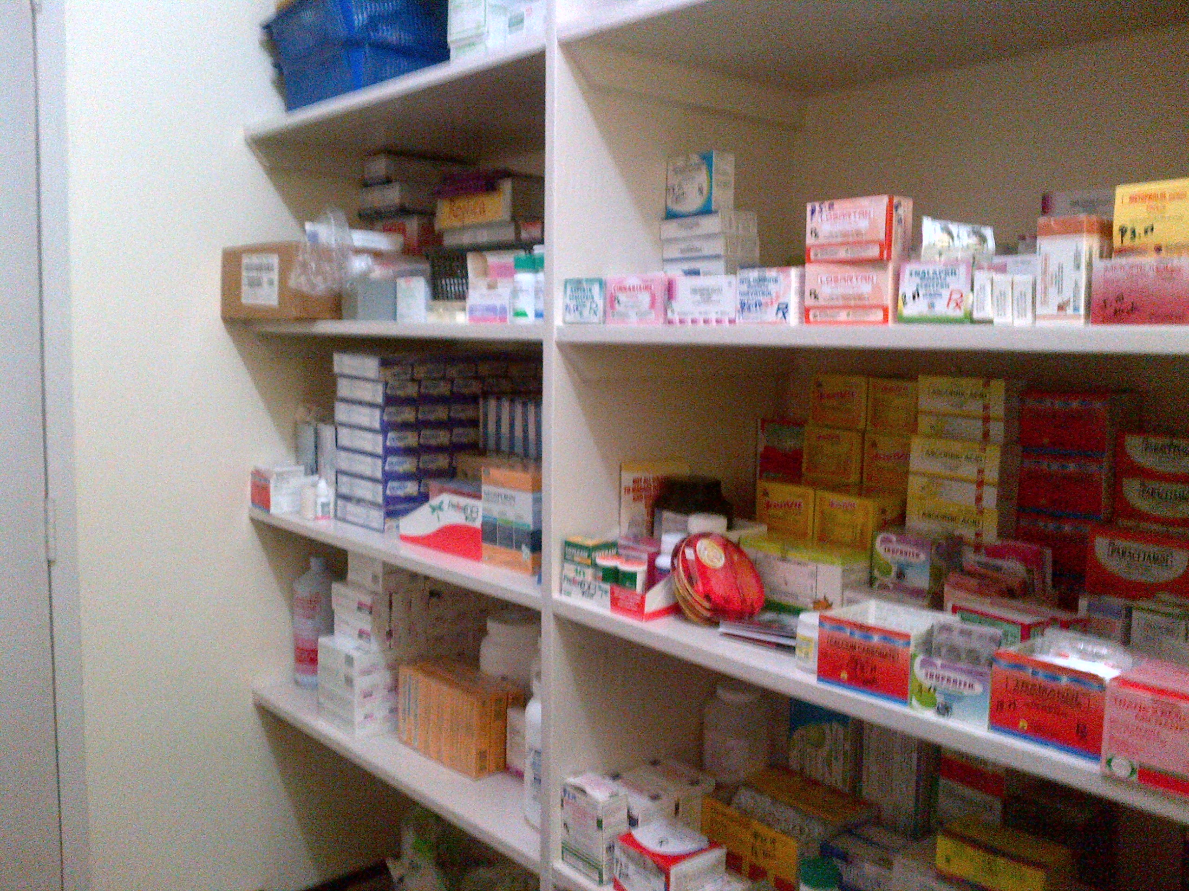
Field observations

Slide 38
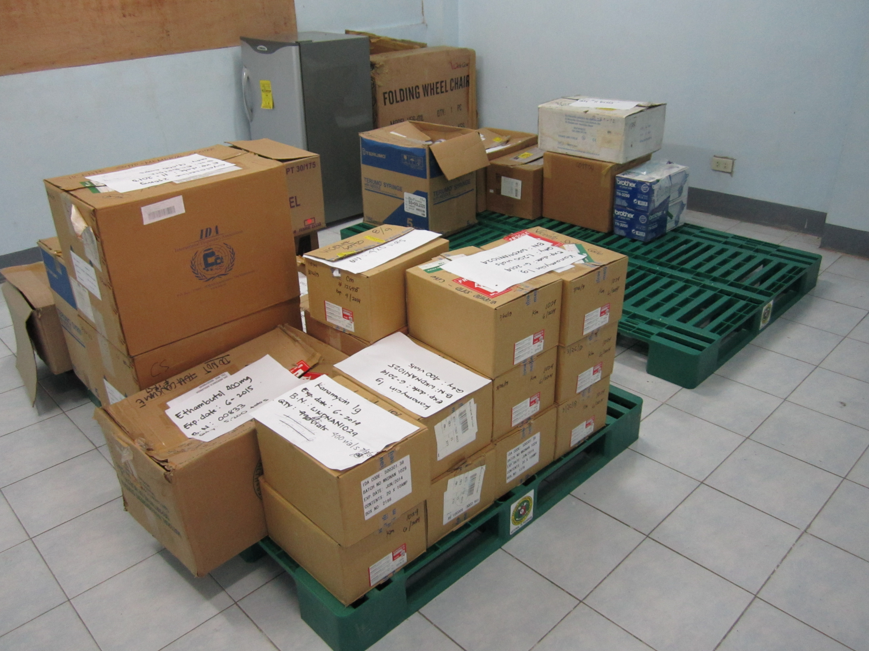
Field observations

Slide 39
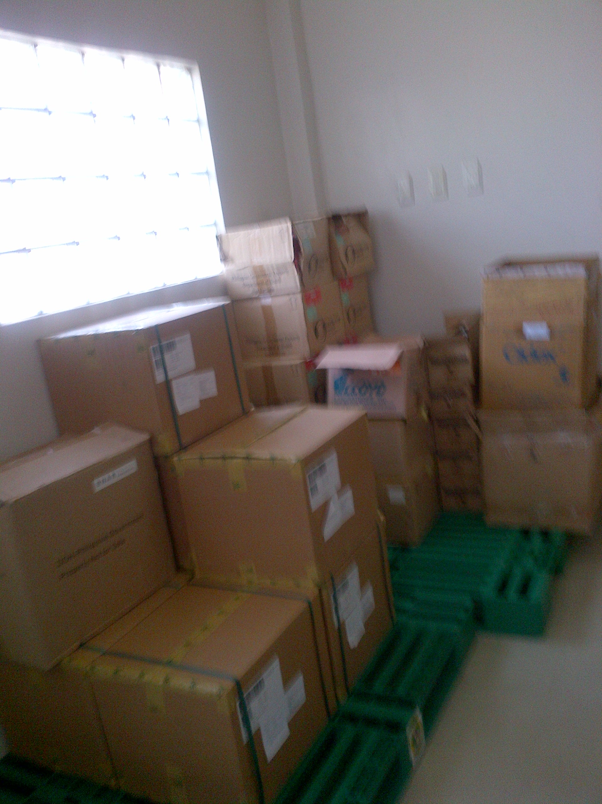
Field observations
Notes:
What is wrong in this picture?

Slide 40
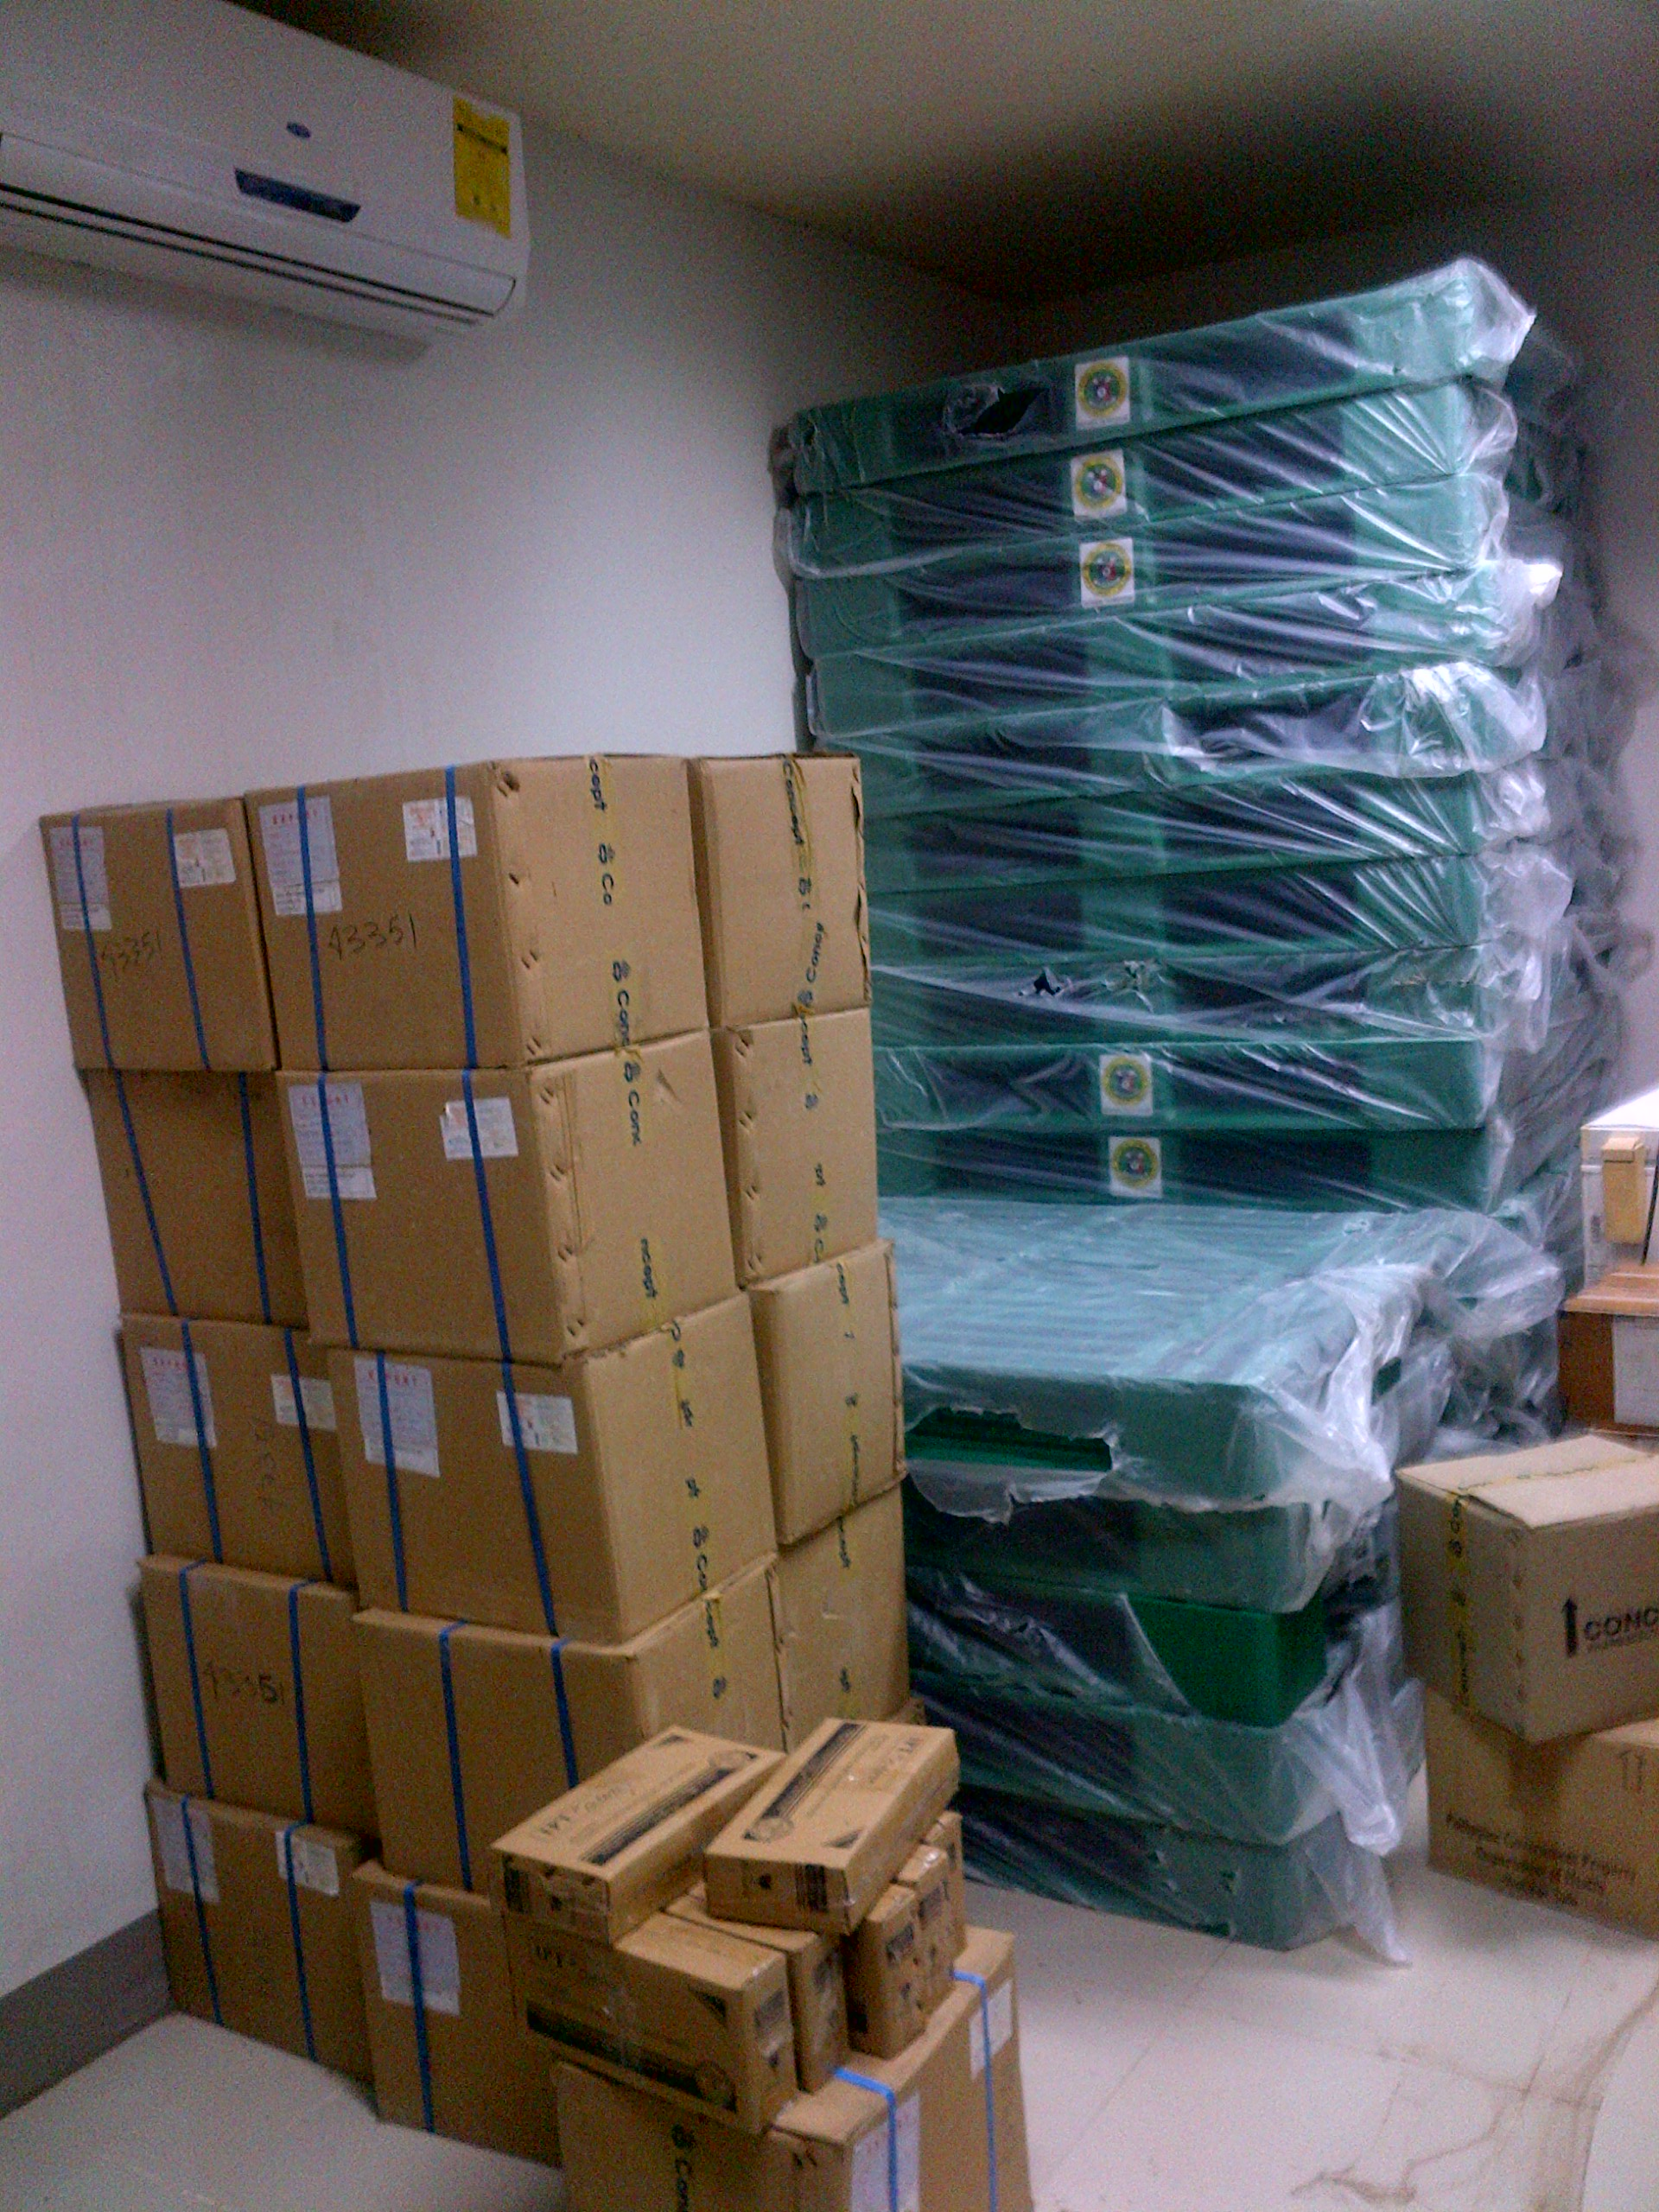
Field observations
Notes:
What is wrong in this picture?

Slide 41
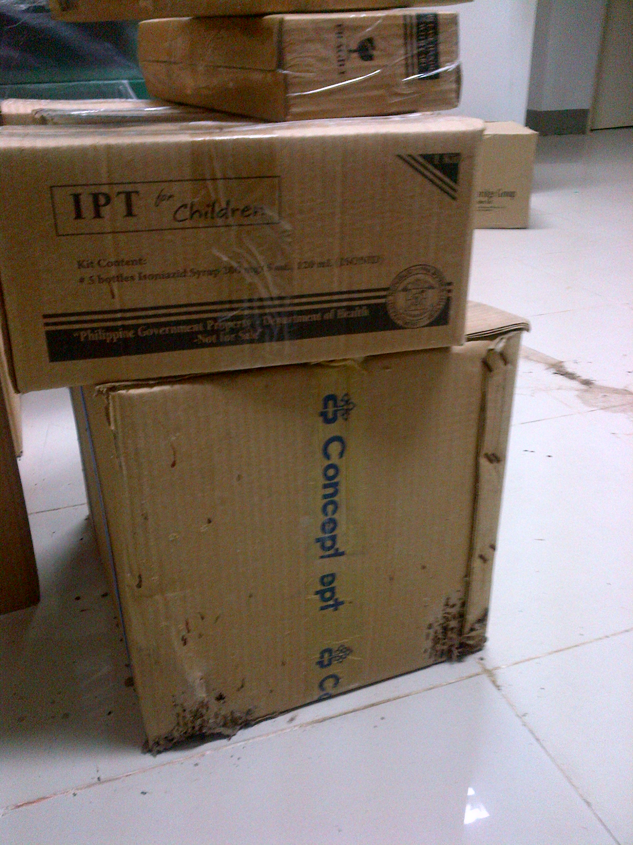
Field observations
Notes:
What is wrong in this picture?

Slide 42
Thank you

