Slide 1
EXERCISE 8: Recording Forms for Referrals
For each case below, accomplish a
Form 7. NTP Referral Form and/or the
Form 8. Hospital TB Referral Logbook, as indicated.

Slide 2
Pepito Manal, 61 year old male, was admitted to the emergency room of Hospital XO on March 18, 2014 for hemoptysis. His Chest X-ray showed multiple cavitary lesions in both lung fields. He was subsequently transferred to the service ward with the impression of “hemoptysis secondary to pulmonary tuberculosis, extensive”.
The nurse on duty at the ward referred Pepito to the hospital TB nurse using the internal referral form. Upon visit by the nurse to the ward, the following were additional information obtained from Pepito:

Slide 3
He lives at Purok 1, Bgy. Senyales, Talas Municipality, Province H. No landline or cellphone number available.
He reported no previous history of TB treatment.
Patient weighed 40 kg.
The attending physician conferred with the hospital DOTS team and they decided to start anti-TB treatment even without DSSM (due to the hemoptysis). But they did not register the patient since they agreed with the family to refer to the RHU upon discharge.
(Accomplish the TB referral logbook)

Slide 4
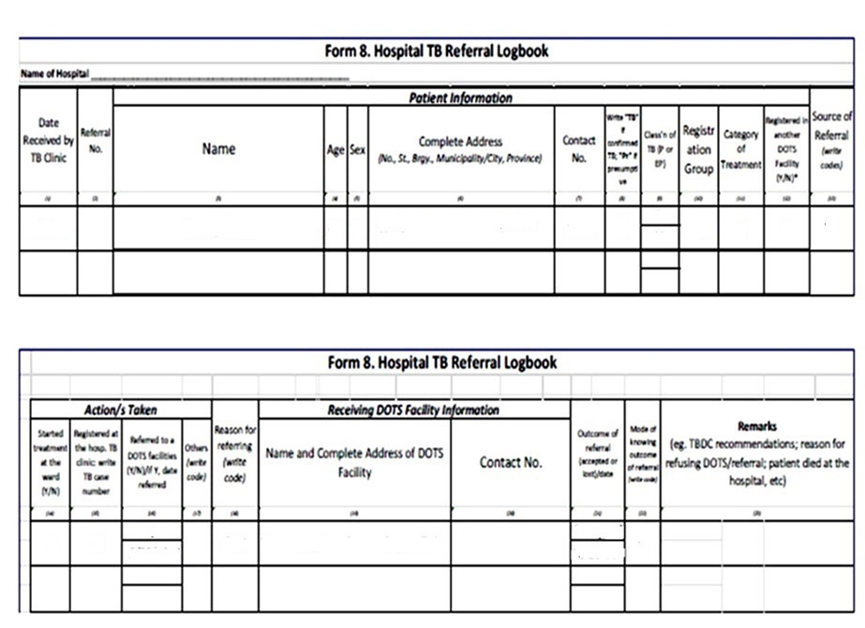

Slide 5
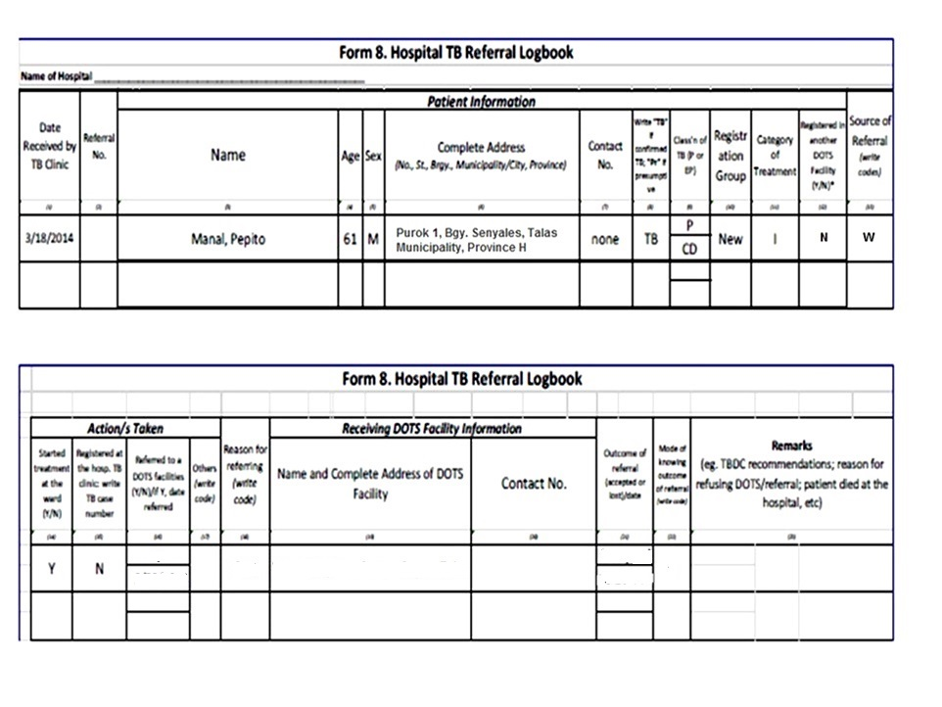

Slide 6
After 5 days, March 23, patient was discharged from the hospital. He was referred to the Talas RHU for DSSM and continuation of treatment. Talas RHU is located in Bgy. Centro-Bayan, Talas.
Hospital XO details: XO Provincial Hospital, BgyTagon, Province H; tel. no. 434-8873.
(Accomplish an NTP referral form and
update the TB referral logbook.)

Slide 8
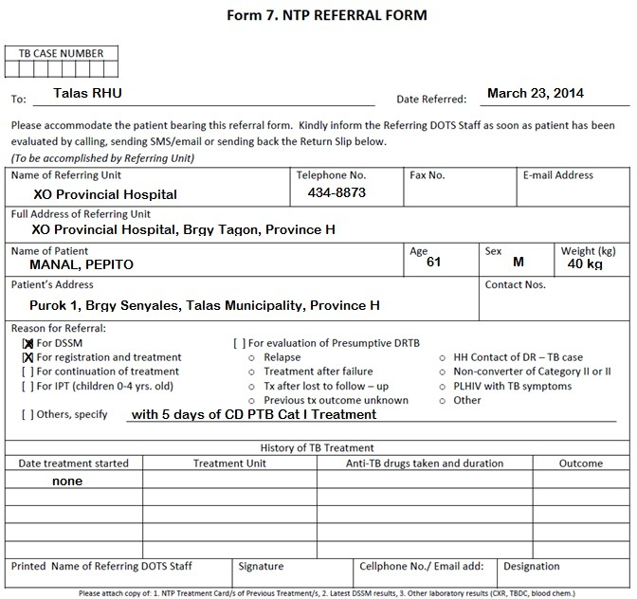

Slide 9
Update

Slide 10
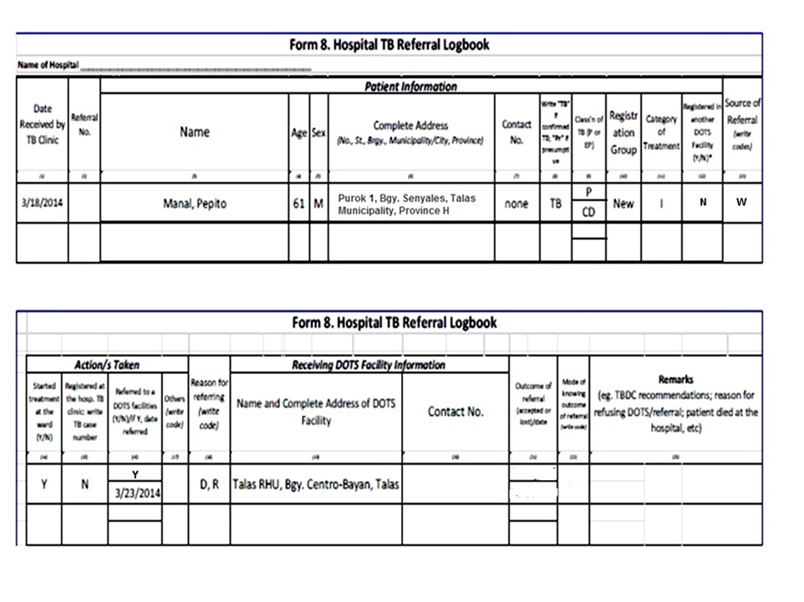

Slide 11
On March 28, the hospital TB nurse received a text message from the Talas RHU nurse stating that Pepito has resumed treatment and was registered that day at the RHU. His DSSM result was negative (same date).
(Update the hospital referral logbook)

Slide 12
Update

Slide 13
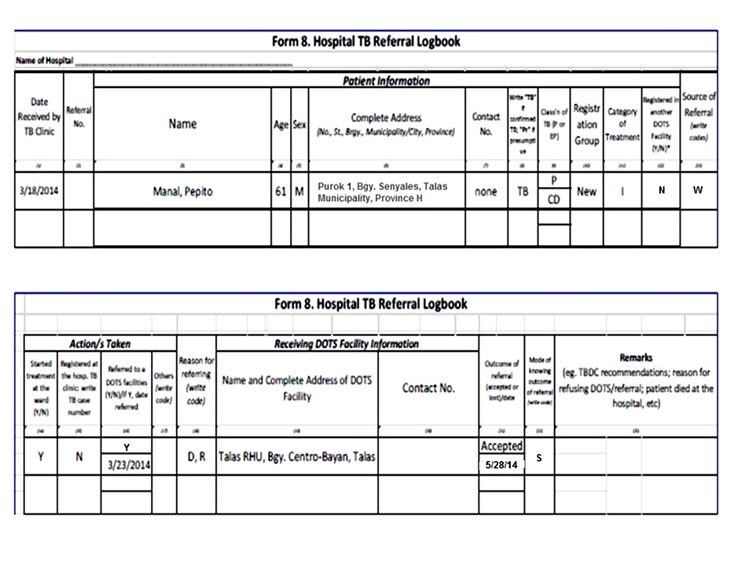

Slide 15
