Slide 1



Multisectoral coordinating committee for tb elimination
Name of Presenter
Name of Province or City
Date: ______
Venue___________

Slide 2

What is a multisectoral coordinating committee (MSCC)?
An organized partnership between LGUs and other sectors, both public and private, working for TB elimination that includes ensuring a functional and comprehensive delivery of TB services in the province or city
This organizational body can be called by different names:
  Provincial/City Coordinating Committee (PCC/CCC),
  Multisectoral Stakeholders’ Alliance (MSA),
  Local TB council or local coalition,
  Or any equivalent.
TB ELIMINATION

Slide 3
Function of the MSCC
It acts as a coordinating and decision-making body for the delivery of TB service DOTS in the local SDN (DOTS in SDN)
Multisectoral Coordinating Committee
DOTS Facility
(RHU, Health Center)
Private Hospitals
Government Hospitals
Private Physician/ Clinics
Jails and Prisons
Private TMLs
DedEd: Public Schools
Private Workplaces
Government Workplaces
Pharmacies
Community (BHWs, CHTs, CBOs)

Slide 4


Roles and responsibilities Of the MSCC
1. Advocacy
Advocate for the passage of policies and resolutions related to DOTS
Advocate with local governments to support activities to sustain the delivery of TB services
Delivery of TB Services

Slide 5
Roles and responsibilities Of the MSCC
2. Policy development
Initiate the development of local policies, guidelines and plan for the local DOTS
MSCC
Issue identification
Environ-mental scan
Consultation
Decision
Strategy develop-ment
Coordin-ation
Implement-ation
Evaluation
Notes:
The slide presents the policy development cycle that the MSCC is expected to undergo when initiating new policies at the LGU level

Slide 6

Roles and responsibilities Of the MSCC
3. Decision-making
Discuss/mediate interventions to address any problems

Slide 7


Roles and responsibilities Of the MSCC
4. Coordination
Lead resource mobilization
Identify capacity building needs and recommend to PHO/CHO for implementation

Slide 8


Roles and responsibilities Of the MSCC
4. Coordination
Regularly assess the notification processes and recommend ways to improve it.
Monitoring and evaluation of the SDN.

Slide 9
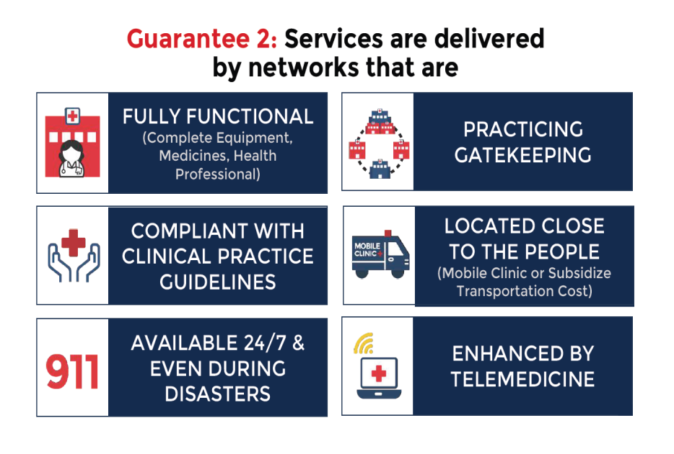

Roles and responsibilities Of the MSCC
4. Coordination
Ensure access and minimize delays to diagnostic and treatment services
Reduce out of pocket cost to patients

Slide 10
Core Members of provincial/city mscc

Slide 11
Core members
Government Sector
Private Sector
Department of Education
Department of Interior and Local Government
Department of Social Welfare
Bureau of Jail Management and Penology
PhilHealth
Department of Labor and Employment
National Commission on Indigenous Peoples
PMA and its component societies
Private companies (TB in the Workplace)
Pharmacies
Informal Sector
  TODA
  JODA
  Fisher folk
  Farmers

Slide 12
Why do we need you?

Slide 13

Burden of TB
To an individual
  illness → 3−4 months absence from work → loss of income = PhP33,792 (PhP11,264 x 3 mo) [min. wage = 512] = 30% loss in household income
  death due to TB → approx 15 productive years lost

Slide 14

Burden of TB
TUBERCULOSIS
Province/City
  people with TB → spread the disease → poor people get the disease → they get poorer → increased pressure on LGU budget

Slide 15
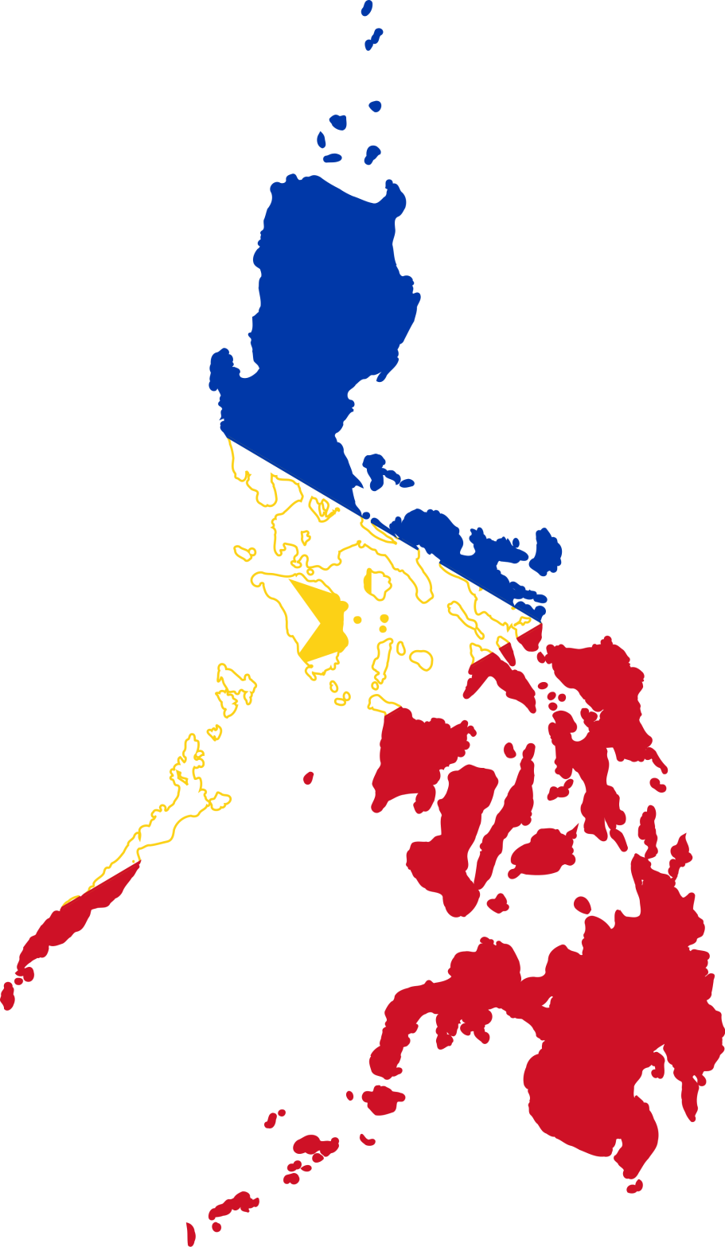

Burden of TB
National
  increased pressure on LGU budget → LGUs become poor → increased pressure on national budget → more budget allocated for TB program → less budget for other national projects → country becomes poor

Slide 16


Our basis for organizing the mscc
Comprehensive Unified Policy for TB Control in the Philippines
Philippine Strategic TB Elimination Plan

Slide 17
Comprehensive Unified policy for tb control in the Philippines
CUP
DOH
DILG
DOJ
DA
DOST
DOLE
DEPED
DND
DSWD
DAR
PHIC
GSIS
OWWA
NEDA
NCIP
SSS
ECC
PHILCAT
PMA
TUCP
ECP
AMHOP
The CUP’s key goal is to harmonize and unify TB control efforts in the Philippines. It also provides for NTP to be the basis for implementation of TB among all stakeholders.
Notes:
The CUP’s key goal is to harmonize and unify TB control efforts in the Philippines. It also provides for the NTP to be the basis for implementation of TB among all stakeholders.

Slide 18
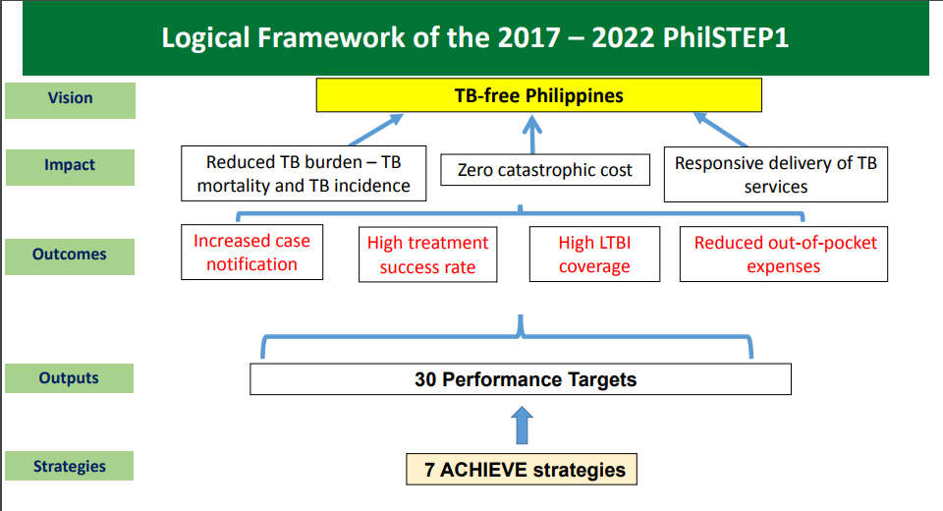
Philippine strategic tb elimination plan
7 ENGAGED STRATEGIES

Slide 19
Areas for collaboration

Slide 20
Department of the Interior and Local Government
  Assist the LGU or local NTP Core Team in drafting a TB ordinance with the following provisions:
    Mandating the MSCC as the coordinating body to oversee the SDN and the public-private partnerships established in the LGU
    Requiring the private partners to do the following:
      Notify any TB case diagnosed or managed
      Avail of NTP trainings/orientation to standardize all NTP protocols
      Follow the NTP protocols once trained
      Follow the referral protocols and procedures established by local government for TB and other health programs
  Implement TB in the Workplace in their office

Slide 21
Department of Education
Incorporate TB topics in the curriculum of elementary and secondary levels of public and private schools
Conduct mass screening among children aged 14 years old and below for all public schools
Coordinate similar activities in private schools
Establish referral system between schools and TB service providers in the service delivery network, either public or private
Engage the clinic teachers and school nurses as treatment partners for school children diagnosed with TB
Implement TB in the Workplace in their offices and in schools
Assist PHO/CHO conduct TB information drive among teachers and non-teaching staff in schools
Monitor TB Program implementation in DepEd and report to PHO/CHO during MSCC meetings

Slide 22
Department of Social Welfare and Development
Revise policy on 4Ps to include additional benefits for poor families affected by TB
Conduct IEC and BCC among high-risk groups such as the urban and rural poor, children, senior citizens
Implement TB in the Workplace in their offices
Conduct mass screening in day care centers
Establish referral systems between day care centers, orphanages, other shelters and TB service providers in the SDN
Engage parent leaders, social workers and day care workers as treatment partners for clients with TB
Create sustainable livelihood programs for patients and families affected by TB
Coordinate with National Nutrition Council for supplementary feeding program for TB patients who are underweight and malnourished
Monitor TB program implementation in their department and report to PHO/CHO during MSCC meetings

Slide 23
Department of Labor and Employment
Monitor the implementation of Department Order No. 73-05: Guidelines for the Implementation of Policy and Program on Tuberculosis Prevention and Control in the Workplace and submit a report to PHO/CHO through NTP coordinators
Monitor status of employees with TB and ensure nondiscrimination and fair treatment from employers
Assist workplaces in crafting their workplace TB policies
Monitor implementation of workplace TB policies and report to PHO/CHO the status of all workplaces identified in the area
Assist PHO/CHO in TB orientation of company employees and establish referral mechanisms between the company and the RHUs/health center
In coordination with Employees’ Compensation Commission, run an information drive on employee’s benefits and compensation if TB is acquired in the workplace

Slide 24
National Commission on Indigenous Peoples
Assist the PHOs of provinces where IPs are found in conducting TB orientation among IPs
Assist the PHOs in establishing a referral system between the IP groups and the RHUs
Engage the IPs as TB advocates among their peoples
Coordinate with PHOs regarding issues and concerns expressed by IPs regarding TB Program
Monitor TB program implementation among IP groups and report to PHO/CHO during MSCC meetings

Slide 25
Philippine Health Insurance Corporation
Assist the PHO/CHO in identifying PHIC-accredited TB service providers in the province or HUC for mapping purposes
Facilitate accreditation of non-accredited TB service providers in the LGU
Formulate new policies to cover free X-rays and other lab exams (e.g., rapid diagnostic test, DSSM) for TB patients that can be availed of in public and private diagnostic facilities

Slide 26
PMA and/or its component societies
Implementation of the mandatory notification of diagnosed TB patients
Referral of patients between public and private facilities

Slide 27
Community-based organizations (CBOs)
Household contact tracing
Community education
Case finding in the community
Treatment partners in the community

Slide 28
Suggested organizational chart
Co-chairman
Chairman
Province – PHO
HUC - CHO
Province – Governor
HUC - Mayor
Secretariat
Sub-Committees
NTP Core Team
ACSM
RESOURCE MOBILIZATION
CAPACITY BUILDING
MONITORING & EVALUATION
DILG
DSWD
CBO
FBO
Civil Society
NCIP
Private Sector Groups
Civil Society Groups
NGOs
PHIC
DepEd
DOLE
DMOs
RHU staff
PHO/CHO
NTP Core Team
Private Sector Group
Notes:
The organizational chart is only a recommendation. The LGU can opt to shuffle the members depending on their stakeholder analysis and what the organizations/ agencies have agreed to commit. If the membership of the MSCC is too large, you may organize them into sub-committees and assign them to tasks depending on their office’s mandate or on their commitments.

Slide 29

Description of the MSCC positions
Chairman
  Local Chief Executive (Governor/Mayor; alternative: Vice-Governor/Vice-Mayor)
  The MSCC should be led by a person of high authority because the representatives of the organizations and the agencies who will become members of the MSCC are also heads of offices
  It would be difficult to lead a group of leaders if a person with no authority or influence is assigned to this position
  The chairman shall always preside over the meetings to sustain members’ commitment and interest

Slide 30
Description of the MSCC positions
Co-Chairman
  Provincial/City Health Officer
  If the local chief executive is unable to attend the meetings/MSCC-related activities, the PHO/CHO may stand in as representative of the LCE
  It would be an asset to the group if the PHO/CHO is equally charismatic or has the good qualities of a political leader

Slide 31

Description of the MSCC positions
Secretariat
  Coordinate the activities planned by the MSCC related to the SDN.
  Document all meetings and activities and maintain records
  Facilitate communication between and among MSCC and SDN members
  Coordination with MSCC members
  Provide feedback to participating facilities and MSCC about any problems encountered in the TB Program
  Update the MSCC on new NTP policies and guidelines
  Provide NTP reports to the MSCC as basis for planning and decision making
  Preparation of logistics during MSCC events

Slide 32
Description of mscc sub-committees
Advocacy, Communication and Social Mobilization Committee
  Engage public and private partners in TB control, and ensure their collaboration and coordination
  Strengthening of networks
  Develop and distribute IEC materials and behavior change communication to educate communities on TB and to foster proper health-seeking behaviors and attitude towards TB.
  Engage community-based organizations for TB control, including organizing, strengthening and ensuring their sustainability

Slide 33
Description of mscc sub-committees
Resource Mobilization Committee
  Generate and allocate resources
  Safeguard human, material and financial resources
  Conduct fund raising activities such as a donation drive from private sector members, and special events like fun run, BINGO socials
  Provide funds for program-related activities such as:
    Financial assistance for MDRTB patients
    Livelihood training for TB patients

Slide 34
Description of mscc sub-committees
Capacity Building Committee
  Coordinate with DOH for the training of SDN partners
  Act as resource speakers, if applicable
  Act as trainers, where applicable.
  Identify participants for the training
  Conduct training needs analysis
  Design appropriate training programs and monitoring of results

Slide 35
Description of mscc sub-committees
Monitoring and Evaluation Committee
  Monitor and evaluate the performance of the RHUs as well as the TB services of member organizations and SDN partners.
  Facilitate the preparation of the SDN implementation plan with SDN partners
  Prepare the M&E plan for SDN monitoring and evaluation.

Slide 36

When you join us, this is what our mscc will be like…

Slide 37

The Mscc will bE Goal-oriented

Slide 38

It will have Committed members

Slide 39

There is Trust among all members

Slide 40

There is Equal power OVER, ownership OF, and responsibility FOR the tb CONTROL program

Slide 41

It is Self-sustaining

Slide 42


Slide 43
Thank you!

