Slide 1



Introduction to DOTS Network
Notes:
This presentation is intended primarily for the provincial multi-sectoral alliance (PMSA). Secondary audience for this presentation are the PHOs and RHUs.
This is for use in the advocacy and consultation step of installing the TB DOTS Referral Network (TDRN).
The objective is to provide the audience (PMSA) a concept of what the TDRN is all about and to elicit support for the proposed activities to formalize, implement and sustain the TDRN.

Slide 2
Outline of Presentation
What is a DOTS Network?
Mandates for establishing the DOTS in SDN
Proposed guidelines in establishing the DOTS in SDN
  The Multisectoral Coordinating Committee as coordinating body for the DOTS in SDN
Notes:
The three main topics to be discussed are listed in this slide.
The presentation will define DOTS in SDN and provide the reason/mandate for establishing it.
It will discuss the proposed guidelines in establishing DOTS in SDN, including strengthening the PMSA as the coordinating body for the DOTS in SDN.

Slide 3
Definition: DOTS in service delivery NETWORK (SDN)
A province- or city-wide coordinated network of public and private health care facilities that provide a part or the whole spectrum of TB services from prevention, screening, and diagnosis to completion of treatment
Notes:
This slide defines what a TDRN is.
Basically, all providers and facilities that can provide TB services and refer among each other can be part of the SDN. Even facilities that provide only information and education (e.g., schools, pharmacies) and just refer clients can be part of the TDRN.

Slide 4
Operational definition of a functional dots network
A contribution of at least 30% of all notified TB cases from private sector and 15% from the community
Notes:
In the NTP operational definition, it qualifies a referral system as being functional based on output, which is that 30% or more of registered TB cases were contributed by the SDN partners.
“Non-NTP” in this context are all partners outside the rural health units and health centers.

Slide 5
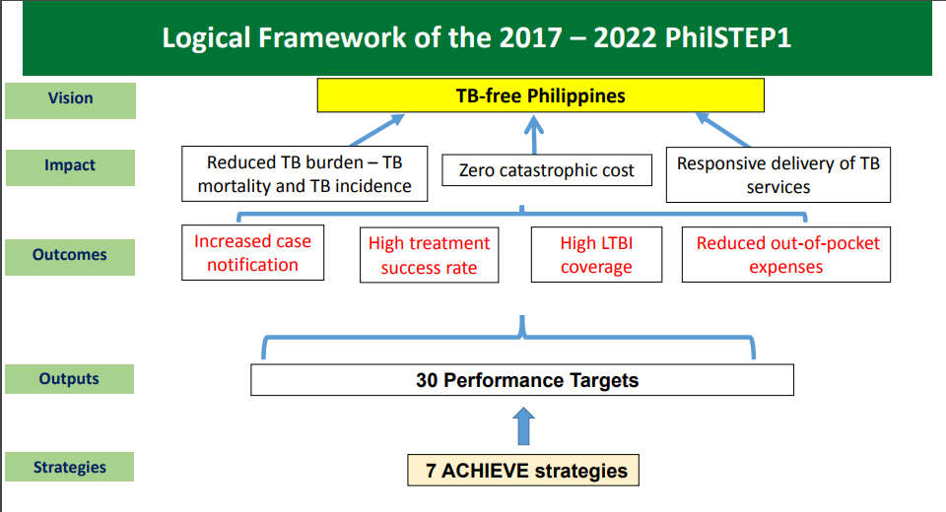
PHILIPPINE STRATEGIC TB ELIMINATION PLAN PHASE 1 (Philstep1)
7 ENGAGED STRATEGIES
Source: DOH NTP
Notes:
Why establish a TDRN?
The mandate behind the strategy is provided by the DOH. DOH has formally adopted the Philippine Strategic TB Elimination Plan as the country’s roadmap for TB control from 2017─2022. One of its objectives is ”to improve the mechanism of multisectoral partnerships for PhilSTEP1, thereby improving services.”
The DOH espouses public-private partnership, not just for TB but as an important strategy under the National Health Agenda.

Slide 6

Strategy 1. Empower communities and patient groups to promptly access quality TB services
Performance Target:
15% of total TB notifications come from community referrals
Photo source: https://globalonenesssummit.org/empowering-communities/
Notes:
PhilSTEP1 Strategy 1 is Empower communities and patient groups to promptly access quality TB services.
One of the key performance targets is15% of total TB notifications are coming from community referrals.

Slide 7

Strategy 2. Network with other agencies to reduce out-of-pocket expenses and expand social protection programs
DSWD
Private
Performance Target:
70% of patients supported by PhilHealth benefit payments
70% of CCT families with TB affected member availing of social protection program benefits
PHIC
Photo source: www.business-achievers.com/
Notes:
In the PhilSTEP1, networking with other agencies is under Strategy 2.
Two of the key performance targets are 70% of patients are supported by PHIC benefit payments and 70% of CCT (conditional cash transfer or 4Ps – Pantawid Pamilyang Pilipino Program) families with TB-affected member are availing of social protection program.

Slide 8

Strategy 5. Guarantee compliance to national protocol of TB prevention and care services and availability of NTP products
Performance Target:
90% of facilities certified and PhilHealth accredited at the same time
Notes:
In Strategy 5, all TB service providers (public and private) should be compliant with nationals protocols.
One of the key performance targets is 90% of facilities are certified and PHIC accredited.

Slide 9









Strategy 6. Expand provision of expanded integrated patient-centered TB service
Provincial/City Health Office
LGU Hospital
Performance Target:
90% of provinces / HUCs with functional DOTS network / SDN
Photo courtesy of www.triotree.com and Makati Health Department
RHUs/health centers
Notes:
In PhilSTEP1, engagement of all private health care providers is still a major strategy (Strategy 6).
One of the key performance targets is to establish a functional province/city-wide referral system in 90% of provinces/highly urbanized cities.

Slide 10
Chapter 7. TB DOTS Referral System
Policies and procedures to strengthen and sustain the TB DOTS referral system
  Public Health facilities (health centers, RHU’s, treatment centers)
  Private health facilities (pvt hospitals, clinics, NGOs, pharmacies, etc.)
  Other government facilities (pub hospitals, jails/prisons, schools, etc.)
  Community groups (CHTs, CBOs, etc.)
Notes:
Another policy issuance that provides mandate to installing the DOTS in SDN is the recently revised NTP Manual of Procedures, 5th edition.
One of the new chapters, not present in the previous edition, is the chapter on TB-DOTS referral system, which outlines the policies and procedures to strengthen and sustain the referral system.
The chapter further defines the different providers and categorizes them into four main types: DOTS facilities, private sector, other government facilities, and community. Examples of each type are shown here.

Slide 11
Schematic diagram of DOTS NETWORK
DOTS Facility
(RHU, Health Center)
Private Hospitals
Government Hospitals
Private Physicians/ Clinics
Private TMLs
Jails and Prisons
DedEd: Public Schools
Private Workplaces
Government Workplaces
Pharmacies
Community (BHWs, CHTs, CBOs)
Notes:
This illustration shows the different types of providers. Note that the three other types (private, other government and community) have the LGU DOTS facility or the RHU/health center as the focal point of referral. While this may be the case since an overwhelming majority of DOTS facilities currently are RHU/health centers, referrals can also be executed between non-RHU facilities.
Note also that the ideal referral system should be two-way and not one-way. This emphasizes the need for feedback from referred to facility to referring facility.

Slide 12




Prototype Service Delivery Network
Other public facilities
Provincial/City Health Office
LGU Hospital
Private hospitals
Private standalone clinics
RHUs/health centers
Photo courtesy of Makati Health Department
Private pharmacies
Notes:
This illustrates a prototype of how the SDN works.

Slide 13
Many local governments already have an ongoing referral system with different types of providers
The PhilSTEP recommends to build on these existing systems
Advancing the DOTS Network: expand, formalize, systematize, monitor and evaluate
Notes:
Referral systems are not new to the LGUs and the NTP. Many, if not all, local governments already have these referral systems (e.g., the enhanced referral systems or ERS). Hence, the PhilSTEP1-recommended strategies are not intended to start from zero but rather to build on these existing systems.
Therefore, advancing the TDRN as recommended by PhilSTEP1 requires expanding, formalizing, systematizing and monitoring the existing systems.

Slide 14
Strengthening the DOTS NETWORK
EXPAND | Directory of all providers providing TB services Capacity building of partners
FORMALIZE | Formal agreement between parties (policy support)
SYSTEMATIZE | MSCC as coordinating body Protocols and procedures (referral tracking)
MONITOR AND EVALUATE | Monitoring and evaluation system
Notes:
With the intent of advancing the SDNs as recommended by PhilSTEP1, the role of LGUs is therefore to expand, formalize, systematize and monitor the TDRN. The DOH Regional Offices are willing to provide assistance in achieving these objectives with the PHO/CHO and PMSA as the lead.
This brings us to the main agenda for this consultative and advocacy meeting, which is to secure the commitment of the PMSA to undertake the proposed procedures to enhancing these SDNs.
Some of the processes to enhance the SDN are:
Creating a local directory of all partners in the province/city
Capacity building or training of new partners, including private, other public agencies and community-based partners
Formalizing participation of facilities through a written agreement
Strengthening the PMSA or other coordinating bodies to provide oversight of the TDRN, in addition to the core function of the PHO/CHO as lead technical coordinator
Establishing formal, written protocols and procedures for the referral system. This should include the referral tracking and feedback
Institutionalizing a monitoring and evaluation system for the TDRN
These procedures are all intended to install or strengthen an existing TDRN.

Slide 15
Proposed steps
Identify a multisectoral coordinating committee
Conduct mapping of TB service providers
Conduct advocacy and consultation
Create a directory of TB service providers participating in SDN
Conduct training of participating TB service providers
Develop referral protocols and procedures
Issue a local policy to support the DOTS in SDN
Plan a monitoring and evaluation system
Promote the DOTS Network
Notes:
These are the proposed steps and activities to install or strengthen existing SDNs. The steps are modeled after maternal and child health service delivery networks (SDN) also installed as part of the DOH MCH program.
(May read through the slide…)
The next few slides will just quickly go through each step.

Slide 16
Step 1. Identify a multisectoral coordinating committee
What is a multisectoral coordinating committee?
An organized partnership between LGUs and other sectors, both public and private, working for TB elimination that includes ensuring a functional and comprehensive delivery of TB services in the province or city
Serves as the coordinating and decision-making body for the TB service delivery network

Slide 17
Step 1. Identify a multisectoral coordinating committee
Other names of MSCC
  Provincial/City Coordinating Committee
  Multisectoral Alliance
  Local TB Council
  Local Coalition on TB

Slide 18
Step 1. Identify a multisectoral coordinating committee
Provincial MSA
Advocacy
Decision making
Policy development
Provincial Health Office
Program management
Logistics management
Monitoring
Coordination
Lead technical assistance provider
Functions
Functions
Notes:
As mentioned earlier, the PMSA is the proposed coordinating body for the SDN. This can be an additional function to their current mandate of advocacy, decision making and policy development. (Note: this will depend on the PMSA roles stipulated in the respective provincial PMSA ordinance. It may already be part of their role based on their ordinance.)
The PHO remains as the lead technical assistance provider to the participating facilities.

Slide 19
Step 2: Conduct Mapping of TB service providers
1. DOTS facilities
  Rural health units or health centers
  DOTS-providing hospitals (public and private)
  Private PPMD clinics
  Private standalone clinics
  NGO-run DOTS clinics
  Other government facilities with their own TB register
2. DOTS-referring facilities/groups/individuals
  Health facilities – public and private hospitals, standalone private clinics, pharmacies, jail clinics
  Non-health facilities – schools, workplaces, daycare centers, orphanages, residential homes
  Non-health individuals/groups – church/faith-based organizations, community health teams, community volunteers, TB Task Forces
Notes:
Mapping is intended to provide all participating facilities and providers information on where to refer patients, whom to give feedback to for any concerns and who are the engaged facilities participating in TB control.
These are some of the providers involved in the TB program who can be included in SDN.
The main output of the mapping activity is a local DOTS directory that can be circulated among all partners.

Slide 20
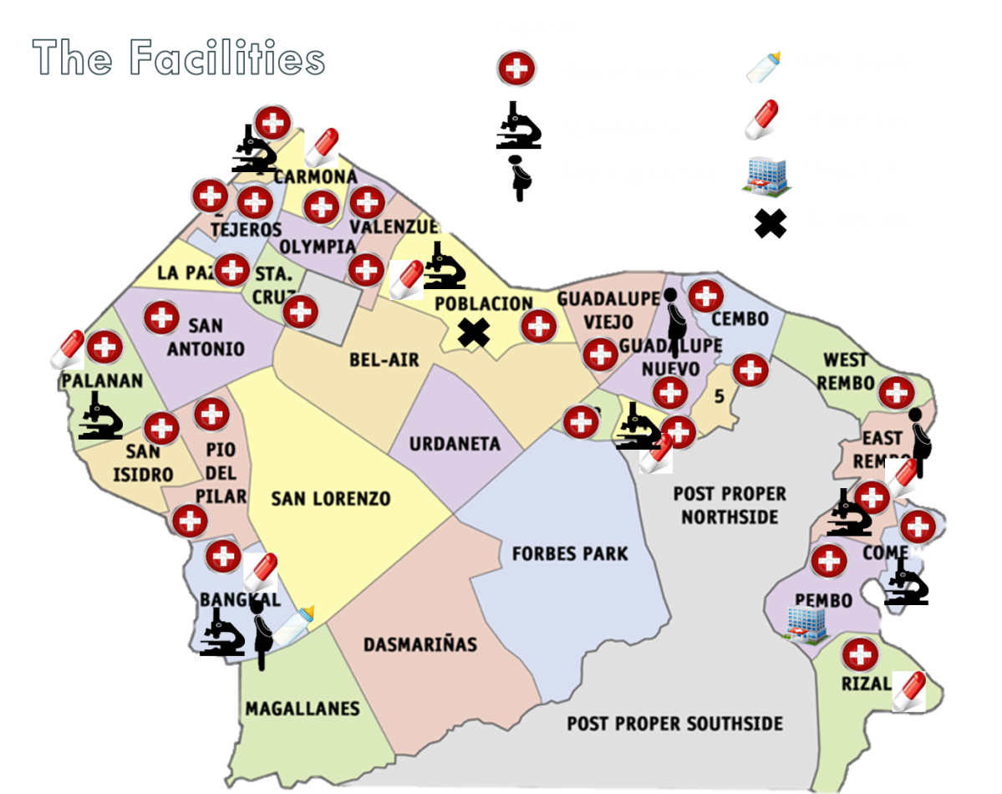
Step 2: conduct Mapping of TB service providers
3. Other Diagnostic Facilities
  X-ray facilities (diagnostic centers)
  Xpert sites (that are not DOTS facilities nor DOTS-referring) – e.g., provincial health offices
  Private laboratories providing DSSM (TMLs)
Photo courtesy of Makati Health Dept.
Notes:
Mapping is intended to provide all participating facilities and providers information on where to refer patients, whom to give feedback to for any concerns and who are the engaged facilities participating in TB control.
These are some of the providers involved in the TB program that can be included.
The main output of the mapping activity is a local DOTS directory that can be circulated to all partners.

Slide 21
Step 3: conduct Advocacy and Consultation
Attendees | Outputs
MSCC | Provincial/city action plan for DOTS Network installation/expansion Commitment and plan for local policy development for the DOTS Network
Municipal LGUs and RHUs (provinces) Barangay LGUs and health centers (HUCs) | Municipal/barangay action plan for DOTS Network installation/expansion Support to implement the policies and the referral protocols and procedures at the grassroots level.
TB service providers to be engaged | Letter of intent to join the DOTS Network Training needs assessment done
Notes:
Advocacy and consultation, such as the one we are conducting now, are intended to get support of partners, whether public or private, towards supporting or participating in the TDRN.
Advocacy directed at private partners, other government agencies and community-based partners is aimed at “recruiting” them to join the SDN. This is currently being done by the local governments.
Advocacy directed at the local governments/RHUs is aimed at motivating them to exercise their mandate of being the local TB program managers and provide technical and other support to partner facilities/providers.
The intended outputs of these advocacies are commitment and clear next steps towards installing or strengthening the SDN.

Slide 22
Step 4: create a directory of participating TB service providers
FOR DOTS-REFFERING FACILITES
Name of Referring Unit | Address | Contact Person and Number

Slide 23
Step 4: create a directory of participating TB service providers
FOR DOTS-PROVIDING FACILITES
Type of Service Provided and Schedule | Name of DOTS- Providing Facility | Address | Contact Person and Number | PHIC Accreditation Status

Slide 24
Step 5: Conduct training of participating TB service providers
Private Hospitals | Basic DOTS Training (hospital TB team) Basic DOTS and ISTC Orientation (private practitioners)
TMLs | DSSM Training
Pharmacies | PDI Training
Workplace | Program Management Training (Management) TB Educators Training (health Staff)
Other government agencies | Basic DOTS orientation or training DOTS training for jails/prisons DOTS orientation for DepEd and DSWD staff
Notes:
Capacity building intends to build competence of health facility staff in providing different types of DOTS services—including education, counseling, referral and treatment.
This slide shows examples of the various types of training pertaining to different facilities.

Slide 25
Step 6: develop referral Protocols and Procedures
Can be done through a consultative workshop with the following attendees:
  PHO
  MHOs
  Private sector representatives
  Representatives from government agencies participating in DOTS Network
Notes:
As coordinating body, the PMSA can lead the discussions to finalize a set of referral protocols, procedures and tracking mechanism. This is directly related to the monitoring and evaluation since the recording and reporting for SDN referrals will help monitor functionality of the referral system.

Slide 26
Step 6: develop referral Protocols and Procedures
Contents of Referral Protocols and Procedures
Referral procedures (including referral feedback and tracking mechanisms)
Reporting system
Logistics (agreements on commodities, forms)
Quality Assurance (EQA for TML’s, DOTS certification)
Monitoring system
Notes:
These are the proposed minimum contents of the referral protocols. May read through the slide…

Slide 27
Step 7: Issue a local policy to support the dots network
Memorandum of Understanding/Agreement
  Individual facilities
  All facilities in the network
  Provincial level
  Municipal level
Provincial Ordinance
Executive Order
Notes:
To formalize the relationship between facilities, a written instrument such as a memorandum of understanding should be executed.
There are several options to do this and can be discussed or decided later. Among the options are: whether to execute a memorandum of understanding (MOU) between each facility and the LGU or to execute a municipal- or provincial-level MOU.
In addition to an MOU, a policy issuance such as a provincial executive order or provincial ordinance can also strengthen the TDRN as it provides additional institutional mandate from the local government aside from the national mandates earlier mentioned.
Lastly, a letter of agreement between individual providers and the engaged facility is another level of agreement. This implies that the LGU need not pursue individual MOUs with practitioners (i.e., physicians) if they will have a letter of agreement with the health facilities where they are affiliated.

Slide 28
Step 8: Plan a Monitoring and Evaluation system
  Crafted by the PHO/CHO and approved by MSCC
  Joint monitoring (PHO, MHO and partners)
  Outputs
    Monitoring and evaluation plan and tools
    Monitoring reports with recommendations
Notes:
Once the formal SDN is in place, monitoring, supervision and evaluation should be regularly implemented. While the PHO/CHO provides technical monitoring of service delivery (such as compliance with NTP protocols), the PMSA can include SDN in their monitoring and evaluation plans for the governance aspects.

Slide 29
Step 9: promote the dots network
  Timed in a TB advocacy event like World TB Day or Lung Month Celebration
  Formal signing of MOU (or equivalent)
  Create DOTS Network brand (e.g. logo, slogan)
Notes:
The launch of the formalized TDRN is optional. When conducted, it can be an additional venue for advocacy and education. It can be timed during national TB celebrations such as the World TB Day in March and the Lung Month in August.

Slide 30
30% of TB cases contributed by “non-NTP” providers
DOTS Facility
(RHU, Health Center)
Private Hospital
Government Hospitals
Private Physician/ Clinics
Private TMLs
Jails and Prisons
DedEd: Public Schools
Private Workplace
Government Workplace
Pharmacies
Community (BHWs, CHTs, CBOs)
Notes:
Hopefully, with the above steps we will be able to install a fully functional delivery of TB services in a service delivery network that will contribute to TB case finding.

Slide 31
Thank you.
Notes:
(Additional sides follow for the open forum)

Slide 32
Discussion points: MSCC
Roles and mandate of the MSCC
How can the MSCC oversee installation and function of the DOTS Network?
  Creation of a subcommittee?
  Role of MSCC in “recruitment” of facilities to join the DOTS Network
  Role of MSCC in the monitoring of participating facilities, if any
  Representation in the MSCC of facilitating facilities (e.g., local chapters of DSAP, PPhA, etc.)
Notes:
This slide is for the open forum and serves as guide on the major decision points that we want to be consulted with the PMSA and/or PHO/CHO.
This may or may not be flashed on the screen depending on the agreement with the PHO/CHO, and depending on the approach of the one presiding the meeting (e.g., PMSA. chair)

Slide 33
How can the participation of TB service providers be formalized?
  Province-wide MOU with all participating facilities (see SDN toolkit for proposed MOU template)
  Other forms of agreements (individual MOUs, municipal-level MOUs)
Plan for the DOTS Network installation
  Listing of engaged facilities
  Consultative workshop on DOTS Network protocols and procedures (with representatives from RHUs and other engaged facilities)

Slide 34
  Development, finalization and signing of MOU
  Development of other DOTS Network-related policies (eg, provincial/city ordinance)
  Launching of the DOTS Network
Plan for the following meetings

Slide 35
Discussion points: mlgu/blgus, RHUs, health centers
Plan for the DOTS Network installation
  Listing of engaged facilities
  Consultative workshop on DOTS Network protocols and procedures (with representatives from RHUs and other engaged facilities)
  Development, finalization and signing of MOU
  Development of other DOTS Network-related policies (eg, provincial/city ordinance)
  Launching of the DOTS Network
Plan for the following meetings

Slide 36
Discussion points: TB service Providers
How can the participation of TB service providers be formalized?
  Province-wide MOU with all participating facilities
  Other forms of agreements (individual MOUs, municipal-level MOUs)
Plan for the DOTS Network installation
  Consultative workshop on DOTS Network protocols and procedures (with representatives from RHUs and other engaged facilities)
  Development, finalization and signing of MOU
  Development of other DOTS Network-related policies (eg, provincial/city ordinance)
  Launching of the DOTS Network
Trainings needed
Plan for the following meetings

